Slide 1
LACTATION Dr Pramod Kumar Bihar Veterinary College Bihar Animal Sciences University Patna

Slide 2
Estrogen stimulates development of mammary ducts, and progesterone and estrogen stimulate proliferation of secretory tissues. In vivo, sequential addition of insulin, glucocorticoid and prolactin leads to biosynthesis of casein and lactose. Sensitivity of individual cells to progestational inhibition decrease variably which may be interdependent upon relative increases in estrogen, prolactin, corticoids, and growth hormone to cause asynchronies at calving. Since prolactin in plasma is not correlated with progesterone or the estrogens, factors other than feedback effects of ovarian steroids may be responsible for its sustained increase peri-parturiently. Also, elevated prolactin peri-parturiently may be unrelated to subsequent rates of lactation because its basal concentrations may meet requirements when inhibiting effects of progesterone are removed. The mammary cells neither are synchronized highly for biosynthesis nor secrete normal milk for several days after calving. At the latter time, concentrations in plasma are low for progesterone and estrogen before calving for glucocorticoids and prolactin, and increasing for insulin.

Slide 3
Uterine contractions
Stretch of cervix and distention of vagina
Afferents from cervix and vagina
positive feedback to the hypothalmus
Oxytocin from posterior pituitary
Formation of Prostaglandins in the decidua
Notes:
3

Slide 4
Role of estrogens
Causes the ductal system of the quarter to grow and branch.
Stroma of the udder increase in quantity and large quantities of fat are laid in the stroma.
Growth hormone, adrenal glucocoticoids, prolactin & insulin are also needed for ductal growth.

Slide 5
Circulating estrogens
Increases the number of gap junctions between myometrial cells
Production of prostaglandins
Increase in myometrial contractile proteins
Increase in number of oxytocin receptors

Slide 6
Role of progesterone
Acts synergistically with estrogen causes additional growth of the mammary lobules
budding of alveoli
development of secretory characteristics in alveoli cells

Slide 7
Effect of cortisol
Increase in cortisol formation in the fetus
CRH secretion by the fetal hypothalamus increases cortisol
Increased placental production of CRH.
This increases circulating ACTH in the fetus

Slide 8
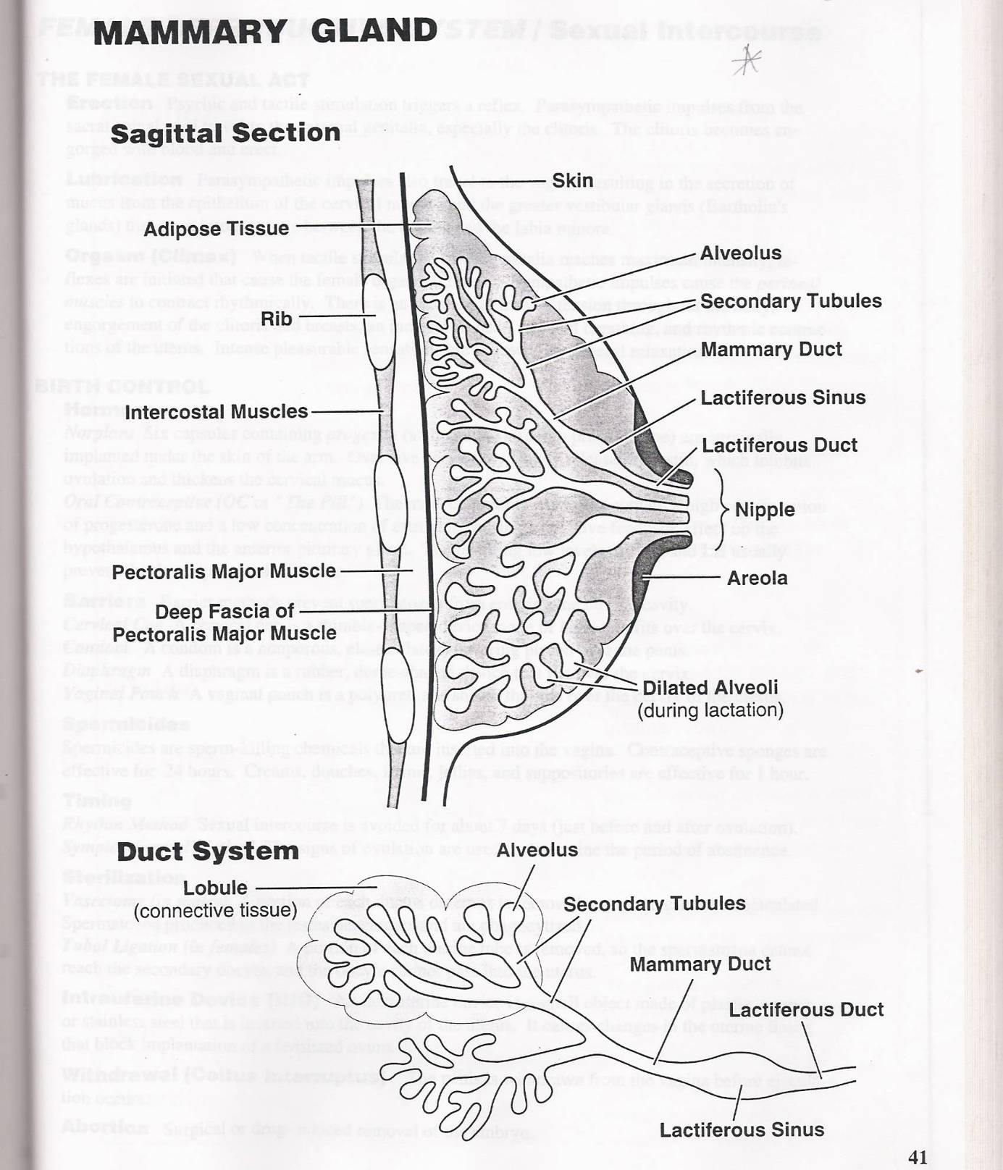
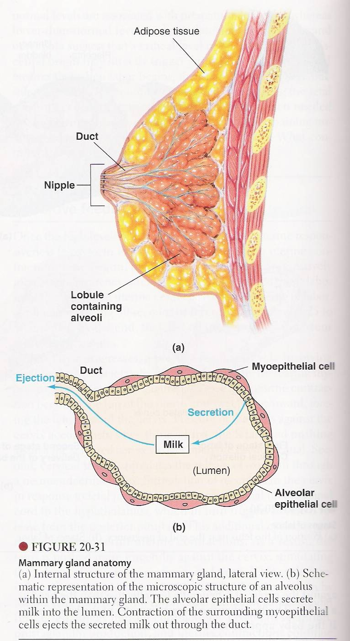

Slide 9
Lactation – Secretion and Ejection of Milk
Prolactin causes formation and secretion of milk in estrogen- and progesterone-primed udders
Oxytocin causes contraction of myoepithelial cells, leads to milk ejection
Estrogen increase the number of oxytocin receptors on myoepithelial cells
Estrogen and progesterone antagonize the milk production effect of prolactin
After parturition, abrupt decline of estrogens and progesterone initiates lactation

Slide 10
Prolactin – Synthesis and Control
Produced by the lactotrophs cells of the anterior pituitary gland
Under stimulatory control of thyroid releasing hormone
Increased release at night
In females - increased release during puberty
Prolactin levels are high during pregnancy - oestrogen causes an increase in numbers of lactotrophs
During lactation, suckling of the quarter results in an increased release of prolactin ( decreased PIH and increased PRH)
Response to suckling declines with time post-partum, may well remain above normal for 18 months or more if suckling frequency is maintained at a high level basal levels

Slide 11
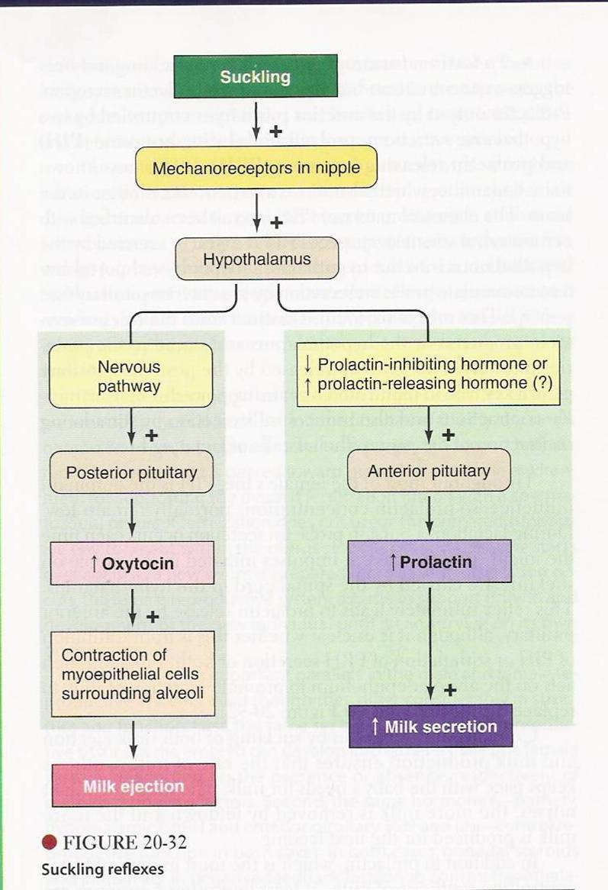

Slide 12
Function of prolactin:
prolactin
Promotes the secretion of milk
Estrogen and progesterone
Birth
Decrease [estrogen + progesterone
Increase lactogenic effect
(prolactin)
Increase [milk] in the alveoli of the
Breast – not the ducts!!!!!

Slide 13
Prolactin Levels
High during pregnancy, drifts down to its normal level after the calf is born
By the end of first week after birth, prolactin is down to 50 percent of its normal level, after three or four months, it is the same as it was before pregnancy
Every time the calf suckles, there is a new burst of prolactin for milk production and a burst of oxytocin for let down of milk
The more the dam nurses the calf, the more milk the body will produce; suckling is simply the message to the body to make more of it.

