Slide 1


Veterinary Toxicology
(Overview & Syllabus)
Dr. Nirbhay Kumar
Asstt. Professor & Head
Deptt. of Veterinary Pharmacology & Toxicology
Bihar Veterinary College, Bihar Animal Sciences University, Patna

Slide 2
Unit-6
(Veterinary Toxicology)

Slide 3
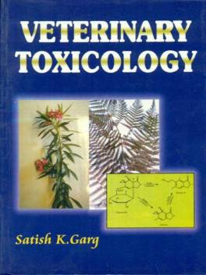
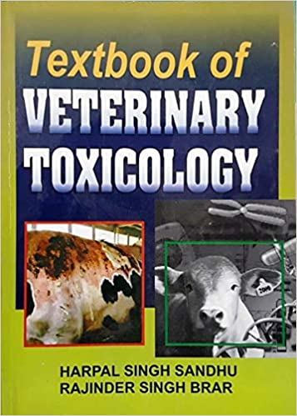
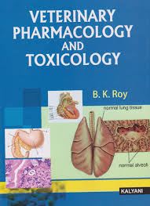
Recommended Books
Indian Authors

Slide 4
Recommended Books
Foreign Authors

Slide 5
Unit-6
(Veterinary Toxicology)
SYLLABUS

Slide 6
General Toxicology:
Definitions,
History of toxicology,
Fundamentals and Scope of toxicology.
Sources and classification of toxicants,
Factors modifying toxicity,
General approaches to diagnosis and treatment of poisoning.

Slide 7
Toxicity caused by metals and non-metals:
Arsenic,
lead,
mercury,
copper, molybdenum,
selenium,
phosphorus,
fluoride,
nitrates or nitrites,
chlorate,
common salt and urea.

Slide 8
Poisonous Plants:
Cyanogenetic plants,
Abrus, ipomoea, datura,
Nux vomica, castor,
Oxalate producing plants,
Plants causing thiamine deficiency,
Plants causing photosensitization and
Lathyrism, oleander, and cotton.

Slide 9
Toxicity caused by Agrochemicals:
Insecticides :
Chlorinated hydrocarbons,
Organophosphates,
Carbamates,
Pyrethroids,
Newer insecticides.
Herbicides, fungicides and rodenticides.

Slide 10
Fungal and bacterial toxins
Aflatoxins, rubratoxin,
Ochratoxin, sporidesmin,
Citrinin, F-2 toxin,
Trichothecenes,
Ergot, fescue,
Botulinum toxin and tetanus toxin.

Slide 11
Venomous bites and stings
Snake, scorpion, spider,
Bees and wasp,
Toad and fishes (puffer fish, shellfish).
Toxicity caused by food additives & preservatives.
Drug and pesticide residue toxicology.
Environmental pollutants
Air and water pollutants.
Concept of radiation hazards.

Slide 12
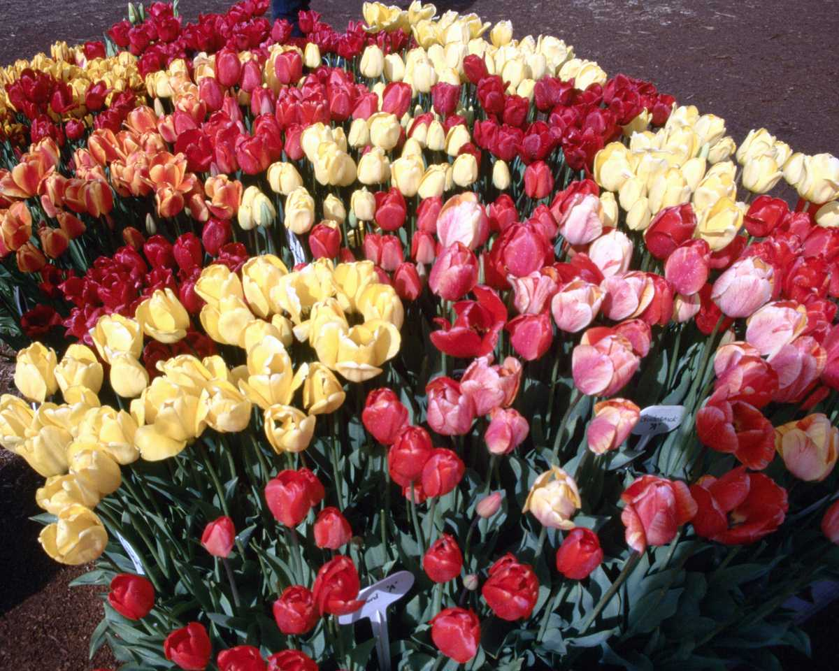
Thank You

