Slide 1
Introduction, Terms & Definitions related to Toxicology
Dr. Nirbhay Kumar
Asstt. Professor & Head
Deptt. of Veterinary Pharmacology & Toxicology
Bihar Veterinary College, Bihar Animal Sciences University, Patna

Slide 2
Toxicology
The word ‘toxicology’ is derived from Greek word ‘toxicon’ which means ‘poison’.
Thus, toxicology literally means the ‘study of poisons’.
It can thus be defined as “the study of poisons and their harmful effects on living organisms”.

Slide 3
Toxicology contd…
It includes the sources of poisons, their identification, physicochemical properties, toxicity including median lethal dose, factors affecting toxicity, toxicokinetics, toxicodynamics, clinical signs of toxicity, post mortem changes, histopathology, diagnosis including differential diagnosis, analytical procedures and principles of treatment of the conditions that they cause.
It also includes study of special effects of toxicants such as carcinogenesis, teratogenesis, mutagenesis, immunotoxicity, neurotoxicity, reproductive toxicity and ecotoxicity etc.

Slide 4
Terms & Definitions

Slide 5
Xenobiotics
Xenobiotics (Xeno is a Greek term which means ‘strange’ or ‘alien’) are substances that are foreign to the body and are biologically active.
These can not be broken down to generate energy or be assimilated into a biosynthetic pathway.

Slide 6
Xenobiotics contd…
It is a very wide class which includes structurally diverse agents both natural and man made chemicals such as drugs, industrial chemicals, pesticides, alkaloids, secondary plant metabolites and toxins of moulds, plants and animals and environmental pollutants.

Slide 7
Poison
Poison is any substance which when taken inwardly in a very small dose or applied in any kind of manner to a living body depraves the health or entirely destroys life (M.J.B. Orfila, 1821).
“All substances are poisons; there is none which is not a poison. The right dose differentiates a poison from a remedy” --- Paracelsus.
Toxicant
It is a synonym of poison and is more professional term.

Slide 8
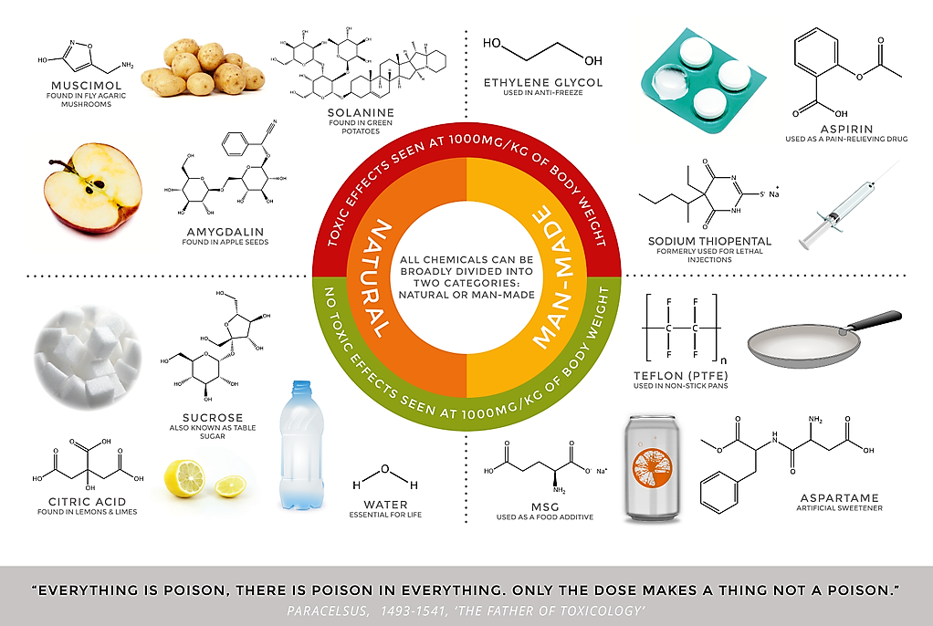

Slide 9
Toxin
These are special types of poisons that are produced by living organisms in small quantities.
These are generally classified as biotoxins.
Toxins are of different types like:-
Phytotoxins (plant toxins),
Mycotoxins (fungal toxins),
Zootoxins (toxins of lower animals e.g. bufotoxin, snake venom etc.),
Bacterial toxins (liberated by bacterial cells) etc.

Slide 10
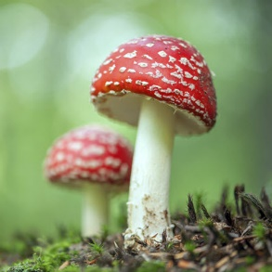
Figure:
Amanita muscaria mushroom contains a neurotoxin (Image Source: iStock Photos©)

Slide 11
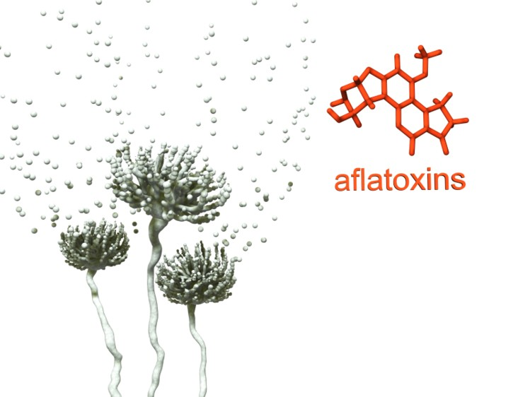
Figure:
Aspergillus flavus growing on maize and other grains produces mycotoxin (Image Source: mycotoxins.info)

Slide 12
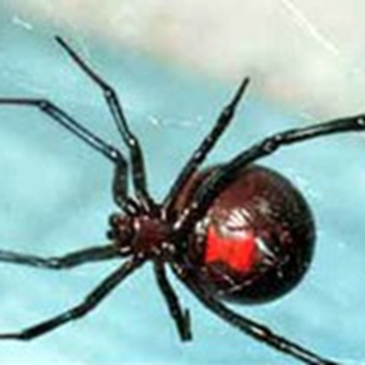
Figure:
Black Widow spiders produce a poison that is a toxin (Image Source: Texas Parks & Wildlife©)

Slide 13
Venom
It is a toxicant synthesized in a specialized gland and ejected by the process of biting or stinging. Venom is also a zootoxin but is transmitted by the process of biting or stinging.

Slide 14
Toxicity
It may be defined as the inherent capacity of a substance to produce toxic effects or detrimental changes on the organisms.
Toxicosis
It is the state resulting from exposure to a poison. The term is being used interchangeably with poisoning and intoxication.

Slide 15
Hazard
Danger or Risk.
It is the likelihood of poisoning of a living organism after exposure to a particular toxicant. A highly toxic chemical may not be that hazardous as the least toxic chemical.

Slide 16
Thank You

