Slide 1
Branches & Scope of Toxicology
Dr. Nirbhay Kumar
Asstt. Professor & Head
Deptt. of Veterinary Pharmacology & Toxicology
Bihar Veterinary College, Bihar Animal Sciences University, Patna

Slide 2
Branches of Toxicology

Slide 3
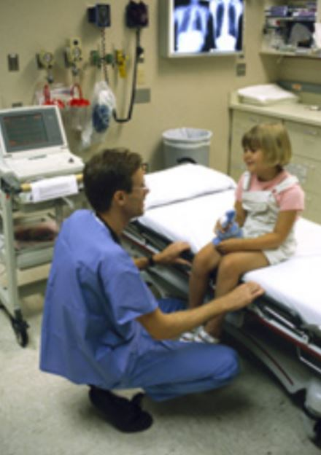
Clinical Toxicology
It deals with the effects of poisons/ toxicants on human beings, animals and other living organisms, their diagnosis and treatment and methods for their detection etc.

Slide 4
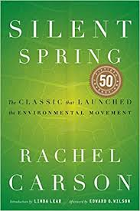
Environmental Toxicology (ENTOX)
It is a multidisciplinary field of science concerned with the study of the harmful effects of various chemical, biological and physical agents on individual living organisms. It is not to be confused with ecotoxicology which is concerned on studying the harmful effects at the population and ecosystem levels.
Rachel Carson is considered to have established environmental toxicology as a distinct field within toxicology in 1962, with the publication of her book Silent Spring, which covered the effects of uncontrolled pesticide use.

Slide 5
Forensic Toxicology
It is the use of toxicology and other disciplines such as analytical chemistry, pharmacology and clinical chemistry to aid medico-legal or vetero-legal investigation of death, poisoning, and drug use.

Slide 6
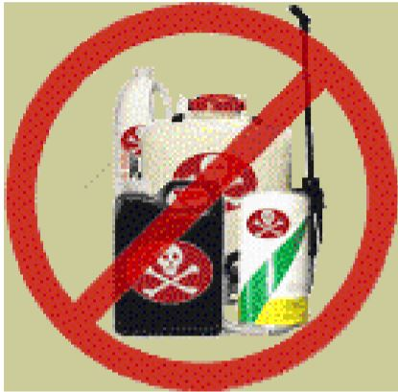
Regulatory Toxicology
It deals with the administrative functions concerned with the development and interpretation of the mandatory toxicology testing programmes and controlling the use, distribution and availability of chemicals used commercially and therapeutically. For example, Food and Drug Administration (FDA) regulates drugs, cosmetics and food additives.

Slide 7
Nutritional Toxicology
It is the study of toxicological aspects of food/ feed stuffs and nutritional habits.
Aquatic Toxicology
It deals with assessing the toxicity on aquatic organisms of chemicals discharged into marine and fresh water.

Slide 8
Industrial Toxicology
It deals with the clinical study of workers of industries and environment around them.
Occupational Toxicology
It deals with assessing the potential of adverse effects from chemicals in occupational environment and the recommendations of appropriate protective and precautionary measures.

Slide 9
Geographical Toxicology
It deals with the geographical distribution of toxicants/ toxicity, e.g. poisonous plants, poisonous animals and minerals.
Reproductive Toxicology
It is the study of occurrence of adverse effects on the male or female reproductive system due to exposure to chemical or physical agents.

Slide 10
Developmental Toxicology
It is the study of adverse effects on the developing organisms occurring anytime during the life span of the organism due to exposure to chemical or physical agents before conception (either parent), during prenatal development or postnatally until the time of puberty.
Genetic Toxicology
It deals with the study of interaction of toxicants with the process of heredity.

Slide 11
Toxicokinetics
It refers to the process of absorption, distribution, biotransformation and excretion of toxicants in relation to time, i.e. what the body does to the poison with relation to time.
Toxicodynamics
It refers to the study of biochemical and physiological effects of toxicants and their mechanisms of action and comprises the sequence of events following interaction of the toxicants with target molecules.

Slide 12
Scope of Toxicology

Slide 13
Biomedical
Mechanisms of actions
Effects of exposure
Understanding biological responses through model toxic compounds
Public Health
Recognition and identification of hazards
Occupational exposure
Development and use of pesticides

Slide 14
Regulatory
Development of exposure standards
Detection methods
Environmental
Chemical effects on plants, animals & ecosystems
Clinical
Development of antidotes & treatments
Recognition of exposure

Slide 15
Thank You

