Slide 1
Leucocytozoon
Dr. AJIT KUMAR
HoD
Department of Parasitology
Bihar Veterinary College
Bihar Animal Sciences University
Patna-800014
Image source: Google image

Slide 2
Family: Plasmodiidae
Heteroxenous parasites.
Schizogony occurs in vertebrates and gametogony and sporogony in invertebrates.
Pigment (haemozoin) is usually formed in the host cell except Leucocytozoon spp.
Genus : Haemoproteus, Leucocytozoon and
Plasmodium)

Slide 3
Genus: Leucocytozoon
General characters:
Leucocytozoon is the largest haemoparasite encountered in birds.
Heteroxenous parasite.
Schizogony occurs in vertebrates and gametogony and sporogony in invertebrates.

Slide 4
Genus: Leucocytozoon
General characters:
Leucocytozoon gametocyte does not contain retractile pigment.
Gametocytes stage of Leucocytozoon species found in lymphocytes and /or may be in erythrocytes of infected birds.

Slide 5
Leucocytozoon
Species | Definitive host | Vector
Leucocytozoon simondi | Domestic duck | Simulium spp.
Leucocytozoon smithi | Turkey | Simulium spp.
Leucocytozoon caulleryi | Chicken, turkey etc. | Culicoides spp.

Slide 6
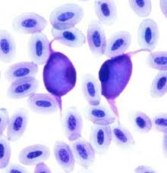
Leucocytozoon
Morphology :
Gaemetocyte : Mature gametocyte of Leucocytozoon is elongate, oval bodies found inside the lymphocyte and erythrocyte.
Host cell nucleus is compressed to side of cell and form a narrow dark bands.
Gaemetocyte
Image source: Google image

Slide 7
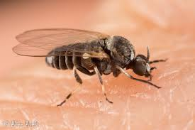
Leucocytozoon
Morphology :
Schizogony occurs in the endothelial and parenchymatous cells of liver, kidney, Lung, brain etc.
Megaloschizonts more numerous than hepatic schizonts found in endothelial cells of lungs, kidney, brain etc.
Infective stage : sporozoites are inoculated into definitive host by the infected fly.
Simulium fly
Image source: Google image

Slide 8
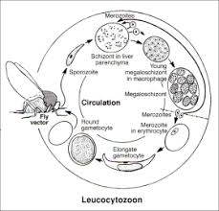
Life-cycle of Leucocytozoon
Image source: Google image

Slide 9
Leucocytozoon
Pathogenesis and clinical signs:
Young birds suffer more than the adult birds. Clinical signs include anorexia, anaemia, listlessness, greenish diarrhoea etc.
White spots found on the heart muscle in Leucocytozoon infection.

Slide 10
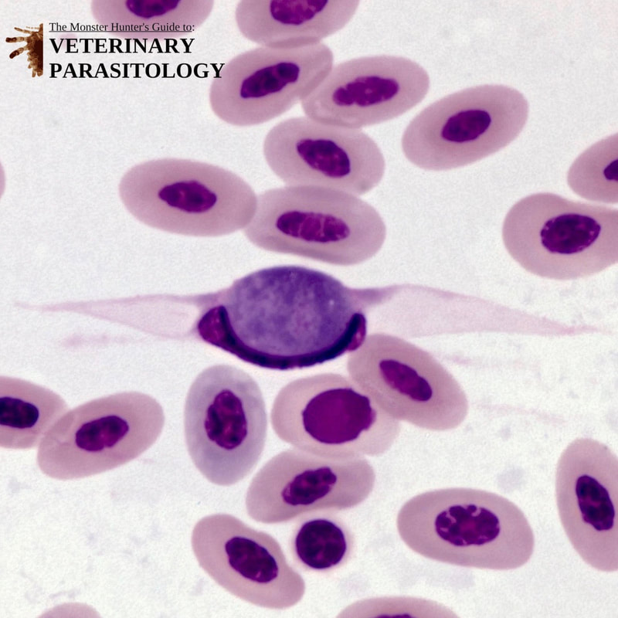
Leucocytozoon
Diagnosis:
By demonstration of gamonts found inside the lymphocyte and erythrocyte in stained blood smear and the megaloschizonts in impression smear of lung.

Slide 11
Leucocytozoon
Treatment :
Pyrimethamine plus sulfonamides as prophylaxis whereas in clinical cases, furazolidon or pyrimethamin is effective.
Sulphamonomethoxine sodium drug is also used in treatment.

Slide 12
Leucocytozoon
Control:
Preventative medication with pyrimethamine and sulfadimethoxine in the feed can be used.
Insect vector control is helpful but difficult.

Slide 13
THANK YOU

