Slide 1
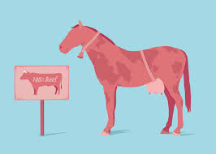
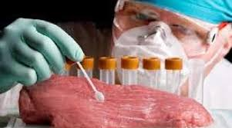
Meat Speciation

Slide 2
Mixing of meat of one species with another
Mislabeling
Adulteration of meat is “the fraudulent practice which involves substitution or mixing of flesh of cheaper variety which is objectionable for the reason of health, religion and economics”.
Mixing of meat of one species with another is punishable under the Prevention of Adulteration Act, 1973.
Common substitutions include horse flesh as beef, mutton as chevon, mutton as venison and beef as mutton.

Slide 3
Methods for identification of meat
Various methods of identification of meat of different species each with its advantages and disadvantages.
The anatomical method cannot be employed in case of minced meat, boiled and cooked meat.
Similarly the use of physical and chemical methods is of no use in cases of cooked/ boiled, minced, lean, processed and meat having close indices.

Slide 4
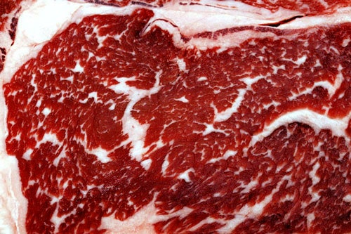
Anatomical
Difference in colour, texture, odour, fat, bone and cartilage of various species of animals.
Buffalo meat is darker and coarser than cattle meat.
Chevon is associated with a typical goaty odour.
Fat of cattle being yellowish as compared to white fat of buffalo.
Marbling of fat is seen in cattle and buffalo while most of the fat in pig is subcutaneous in nature.

Slide 5
Species | Meat |  |  | Fat
 | Colour | Consistency | Odour | Colour & Consistency | Distribution
Sheep (mutton) | Pinkish | Firm | Faint | White and firm | Inter muscular fat present
Goat (chevon) | Pale red | Firm | Goaty | White | Inter muscular fat absent
Cattle (beef) | Red | Fairly firm | - | Yellowish White and very firm | Inter muscular fat present
Buffalo (cara beef) | Dark red | Fairly firm | - | Pure white and firm | -
Pig (pork) | Pinkish grey | Soft | Urine like | White and soft greasy | S/C and Intramuscular
Young cattle (veal) | Pale pink | Not firm | - | White and firm | Very less fat
Horse | Dark red/ bluish | Soft | Sweetish | Yellow and soft greasy | No inter muscular fat
Poultry | White | Firm | - | Yellow and loose | Abdominal cavity and S/C

Slide 6
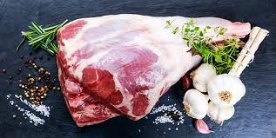
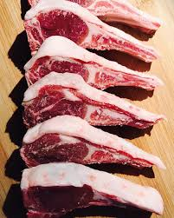
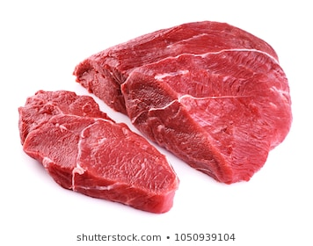
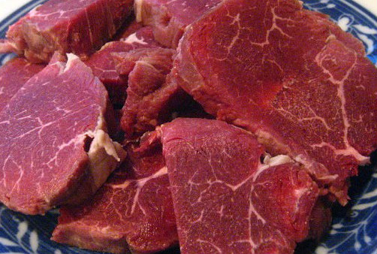
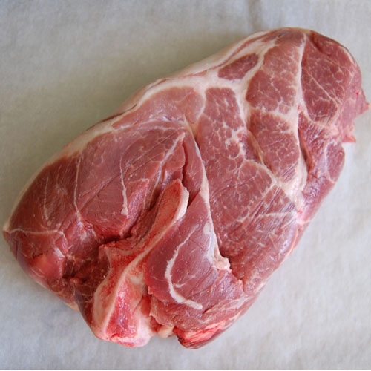
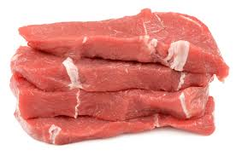
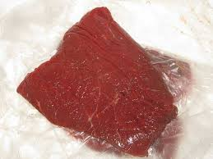
Mutton
Chevon
Beef
Cara beef
Pork
Veal
chevaline

Slide 7
Animal carcass can be differentiated on the basis of the dentition, number of bones, presence or absence of a specific structure on bones.
Dentition of different animal species
Vertebrae of different species
Species | Temporary | Permanent
Cattle/ sheep/ goat/ buffalo | 2(0030/ 3130) = 20 | 2(0030/ 3133)= 32
Pig | 2(3130/3130)= 28 | 2(3143/3143)= 44
Horse | 2(3030/3030)= 24 | 2(3133/3133)= 40
Species | Vertebrae
Cattle/ Buffalo | C7T13L6S5Cy18-20
Sheep/ Goat | C7T13L6S4Cy16-18
Horse | C7T18L6S5Cy15-21
Pig | C7T14-15L6-7S4Cy20-23
Poultry | C15-17T7L+S14Cy5-6

Slide 8
Differentiation of carcass of horse and cattle
In case of horse there is unusual length of sides, together with the great muscular development of hindquarters.
The thoracic cavity is longer in horse with 18 pairs of ribs, whereas in cattle there are 13 ribs.
The ribs of horse are narrower but more markedly curved.
The superior spinous processes of the first six dorsal vertebrae are more developed and less inclined posteriorly in horse.
In the forequarter the ulna extends only half the length of the radius in horse. In cattle it extends and articulates with the carpus.

Slide 9
The fibula of horse extends upto two thirds the length of the tibia. In cattle femur possesses no third trochanter and the fibula is only a small pointed projection.
The last three lumbar transverse processes articulate with each other, the sixth articulating in the similar manner with the sacrum in horses, while in cattle they do not articulate
Carcass of horse shows considerable development of soft yellow fat beneath the peritoneum, especially in mares, but in stallion the fat is generally of a lighter colour and almost white. In ox the kidney fat is always firmer, white and more abundant than in horse.
Horse flesh is dark bluish red and the meat has pronounced sweet taste and well-defined muscle fibers.

Slide 10
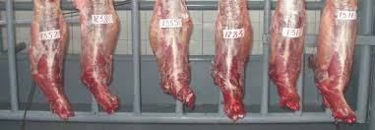
Differentiation of carcass of sheep and goat
Feature | Sheep | Goat
Back & withers | Round and well fleshed | Sharp, little flesh
Thorax | Barrel shaped | Flattened laterally
Tail | Fairly broad | Thin
Radius | 1.25 times length of metacarpus | Twice as long as metacarpus
Scapula | Short and broad. Superior spine, bent back and thickened | Possesses distinct neck. Spine straight and narrow
Sacrum | Lateral borders thickened in form of rolls | Lateral borders thin and sharp
Flesh | Pale red and fine in texture | Dark red and coarse with goaty odour. Sticky subcutaneous tissue, which may have adherent goat hairs.

Slide 11
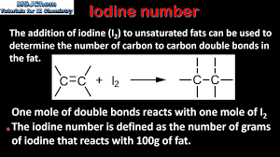
Chemical
These tests are based on the presence or absence of a certain chemicals or their quantity in meat.
Iodine value: the test is based on the amount of iodine absorbed by the unsaturated fatty acids present in fat, and varies with the species of animal.
  Horse: 71-86
  Cattle: 38-46
  Sheep: 35-46
  Pig: 50-70.
Linoleic acid: Horse fat contains 1 to 2% linoleic acid where as all other fat contain less than 0.1%.
Glycogen content: The glycogen content of horse flesh is very high but in case of animals that are exhausted or emaciated the value may be low leading to misinterpretation of results.

Slide 12
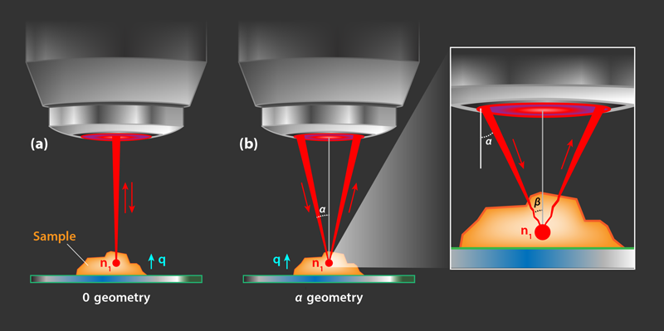

Physical
Refractive index: Fat is heated and converted to oil and the refractive index estimated by means of a refractometer.
  Horse: 53.3
  Cattle:<40
  Pig: <51.9

Slide 13
Biochemical
Various biochemical tests based on the size, migration pattern etc of proteins can be utilized for meat speciation.
These tests are useful in minced meat but do not give good results for cooked meat.
The specific pH of proteins at which their overall electric charge becomes zero and they get precipitated is known as the iso-electric point.
This technique involves the migration of protein through pH gradient in polyacrylamide or agarose gel.
The muscle proteins migrate on gel having ampholyte bed under strong electric field and precipitate at specific iso-electric point giving bands.
Iso-electric focusing:

Slide 14
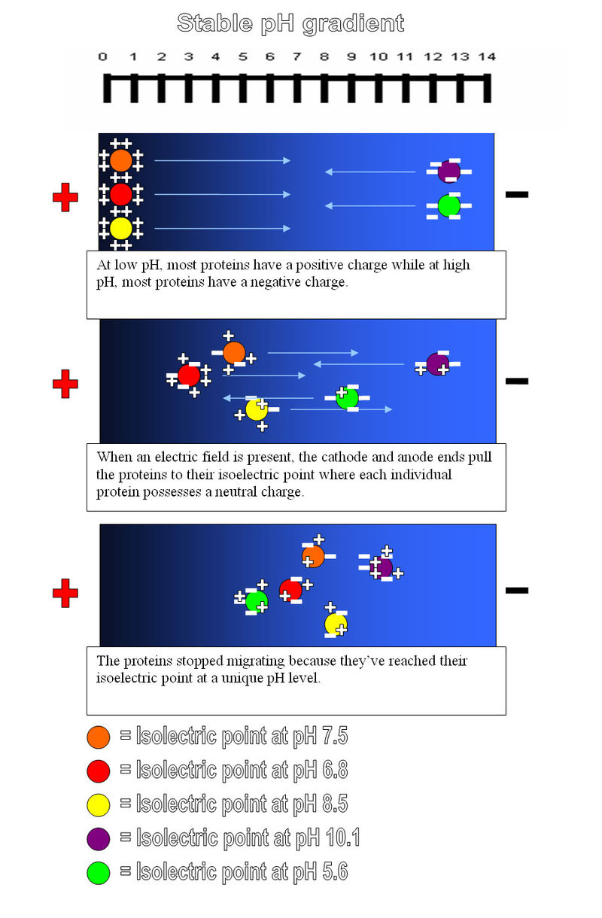
The number of bands, their distribution pattern and iso-electric point are specific for every species and help in identification from a mixture of meats.
The test can be performed on blood, serum, milk, organ etc.

Slide 15

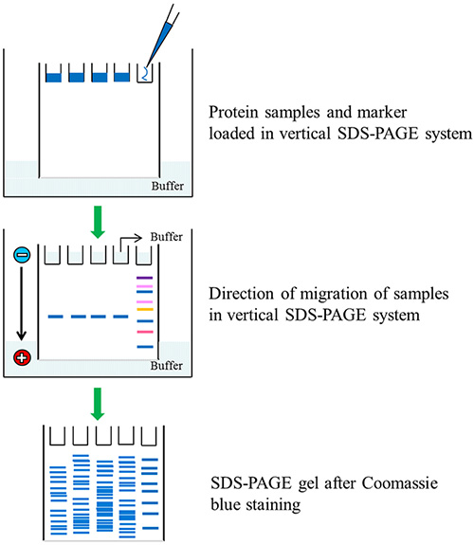
SDS-PAGE
(Sodium Dodecyl Sulfate Polyacrylamide Gel Electrophoresis)
The charge on proteins gets neutralized on treatment with detergents like sodium dodecyl sulphate.
Such proteins migrate through polyacrylamide gel on the basis of size giving a specific banding pattern on staining with suitable dye.
The band pattern is specific for a particular species and thus helps in identification of species.

Slide 16
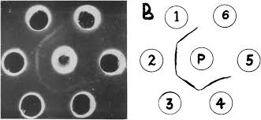
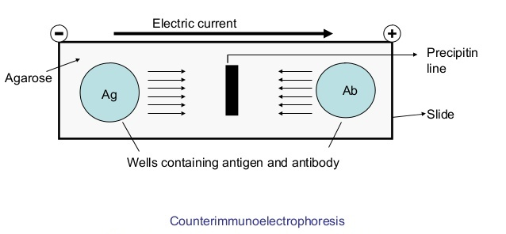
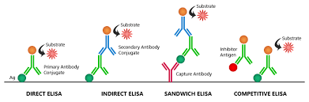
Immunological tests
These tests are based on the antigen antibody reaction.
Agar gel precipitation test
Counter current immunoelectrophoresis
ELISA

Slide 17
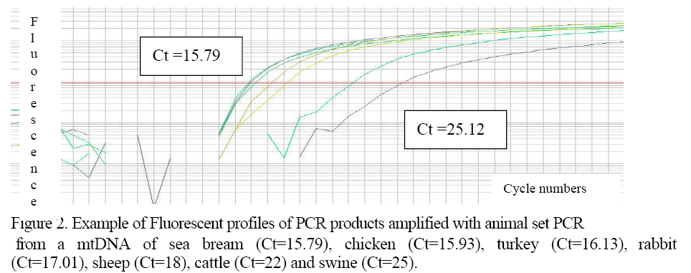
Molecular
Modern DNA based techniques like Polymerase chain reaction and gene probes are being used for identification of species.

