Slide 1
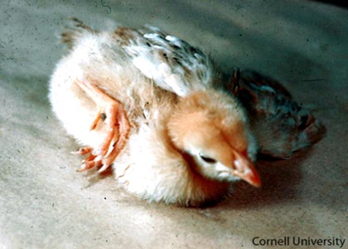
NEWCASTLE DISEASE
8th SEMESTER
Dr. ANIL Kumar
Asst. Professor
Dept. of VCC

Slide 2
NEWCASTLE DISEASE
ETIOLOGY: Paramyxo virus., RNA Virus.
First time recorded in New castle in 1926 in England and in Ranikhet in 1928 in Uttaranchal(India).
It occurs throughout the year, but is most common in the summer.
On the basis of virulence:
1.LENTOGENIC VIRUS(MILD).
2. MESOGENIC VIRUS(MODERATE).
3.VELOGENIC VIRUS(SEVERE).
ND disease confused with Avian influenza :
Avian influenza virus-HA-Rabbit but ND doesn’t.
Avian influenza virus doesn’t produce disease in pigeons but ND can.
ND Virus losses its HA activity at at5,90,180 minutes but pathogenicity lost at 180 minutes but AI Virus become non-infectious before HA property of the virus is lost.

Slide 3
HOST : In poultry(virulent form), but in ducks, turkey, wild birds and pheasants have less severe form of disease.
SPREAD :
Inhalation and Ingestion.
Feed, Water and Equipments.
Movement of people.
Air transmission is very important.
In Humans, the virus causes conjunctivitis, headache and influenza like symptoms.
SYMPTOMS :
In velogenic form :
Depression
Closed eyes and facial swelling.
Drooping wings and anorexia with greenish/yellowish diarrhea.
Some times in neural form--- Torticollis, incordination or even paralysis of legs and arched back position of the body.

Slide 4
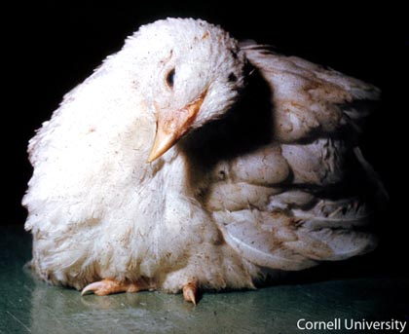
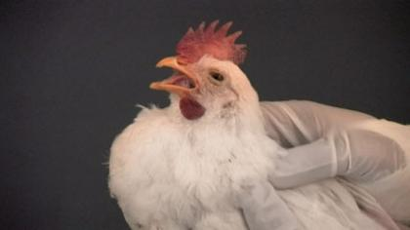
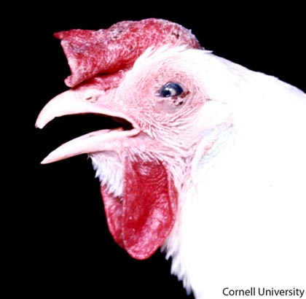
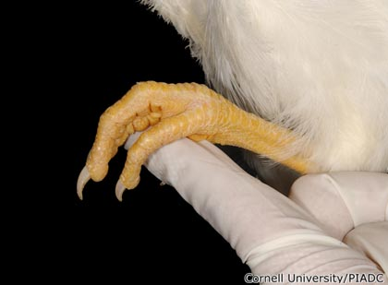
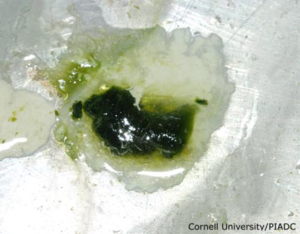
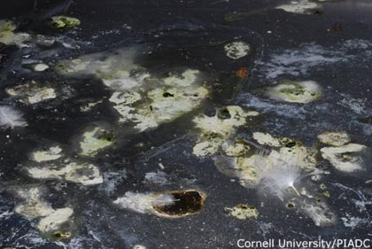
Paralysis of legs
Torticollis
Abnormal perching reflex
Coughing and gasping
Edema(Head),Conjunctivitis, Cornea edema(Eye)
Greenish diarrhea
Greenish diarrhea with white urates

Slide 5
In mesogenic form :
Severe respiratory distress.
Marked drop in egg production.
Some times soft shelled egg or shell less egg.
In lentogenic form:
Only mild respiratory distress.
DIAGNOSIS :
Isolation of virus.
P.M finding :
1. Pin point haemorrhage in proventriculus.
2.Enlarged and haemorrhagic caecal tonsil.
3.Intestinal haemorrhage in intestinal wall.
4. Necrotic spleen.
Serological test :
1.H I Test 2. ELISA Test 3.CFT Test 4. V N Test.
Biological test :
1. Inoculation --- Pigeon-----Produce disease in 6 day.
2. Immunized Poultry-----not produce disease where as unimmunized poultry------ produce disease.

Slide 6
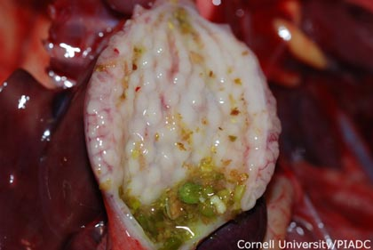
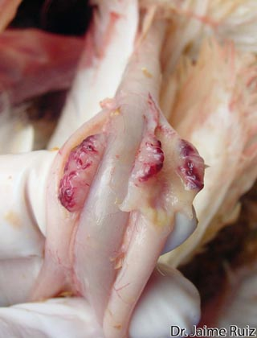
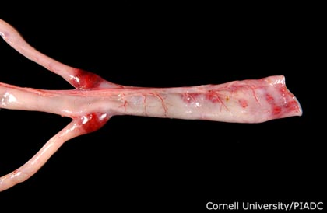
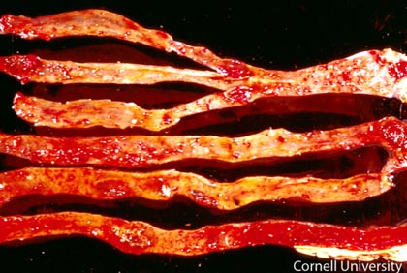
PM FINDINGS
Fig 2: Caecal tonsils with necrosis and marked hemorrhagic lesions
Fig 1:Proventriculus shows edematous glands with some areas of hemorrhages.
Fig 3 :Severe hemorrhages on caecal tonsils and mucosa of the rectum.
Fig 4 : Entire length of intestinal mucosa shows hemorrhagic changes.

Slide 7
TREATMENT: No treatment
PREVENTION AND CONTROL :
Good hygiene, good management, and good biosecurity practices.
Along with vaccination.
There are 3 types of commercially available vaccines for RD disease:
1. Live lentogenic vaccines:
They have F, Hitchner B1, LaSota and V4 vaccines.
Least harmful vaccines(LaSota and B1 most widely used).
Of these F has lowest disease producing power.
LaSota is not used for first vaccination but often as a booster after one or more B1 strain/ F strain vaccines.
Given by eye drop, drinking water or by machine producing spray.

Slide 8
2. Live mesogenic vaccines:
They are Mukteswar (R2b), Roakin, Komarow, and H (Hartford shire).
They are capable of causing severe disease and must be given after earlier vaccination with least harmful vaccines (Live lentogenic vaccines).
Capable of producing a high secondary immune response.
3. Killed vaccines:
Prepared from both virulent and avirulent form.
Given either by i.m or s.c route.
MATERNAL IMMUNITY :
This may prevent the effectiveness of primary vaccination, so, the birds are either vaccinated at 3-4wks of age or vaccinated with live virus at one day old chicks by eye drops or coarse spray and revaccinate at 3-4 wks of age.
Killed vaccines successfully in one day old maternally immune chicks.

