Slide 1
Department of Veterinary Medicine Bihar Veterinary College, Patna – 800 014 (Bihar Animal Sciences University, Patna)
NEONATAL DISEASES
Dr. Ranveer Kumar Sinha Assistant Professor cum Junior Scientist

Slide 2
Department of Veterinary Medicine Bihar Veterinary College, Patna – 800 014 (Bihar Animal Sciences University, Patna)
CALF SCOUR
Dr. Ranveer Kumar Sinha Assistant Professor cum Junior Scientist

Slide 3
Introduction
It is a important calf diseases
Diagnosing, treating and preventing this disease is very important for every cattle industry.
Calf scours can be defined as diarrhoea in calves.
Calf scours is not a specific disease with a specific cause, but it is actually a clinical sign of a disease complex with many possible causes.

Slide 7
Types of Calf Scours
1.Bacterial scours
E.Coli
Salmonella
Clostridium perfringens Types C & D
2.Viral scours
Rotavirus
Corona virus
Bovine Viral Diarrhoea (BVD)
3.Protozoan Scours
Coccidia
Cryptosporidia

Slide 8
Symptoms
Calves do not drink milk or milk replacer.
Calves become severely dehydrated and depressed.
They may have fever initially
Faeces are watery and often tinged with blood
Calves show uneasiness and strain or kick at their abdomen
There may be drooling of saliva

Slide 11
When Should Calves be Treated
Calves running around the pasture with their tails in the air with yellow or white diarrhoea may need treatment.
The main indications for treatment are:
General disposition
Loss of Appetite
Dehydration
Body temperature

Slide 13
Recommended Treatments
The main treatment is fluid therapy:-
1.R.L.@ 10 – 20ml/Kg b.wt slow IV according to level of dehydration
Secondary treatments are:
Antibiotics:
Sulphamethoxazole + Trimethoprim oral or parental or other antibiotic
Anticoccidial drug
Supportive therapay
Nursing care.

Slide 14
Prevention and Control
General hygienic measure
Isolation of infected animal
Avoidance of over crowding
Provide sufficient colostrum to calf
Give dewormer within 10 days after birth
Provide feed mixed with coccidiostat
Apply Tr. Iodine or Povidone iodine at navel just after birth

Slide 15
CALF PNEUMONIA
Calf pneumonia is a Important calf diseases
Diagnosing, treating and preventing this diseases is very important for every cattle industry.
It is a multifactorial disease and most common in calves between one to five months of age.

Slide 16
TYPES of CALF PNEUMONIA
Chronic Pneumonia:
It is more gradual in nature with no distinct ill phase & animal still eat but have a slight nasal discharge with an increased respiratory rate and cough.
Acute Pneumonia:
It is usually more sudden in onset.

Slide 17
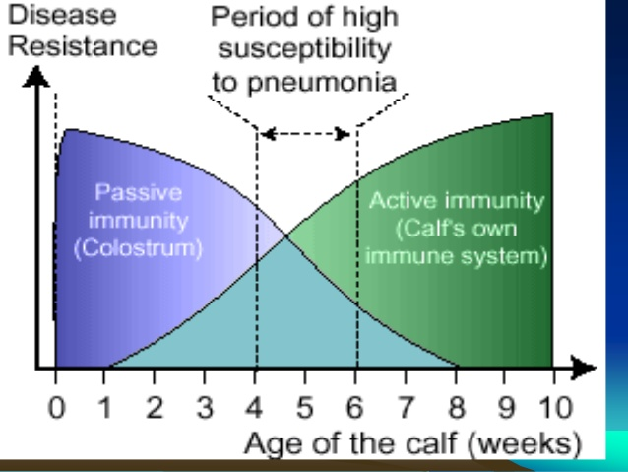

Slide 18
CAUSES OF CALF PNEUMONIA
Environmental Factors:
Low environmental temperature
High Humidity
Poor Ventilation
Infectious Agents:
Viral -Bovine Respiratory syncytial Virus (RSV)
Bacterial
Parasitic
Mycoplasma

Slide 19
SYMPTOM OF CALF PNEUMONIA
By auscultation of the anterior ventral lung crackles and wheezes & an increase in bronchial sounds especially on inspiration.
Dull and depressed
High temperature
Raised breathing due to lung damage
Nasal discharge
Coughing
Reduced food intake
Weight Loss

Slide 23
CONSEQUENCES OF PNEUMONIA
Short-term consequences:
Reduced dry matter intake, delayed weaning and higher risk of an additional pneumonia event at weaning.
Long-term Consequences:
Delayed breeding, higher age at first calving and compromised milk production.

Slide 24
Treatment of calf pneumonia
Removal of primary etiology:
Antibiotics:
Enrofloxacine
Marboflxacine
Cephalosporion .
Sulfa &Trimethoprime
Antihelmintics:
Anti-inflammatory (St & Non St):
SupportiveTreatment:
Injection of vitamin C and A to increase body immunity
Mucolytics & Bronchodilator Antihistaminic
Correct anemia if present.
Easily digestible and palatable food

Slide 25
PREVENTION OF CALF PNEUMONIA
Removal of the cause of diseases
Clean environment
Proper ventilation. If ammonia can be smelled it is a sign of poor ventilation.
Swabbing of the navel with tincture iodine
Removal of the newborn from the infected environment
Feeding calves inadequately will reduce calf growth and their immune system response which helps fight diseases.
Ingestion of colostrums from dam within four to six hours of birth to receive adequate immunity.
Special nutritional and housing requirements. Isolation of newborn calf in calf – rearing unit within few days after birth.

