Slide 1
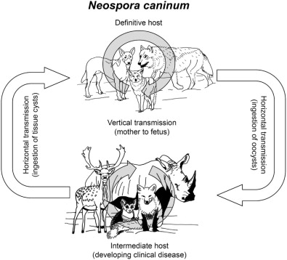
Neospora caninum
Dr. AJIT KUMAR
HoD
Department of Veterinary Parasitology
Bihar Veterinary College
Bihar Animal Sciences University
Patna-800014
Image source: Google image

Slide 2
Neospora caninum
Neospora caninum is a newly recognized fatal apicomplexan protozoal infection of dogs and other animals.
It is a heteroxenous parasite.

Slide 3
Neospora caninum
Definitive (Final ) host:- Dog
Intermediate host :-Ruminates, horse and dog.

Slide 4
Neospora caninum
Each sporulated oocyst contains two sporocysts and each sporocyst contains four sporozoites.
Sporulation occurs outside the host.

Slide 5
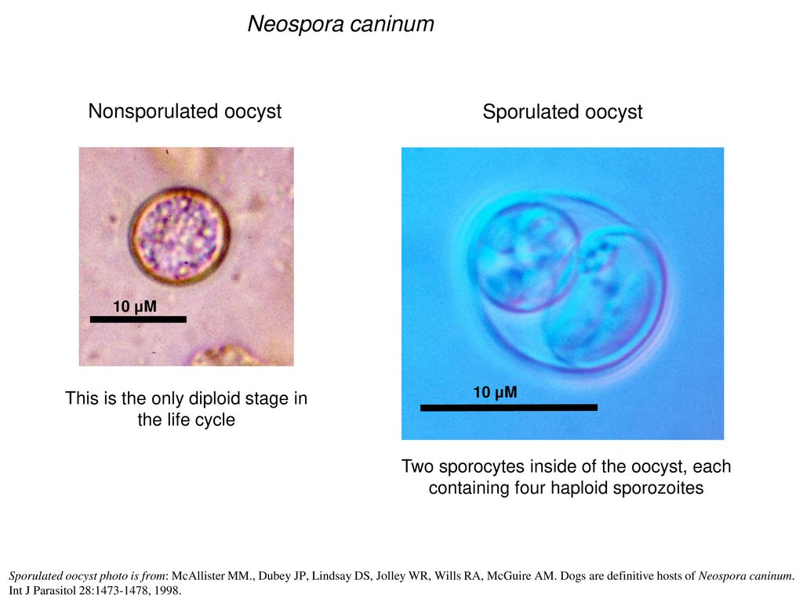
Image source: Google image

Slide 6
Life-cycle of Neospora caninum
Tachyzoites are found in neural cells, fibroblast, macrophages and other cells of body whereas bradyzoite (tissue cyst) are found only in neural tissues (brain, spinal cord and retina).
Bradyzoites are the infective stage for definitive host (dog).
Tissue cysts (bradyzoits) infected dogs shed unsporulated oocysts which become sporulate in environment.

Slide 7
Life-cycle of Neospora caninum
Each sporulated oocyst of Neospora caninum contains two sporocysts and each sporocyst with four sporozoites.
Intermediate hosts may get infection by ingestion of food and water contaminated with Neospora caninum sporulated oocysts.

Slide 8
Life-cycle of Neospora caninum
Tachyzoites of Neospora caninum has been transmitted from infected mother to foetus in cattle, sheep and goat.
Neonatal calves may also get infection through the ingestion of tachyzoites containing milk and colostrum.

Slide 9
Life-cycle of Neospora caninum
Transplacental transmission is the only proven route of transmission in dogs.
Unlike toxoplasmosis, exposure of animals prior to pregnancy fails to prevent transplacental infection during subsequent pregnancies.

Slide 10
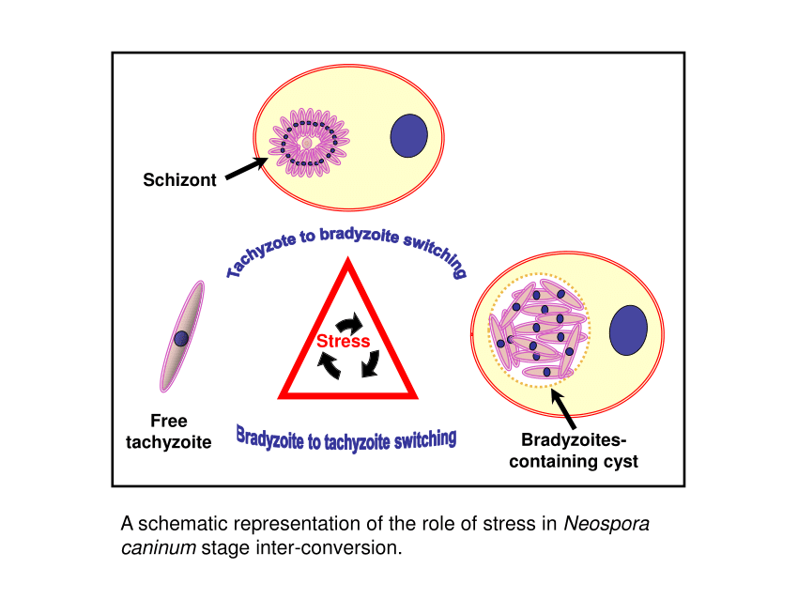
Image source: Google image

Slide 11
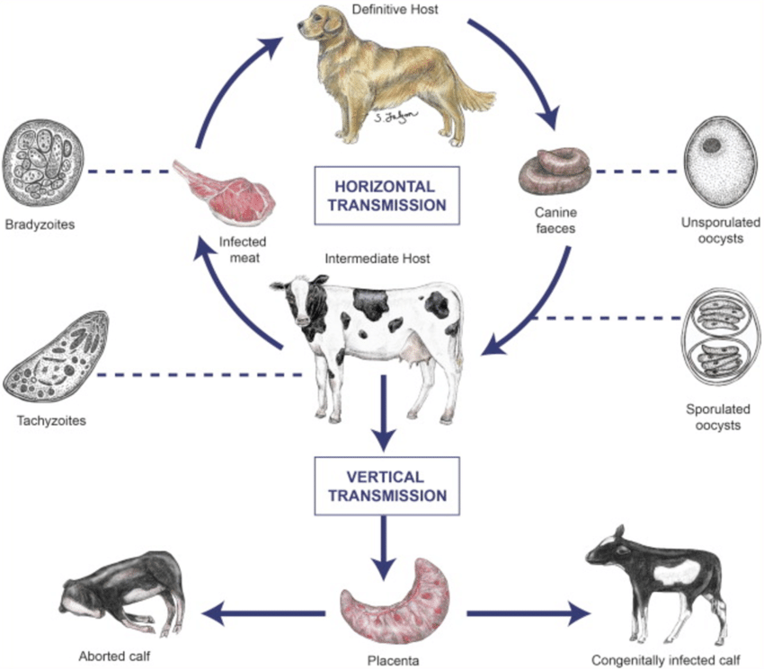
Life- cycle of Neospora caninum
Image source: Google image

Slide 12
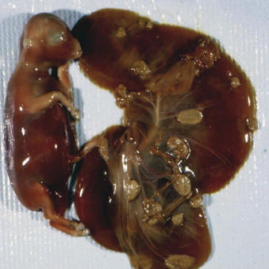
Symptoms of Neospora caninum
Clinical symptoms include ascending paralysis of hind limbs, difficulty in swallowing and paralysis of jaw, retinitis, encephalomyelitis, myositis etc.
Transplacentally infected pups develop severe neuromuscular disease.
Image source: Google image

Slide 13
Treatment of Neospora caninum
Treatment:
Drugs used in the treatment of Neosporosis are Clindamycin, Trimethoprim + Sulfadiazine, Pyrimethamine etc.
Vaccination:
Bovilis and Neoguard are the commercially available vaccines containing killed tachyzoites which reduce abortion in pregnant hosts.

Slide 14
Types of oocysts
Genus | Types of oocysts | Sporogony
Eimeria spp. | Tetrasporocystic bisporozoic (four sporocysts and each sporocyst contains two sporozoites) | Out side the host
Isospora, Toxoplasma, Sarcocystis and Neospora spp. | Bisporocystic tetrasporozoic (two sporocysts and each sporocyst contains four sporozoites) | Outside the host except Sarcocystis spp.
Cryptosporidium spp. | Asporocystic tetrasporozoic (four naked sporozoites) | Inside the host

Slide 15
THANK YOU

