Slide 1
NOISE POLLUTION

Slide 2
Noise is defined as an unwanted or undesirable sound.
The threat of noise pollution is increasing with the rapid pace of urbanization and industrialization.
Unwanted sounds not only cause discomfort and irritability to animals but can also lead to physiological disturbances.
The noise level can be measured with the help of a sound level meter.

Slide 3
SOURCES
Automobiles
Factories
Industries
Air-craft
Vehicle Horns
Loudspeaker
Radios
Transistors
Television etc.

Slide 4
PROPERTIES
The noise has two important properties: loudness or intensity and frequency.
Loudness or intensity depends upon the amplitude of the vibrations which initiated the noise.
The loudness of noise is measured in decibels (dB).
When we say that the sound is-----dB, it means it is-----dB more intense than the smallest distinguishable noise or the reference sound pressure.
0.0002 microbar or dynes/cm²; dyne is 1/1000000th of atmospheric pressure.

Slide 5
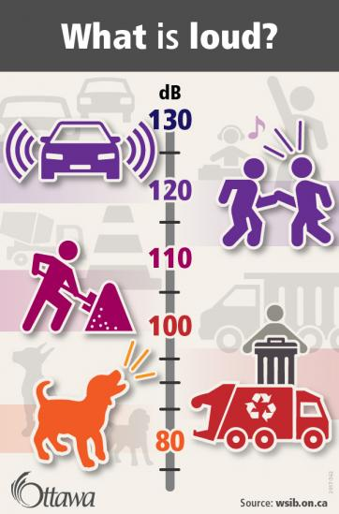
A daily exposure up to 85 dB is the tolerable limit without substantial damage of hearing.
Normal conversation produces a noise of 60-65 dB.
Whispering produces a noise of 20-30 dB.
Heavy street traffic produces a noise of 60-80 dB.
Boiler factories produces a noise of about 120 dB.
In dairies the usual noise levels are found to range between 60-64 decibels.
In dairies with fan ventilation the levels may reach more than 80 decibels.
In piggeries (especially during feeding) the noise can reach levels of about 100 decibels or more.

Slide 6
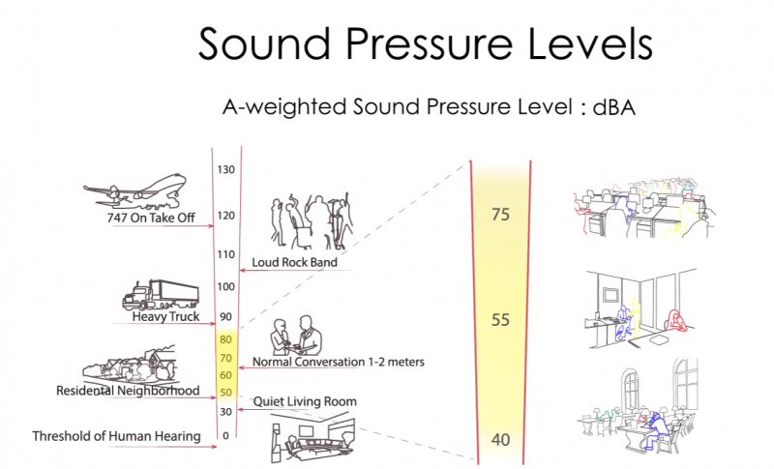
Noise level of 50 dB represents calm environment.
Noise level of a living room in terms of activity is 40-50 dB.
A level of 140 decibel (airplane sound) causes pain in the ear.
Excessive sound levels (160-180 dB) may even cause ear damage.
In case of humans noise beyond 115 decibels is not permitted.
Sound level of 100 decibels for 2 hr and 90 for 8 hr is acceptable.

Slide 7
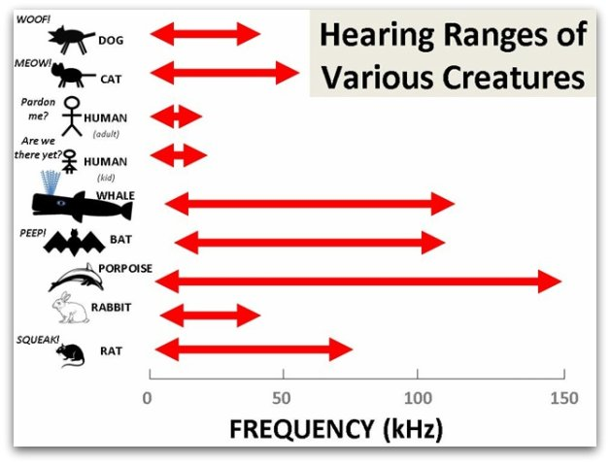
The frequency of noise is denoted as Hertz (Hz).
One Hz is equal to one wave per second.
The human ear can hear frequencies from about 20-20,000 Hz.
The range of vibrations below 20 Hz is infra- audible and those above 20,000 Hz ultra-sonic.
Many animals (dogs) can hear sounds inaudible to the human ear.
Sometimes noise is expressed in psycho-acoustic terms- the phon (psyho-acoustic index of loudness).
It takes into consideration both intensity and frequency.

Slide 8
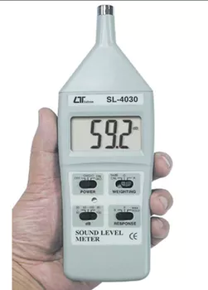
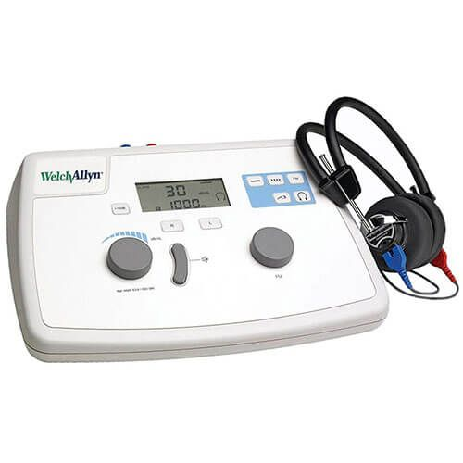
INSTRUMENTS USED IN NOISE STUDIES
Sound level meter:
Measures intensity of sound in decibel ie. dB or sound pressure levels ie. dB(A).
Octave band frequency analyzer:
Measures noise in octave bands and resulting plot shows sound spectrum ie. High pitch, low pitch or variable pitch.
Audiometer:
Measures hearing ability.

Slide 9
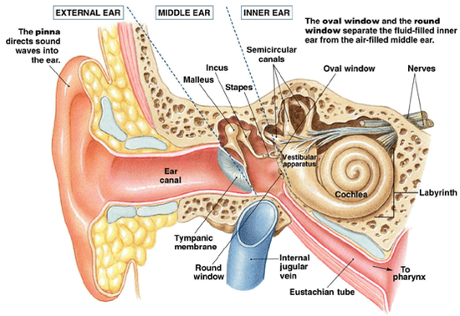
EFFECTS OF NOISE EXPOSURE
AUDITORY & NON-AUDITORY
Auditory effects:
Auditory fatigue (appears at 90 db & greatest at 4000Hz) associated with side effect of whistling and buzzing in ears.
Deafness or hearing loss (temporary loss at frequency 4000 – 6000 Hz and permanent loss at continuous exposure to 100 dB).
Permanent loss of hearing is due to inner ear damage ie. minor change in hair cell ending to destruction of organ of corti at 100 dB.
Rupture of tympanic membrane on exposure at 160 dB.

Slide 10
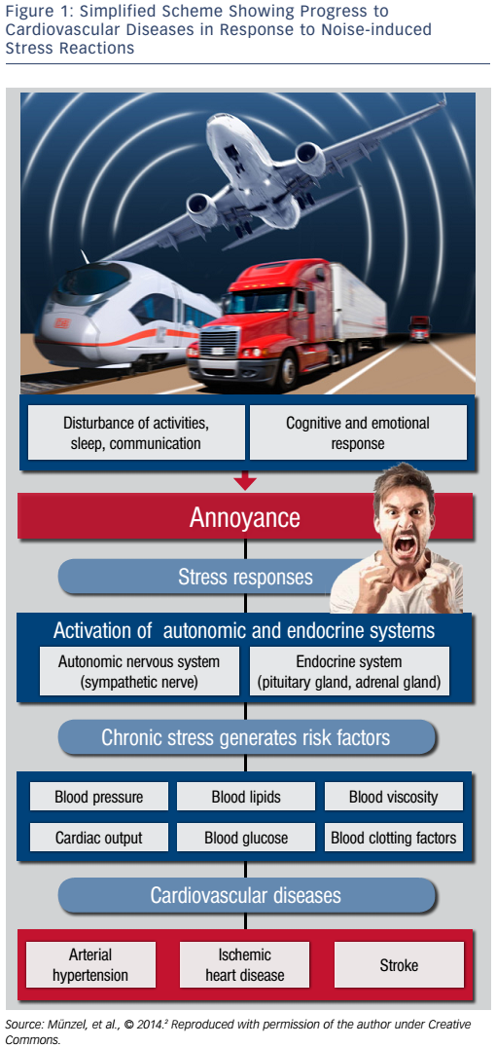
Non auditory effect:
Interference with speech: most common at frequency 300-400 Hz.
Annoyance/irritation
Reduce efficiency of work
Physiological change: rise in blood pressure, intracranial pressure heart rate, breathing and sweating.
Other health effects include giddiness, nausea, fatigue, visual disturbances. stress, hormonal disturbances, cardiovascular problems and muscular rigidity.
In poultry the egg production is seriously affected and in animals behaviour may change.

Slide 11
CONTROL OF NOISE
Careful planning of cities
Control of vehicles
Improvement in acoustic insulation of building
Care in installations of industries and railways
Protection of exposed person
Legislation
Education

Slide 12
Thanks

