Slide 1
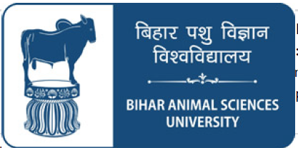
VSR Unit 5: Ovariohysterectomy in Dogs
Dr. Ramesh Tiwary
Assistant Professor
Deptt. of Veterinary Surgery and Radiology

Slide 2
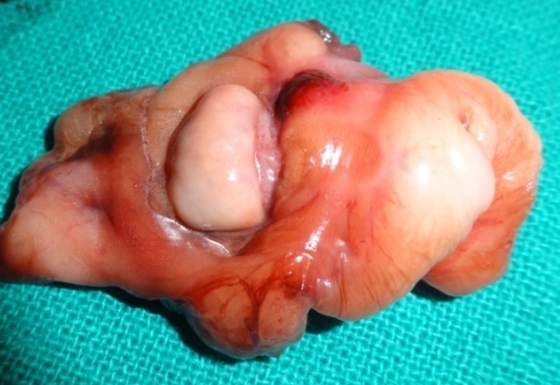
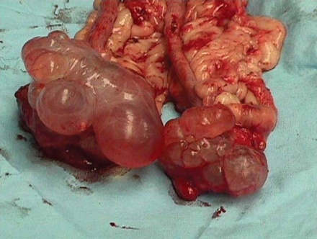
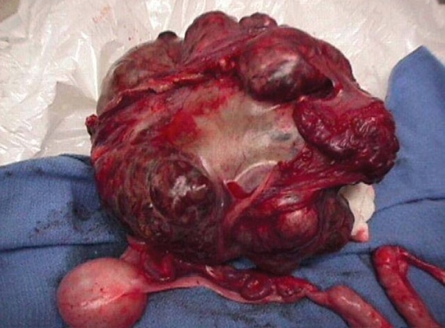
Terms
Neuter refers to ovariohysterectomy (OVH) (surgical removal of the ovaries and uterus).
Ovariectomy (OVE) (surgical removal of the ovaries alone).
Oopherectomy: Surgical removal of the healthy ovaries alone
Overiotomy: Removal of diseased ovaries (Neoplastic or cystic changes )

Slide 3
Indications
To prevent estrous cycles and unwanted pregnancy.
Prevention of pyometra and ovarian or uterine neoplasia.
To reduce the Incidence of mammary tumors.
To prevent vertical transmission of undesirable gene.

Slide 4
Therapeutic Indications
Animals with pyometra
Dystocia
Uterine or ovarian cancer
Vaginal hyperplasia or prolapse
Congenital clotting disorders
Eliminates hormonal changes that interfere with medical therapy for diabetes mellitus or epilepsy.

Slide 5
Surgical Anatomy
Rt. Ovary: Artery and vein Aorta
Lt. Ovary: A-Aorta, Vein-Renal Vein

Slide 6
Approach
Linea Alba: Least bleeding, Slow healing, Chances Post operative infection
Right Flank: Less bleeding, Fast healing, Chances Post operative infection
Laparoscopic: Almost least bleeding, Least post operative infection

Slide 7
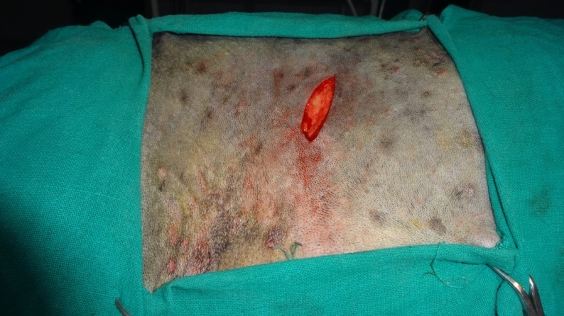
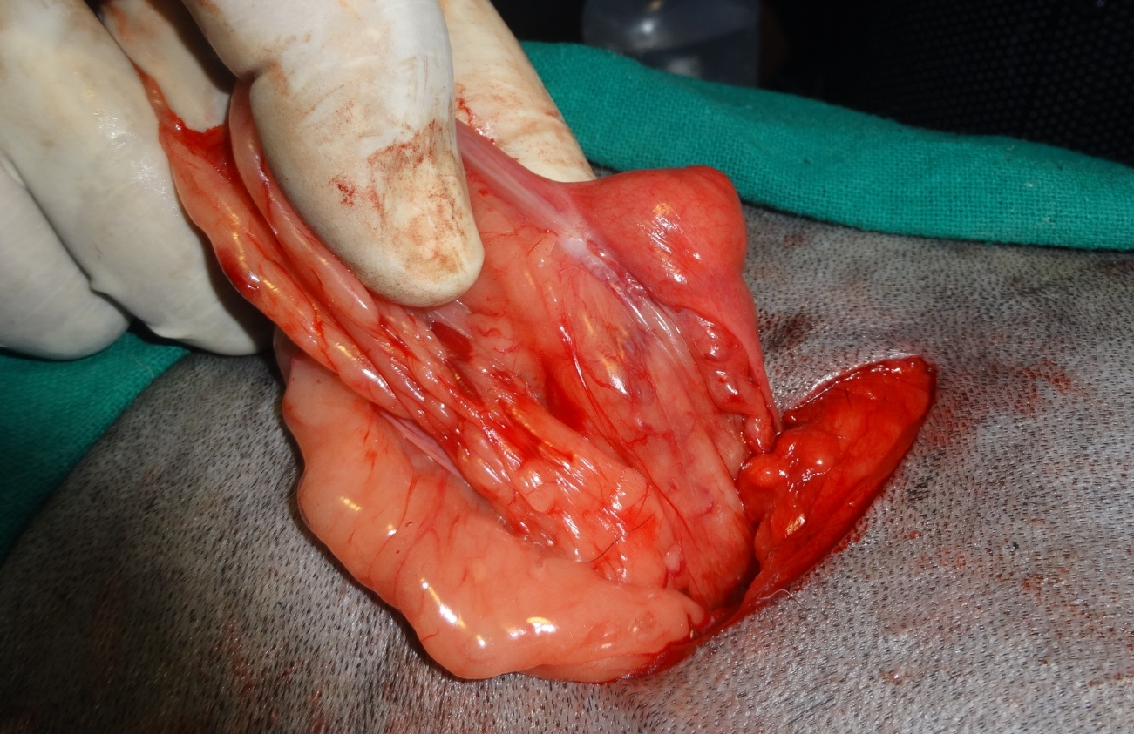
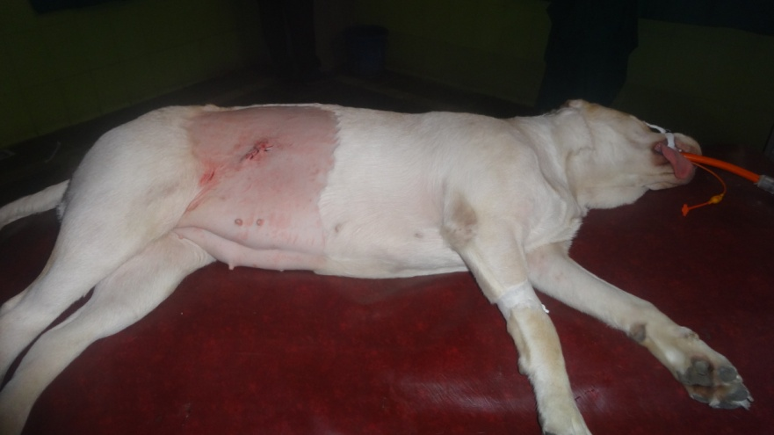
Right Flank
OVE/ OR OVH

Slide 8
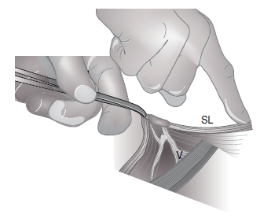
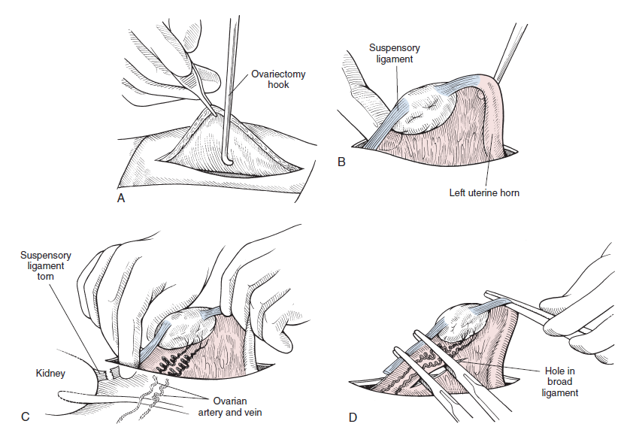

Slide 9
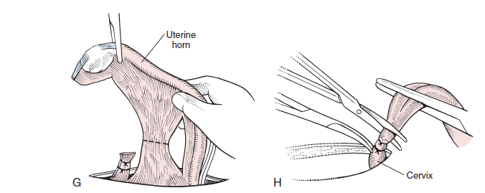
If the broad ligament contains an excessive
amount of fat,
The vessels within it may need to be
ligated.

Slide 10
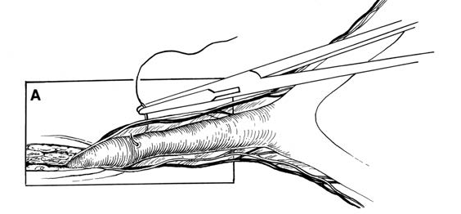
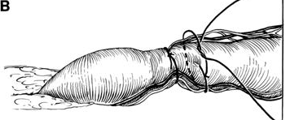
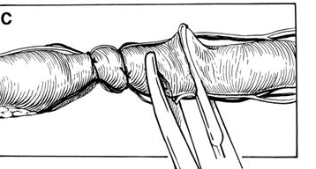
Placement of Ligature in Uterine Body
Place ligature in front of the cervix

Slide 11
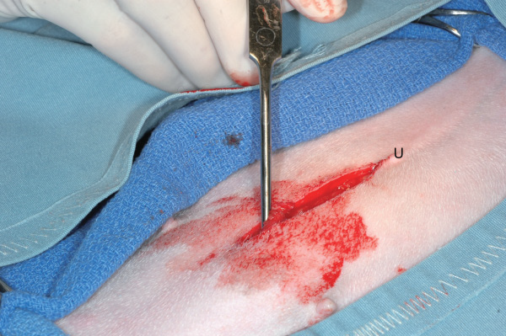
Linea Alba
Make a midline abdominal incision

Slide 12
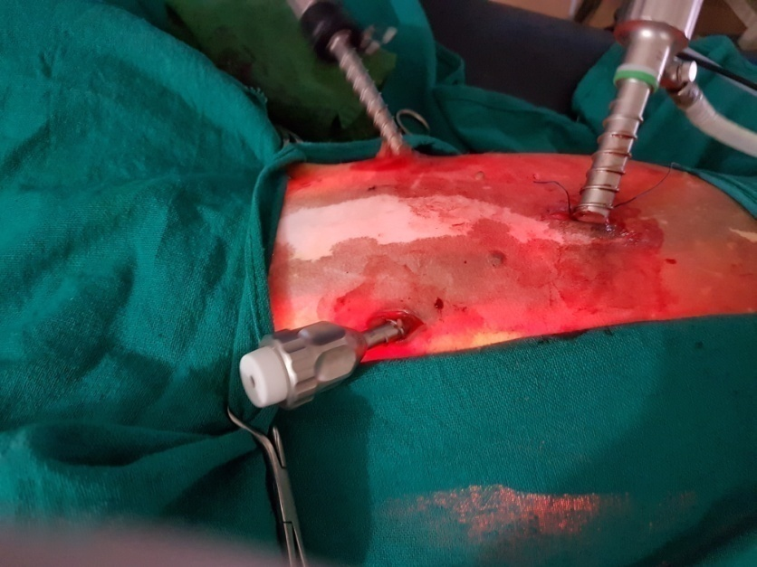
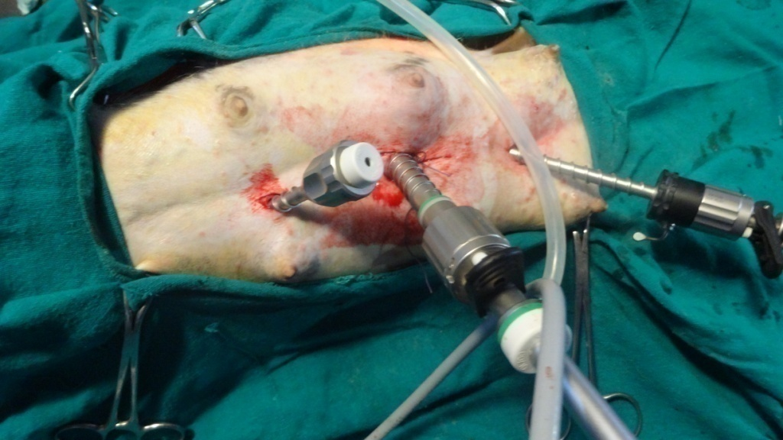
Laparoscopic
Port Placed in triangular fashion
Port Placed in straight line
Camera port Central and caudal to Umbilicus

Slide 13
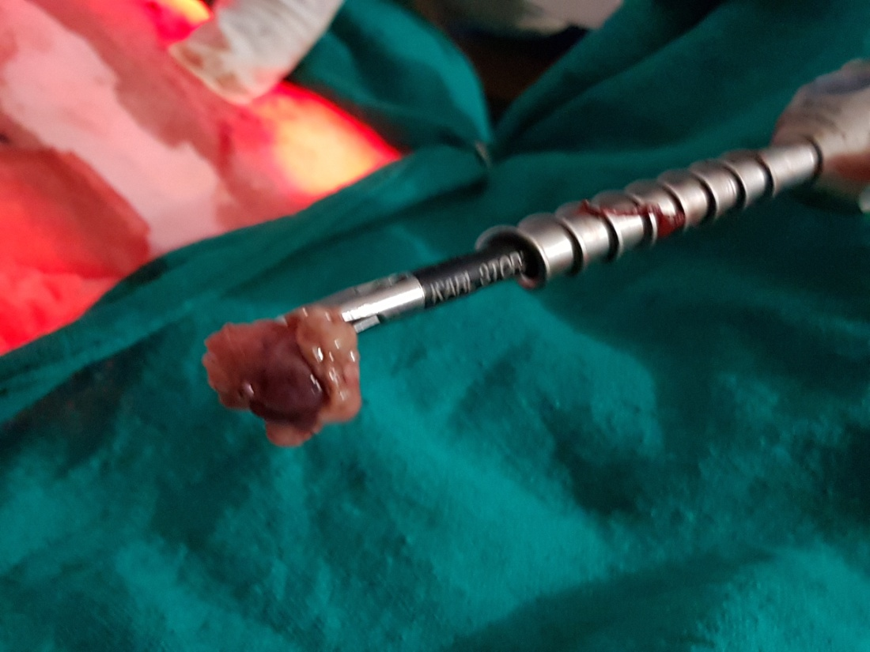
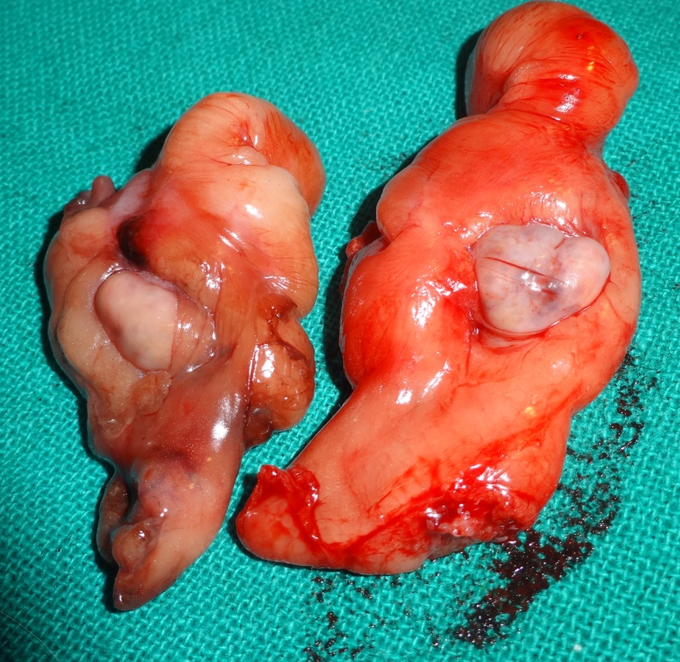

Slide 14
Post operative complications
Urinary incontinence:
Phenylpropanolamine (1.5-2.0 mg/kg PO, bid to tid)
Diethylstilbestrol at 0.1 to 1.0 mg per day for 3 to 5 days, followed by a maintenance does of 1.0 mg per week

Slide 15
Eunuchoid Syndromes
Observed in working dogs after OVH
Affected dogs have decreases in aggression, interest in work, and stamina.
Autotransplantation of an ovary to the subserosa of the stomach wall
The graft produces estradiol and progesterone,
Partially metabolized by the liver.
Circulating estradiol levels are inadequate to initiate estrus, but they are sufficient to prevent the eunuchoid syndrome.

Slide 16
Uterine Stump Pyometra:
Uterine stump pyometra can occur if the animal has elevated blood progesaterone levels.
Uterine stump pyometra can be prevented by
ensuring complete removal of the ovaries during OVH.

