Slide 1
Ovary : its functions and follicular dynamics
Dr Bhavna
Asstt. Prof. cum Jr. Scientist
Deptt. Of Veterinary Gynaecology and Obstetrics

Slide 2
Ovaries lie in the abdominal cavity.
Paired organs
Has both exocrine (ovum release) and endocrine (steroidogenesis) functions.
At birth, a layer of follicular cells surrounds the primary oocytes in the ovary to form primordial follicles.
Shape and size of ovary varies with both species and stage of estrous cycle.

Slide 3
Epithelium covering the mammalian ovary is a single layer of cuboidal or low columnar cells called the germinal epithelium.
This layer covers the entire ovary except in mare, where it is limited to ovulation fossa.
Below germinal epithelium layer is tunica albuginia and then large mass of follicles.

Slide 4
follicles
1. Primodial / Primary follicles
2. Secondary / Growing follicles
3. Tertiary / Vesicular follicles
4. Graafian / Preovulatory follicles
5. Atretic follicles

Slide 5
Primary / Primodial follicles
It consists of an oocyte surrounded by a single layer of cuboidal granulosa (epithelial) cells, but no thecal layers.
At this stage, cow oocyte is 20 to 30µ in diameter.
Only a few develop beyond this stage, as this is referred as resting stage and it may remain as such for few years without any growth.
Ovary of a new born heifer may contain 1,50,000 follicles, which decreases to as few as 100 in cow of 15-20 years of age.

Slide 6
Growing / secondary follicles
Follicles that have left the resting stage as primordial follicles and have started growing, but have not developed thecal layer or antrum.
The epithelium shows mitotic activities and is growing.
Zona pellucida becomes more distinct.
The number of these follicles is relatively few, but by the onset of puberty as many as 2000 growing follicles are present in an individual bovine ovary.
Growing follicles are characterized by having two or more layers of follicle cells but without fully formed vesicle.

Slide 7
tertiary / vesicular follicles
Pituitary gonadotropins (FSH and LH)
Liquor folliculi from granulosa cells
Accumulation in the intercellular spaces
Dissociation of granulosa cells
Formation of large, fluid-filled cavity (Antrum)

Slide 8
Zona pellucida is surrounded by a solid mass of radiating follicular cells, forming the corona radiata.
At this stage both functions of ovary i.e. steriodogenic and gametogenic are developing.
Growing/secondary follicles protrude from the surface of the ovary like a blister and is termed as mature follicle.
There is formation of two cell layers – theca interna and theca externa.

Slide 9
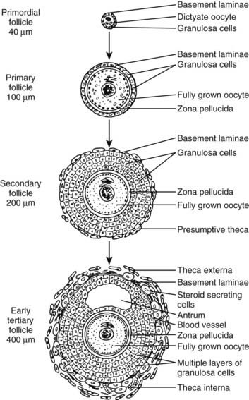

Slide 10
Graafian follicle
Follicular cells increase in size.
Oocyte pressed to one side, surrounded by accumulation of follicular cells (cumulus oophorus).
In the follicular cavity, an epithelium of fairly uniform thickness called the membrana granulosa is formed.

Slide 11
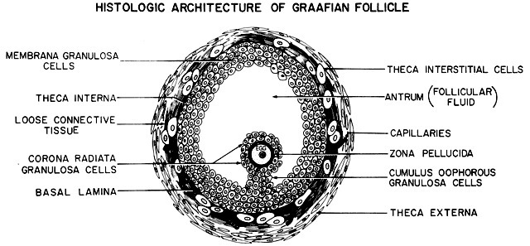

Slide 12
Preovulatory follicle
Blister—like structure protruding from ovarian surface due to rapid accumulation of follicular fluid / thinning of the granulosa layer.
Oocyte, in prophase of meiosis, resumes several hours before ovulation.
First meiotic (maturational) division associated with extrusion of first polar body.

Slide 13
Atretic follicles
Result from follicles that do not ovulate.
Also referred as degenerating or anovular follicles.

Slide 14
Follicular fluid
Originates mainly from the peripheral plasma by transudation across the follicle basement lamina and accumulates in the antrum.
Contains steroids and glycoproteins, synthesized by cell wall of the follicle, amino acids, enzymes, carbohydrates, salts, trace minerals, prostaglandins and most of them are in similar concentration as to blood serum.
In large antral follicles, the follicular fluid contains remarkably high levels of estradiol 17β in follicular phase.
However, polycystic ovaries contain high level of androstenedione.

Slide 15
Functions of Follicular fluid
Follicular fluid performs several functions like:
1. Regulation of granulosa cells’ function, initiation of follicular growth and steriodogenesis.
2. Oocyte maturation, ovulation and egg transport to the oviduct.
3. Prepares follicles for formation of corpus luteum.
4. The stimulatory and inhibitory factors in the fluid regulates follicular cycle.

Slide 16
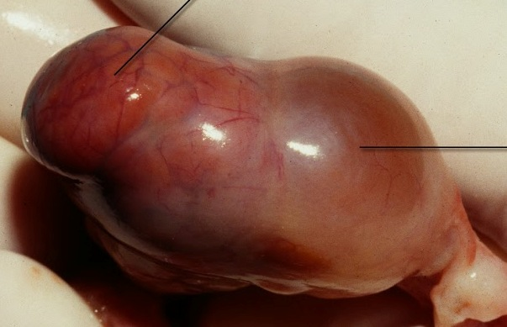
Corpus luteum
The growth of luteal cells is one of the fastest events known in biology, with in 3 to 4 days the blood clot is invaded by the new luteal cells so that the blood filled cavity looses it dark coloration.
CL is one of the most vascularized organ of body.
Corpus luteum develops after the collapse of the follicle at ovulation.

Slide 17
These folds consist of central core of stromal frame and large blood vessels, which becomes distended cells develops a few days before ovulation.
They regress quickly and with infew hours after ovulation all remaining thecal cells are in advanced stage of degeneration.
Hypertrophy and luteinization of granulosa cells begins after ovulation.
Inner wall of follicle develops into macro and microscopic folds that penetrate the central cavity.

Slide 18
Luteal tissue enlarges mainly through hypertrophy of lutein cells.
Progesterone is secreted by the lute in cells as granules.
Generally the period of growth of C.L. is slightly longer than half of the estrous cycle.
In cow, the weight and progesterone content of CL increases rapidly between day 3 and 12 of the cycle and remains relatively constant till day 16, when regression begins, if fertilization does not takes place.

Slide 19
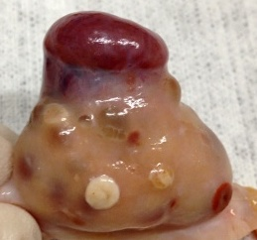
Corpus albicans
If fertilization does not occur, the CL regresses, allowing other layer of ovarian follicle to mature.
As these cells degenerate, the whole organ decreases in size, becomes white or pale brown, known as corpus albicans.
The reminants regress after 14 -15 days of estrus and reduced to half size in 36 hours but persist as a scar like structure for several successive cycles.

Slide 20
Luteolysis
A substance luteolysin, produced by the uterus in absence of pregnancy causes regression of corpus luteum, this luteolysin may be Prostaglandin.
Some scientists (Pharirs and Wyngarden) proposed that PGF_{2α}, may cause luteolysis by constricting the utero-ovarian vessels and causing ischemia and starvation of the luteal cells.

Slide 21
Another group of Scientists proposed that PGF_{2α} may act by:
1. Interfering directly with progesterone synthesis.
2. Competing with LH receptor site.
3. Destroying LH receptor sites.
McCracken proposed that utero-ovarian transfer of PG could be due to countercurrent mechanism atleast in ewes as the ovarian artery follows a tortuous closely adhered path along utero-ovarian vein.

Slide 22
Abortions during early pregnancy and induction of labour during late pregnancy have been demonstrated using PGF_{2α} in most of the domestic species.
Abortion during early pregnancy is probably due to luteolysis as the progesterone production falls sharply.
However, induction of labor in late pregnancy depends upon action of PG on myometrium in addition to its effect on CL.

Slide 23
Endocrinology of follicular growth
Growth, maturation, ovulation and leutinization of Graafian follicle depends upon appropriate pattern of secretion, sufficient concentration and adequate ratio of FSH and LH.
FSH - initiation of antrum formation by stimulating granulosa cell mitosis and follicular fluid formation.
FSH increases LH receptors on granulosa cells increased sensitivity to LH.

Slide 24
LH receptors increment prepares the leutinization of granulosa cells in response to LH ovulatory surge.
Steroidogenic activity of follicle depends on FSH and LH acting on granulosa and theca cells, respectively.
Androgen : Estrogen in follicular fluid reflects the physiologic integrity and viability of the follicle.

Slide 25
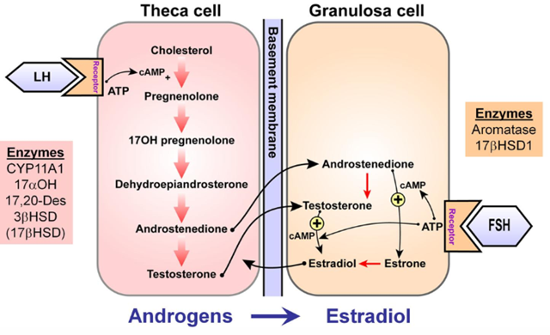
Two cell – two gonadotropin theory

