Slide 1
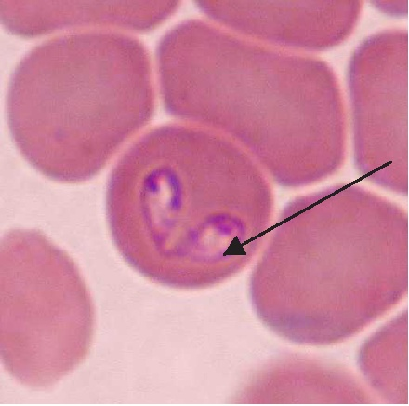
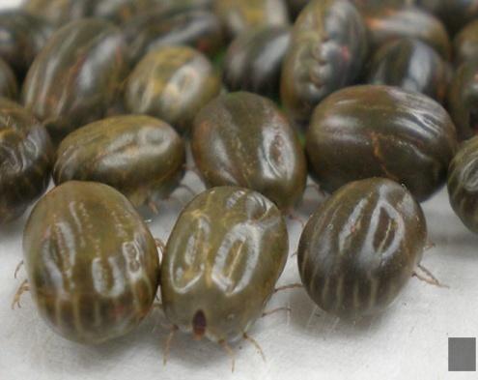
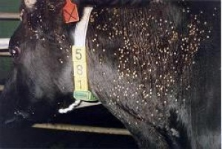
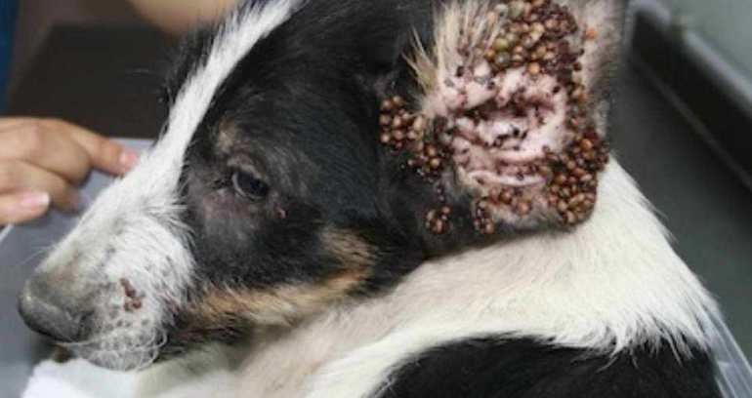
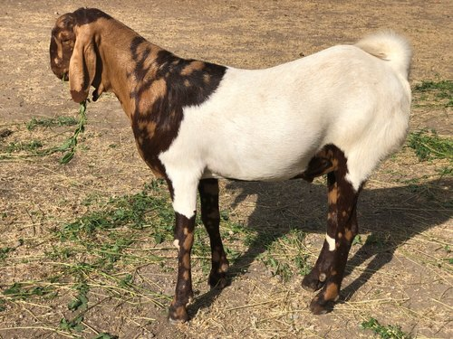
PIROPLASMOSIS
Kaushal Kumar
Assistant Professor & Head
Department of Veterinary Pathology
Bihar Veterinary College
Bihar Animal Sciences University
Patna-800014
Image source: Google image

Slide 2
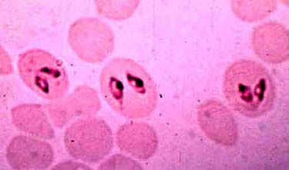
Babesiosis
It is caused by a intraerythrocytic protozoan parasites of the genus Babesia. Transmitted by ticks, babesiosis affects
a wide range of domestic and wild animals and occasionally people.
Babesia parasite has been observed first time by Babes in 1888 from blood of African cattle.

Slide 3
Babesiosis
Babesia species caused diseases are known as
Babesiosis
Red water disease
Texas fever
Biliary fever
Piroplasmosis
Spleenic fever
Tick fever
and
Nantucket fever.

Slide 4
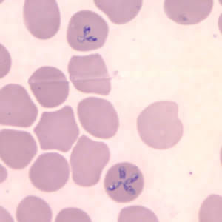
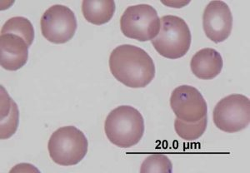
Babesiosis-Etiology
Babesia spp. are found single as round, oval or amoeboid trophozoite or in pairs as pyriform (Pear shaped) merozoites inside the R.B.C.
Infective stage is sporozoites which inoculated into host during blood sucking of tick.
Image source: Google image

Slide 5
Genus: Babesia
Different species of Babesia found in Cattle & Buffalo :-
Species | Definitive host | Vector
Babesia bigemina | Cattle and buffalo | Boophilus microplus ( India), B. annulatus
Babesia bovis | Cattle, and buffalo | -do-
Babesia divergens | Cattle | - do-
Babesia major | Cattle | Haemaphysalis punctata

Slide 6
Babesiosis
Different species of Babesia found in dog & cat :-
Species | Definitive host | Vector
Babesia canis, | Dog | Rhipicephalus sanguineus
Babesia gibsoni | Dog | Rhipicephalus sanguineus
Babesia cati | Cat | Rhipicephalus , Dermacentor etc.
Babesia felis | Cat

Slide 7
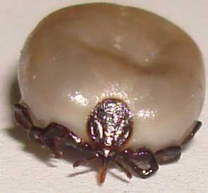
Babesiosis-Transmission
It is tick (hard tick) transmitted parasites.
In 1893, Smith and Kilborne first discovered that transmission of Babesia bigemina by the Boophilus annulatus tick.

Slide 8
Genus: Babesia
Transmission :
When Babesia spp. are transmitted through the ovary (egg) for two or more generation of one host female ticks called transovarian transmission. e.g. Babesia bigemina.
When infection persists from one stage to the next stage in 2 or 3 host ticks feeding on different hosts, transmission is said to be transtadial.
Larva Nymph Adult

Slide 9
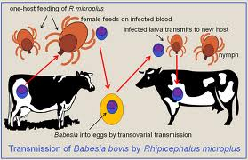
Babesiosis
Transmission :
Image source: Google image

Slide 10
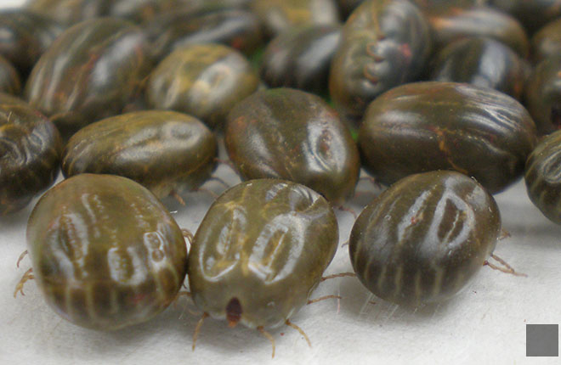
Babesiosis-Transmission
Vector: - transmitted by hard ticks.
Image source: Google image

Slide 11
Life-cycle of Babesia spp.
Sporozoites inoculated in to hosts by the infected tick during blood sucking.
Sporozoites enter inside RBCs and converted into Trophozoites.
Trohozoites multiply by binary fission and form merozoites.
Merozoites form gamonts inside RBCs.
Gamonts come into gut lumen of ticks during blood sucking of infected hosts.

Slide 12
Babesiosis
Pathogenesis :
Depends upon some factors likes -
Species of the Babesia : - B. bovis, B. canis and B. motasi are highly pathogenic than other species of their hosts.
Age of the host – An inverse age resistance is found in Babesia infection i.e. older animals are more susceptible to babesiosis in comparison to younger animals.
Breed of the host, Immune status of host, stress etc.

Slide 13
Babesiosis
Pathogenesis :
Main pathogenesis is intravascular haemolysis which is due to rapid multiplication of Babesia inside the RBCs followed by destruction of the RBCs .
Extravascular haemolysis which mostly occurs in the spleen, due to phagocytosis of infected and non-infected RBCs by the activated macrophage.

Slide 14
Babesiosis
Pathogenesis :
Intra and extravascular haemolysis may cause haemoglobinuria, haemoglobinaemia, bilirubinuria and anaemia with further consequences of tissue hypoxia, metabolic acidosis, hyperkalaemia, hypovolaemic shock and development of multiple organs dysfunction leading to death of the infected host.

Slide 15
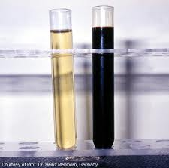
Babesiosis
Symptoms:
High fever (106⁰F)
Coffee colour Urine-Haemoglobinurea. (red water disease)
Hemoglobinemia /Anaemia
Pale mucous membrane (Jaundice)
Pipe-stem diarrhea
Hepatomegaly and splenomegaly
Death in untreated case.
Image source: Google image

Slide 16
Babesosis
Young calves are generally immune due to maternal antibodies received from the mother through the colostrums.
Babesiosis mostly occurs in cattle than buffalo.
Cerebral babesiosis occurs in cattle due to Babesia bovis infection in which blockage of cerebellum capillaries takes place due to clumping of infected RBCs. The resulting symptoms are ataxia, anoxia, paddling of limbs, convulsion and coma.
In Babesia sp. infection, immunity is premunity i.e. the animals recovered from the clinical infection may continue to harbour organisms and remain immune to reinfection.

Slide 17
Diagnosis of Babesiosis
On the basis of cardinal clinical sign ( fever, coffee coloured urine etc.) and necropsy findings (hepatomegaly, splenomegaly , etc)
Microscopic examination of blood smear- During fever Giemsa/Leishman stained blood smear will show Babesia organism mostly in pairs inside the RBCs.
4. By serological test like CFT, IFA, ELISA etc.
5. Molecular test- Polymerase chain reaction (PCR).
Image source: Google image

Slide 18
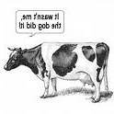
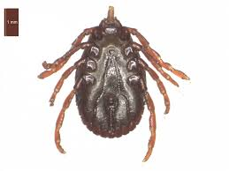
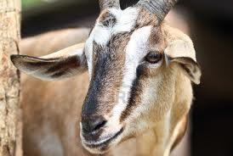
Theilerosis
Arnold Theiler (scientist) found that East coast fever was not the same as redwater but caused by a different protozoan.
A group of tick-borne diseases caused by Theileria spp.

Slide 19
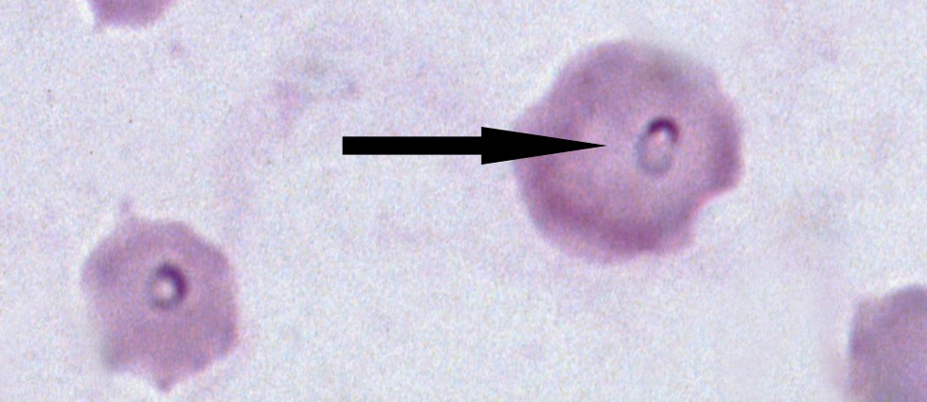
ETIOLOGY: Genus: Theileria
Theileriae are obligate intracellular protozoan parasites phylum: Apicomplexa, order: Piroplasmida, family: Theileriidae, genus :Theileria.
They are most closely related to Babesia, from which they differ by having a developmental stage in leukocytes prior to infection of erythrocytes.
The most pathogenic and economically important are:
T. parva, which causes East Coast fever (ECF),
T. annulata, which causes Tropical theileriosis (TT)
Image source: Google image

Slide 20
Genus: Theileria
Species | Definitive host | Vector | Disease
Theileria annulata | Cattle and buffalo | Hyalomma anatolicum anatolicum | Bovine Tropical theileriosis or Egyptian theileriosis or Mediterranean theileriosis
Theileria parva | Cattle and buffalo | Rhipicephalus appendiculatus | East coast Fever or January fever
Theileria lawrenci | Cattle and buffalo | Rhipicephalus appendiculatus | Corridor disease

Slide 21
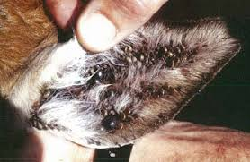
Transmission
Vector:
Theileria species are transmitted by Ixodid ticks.
Image source: Google image

Slide 22
Theileriosis
Transmission :
Transtadial or stage to stage transmission found in Theileria spp.
When parasite enter in one stage of tick (larva or nymph) during feeding on an infected animal. Then, the subsequent stage (nymph or adult) of tick transmit the disease during feeding on a susceptible hosts.
Larva nymph adult
•Theileria parasites are most commonly transmitted when ticks feed on infected animals as nymphs and then on susceptible cattle as adults.
Image source: Google image

Slide 23
Theileriosis
Transmission :
Infective stage is sporozoites which inoculated into final host during blood sucking of infected tick.

Slide 24
Life-cycle of Theileria
Image source: Google image

Slide 25
Theileriosis
Pathogenesis :
T. annulata occurs in India and more pathogenic in case of cross-bred and exotic cattle.
Buffaloes are also infected by this parasite but infection is remain asymptomatic.

Slide 26
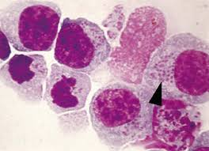
Theileriosis
Pathogenesis :
Macroschoizonts (Koch’s blue bodies) stage initially lead to increased infected lymphoblast population and later lymphocytosis and leucopenia.
Piroplasmic stage responsible for erythrophagocytosis by macrophages resulting to development of anaemia.
Image source: Google image

Slide 27
Theleriosis
Symptoms:
High fever
Enlargement of superficial lymph nodes (prescapular lymph nodes).
Unwillingness to feed and drink
Cessation of rumination, drop milk production, lacrimation, nasal discharge, anaemia etc.
Haemorrhagic diarrhoea and death due to dysponea as a result of oedema in the lungs.

Slide 28
East Coast fever
An acute disease of cattle, is usually characterized by high fever, swelling of the lymph nodes, dyspnea and high mortality.
Caused by Theileria parva, and transmitted by the tick vector Rhipicephalus appendiculatus.
it is a serious problem in east and southern Africa.

Slide 29
Tropical Theileriosis
Caused by Theileria annulata, and transmitted by the tick vector Hyalomma anatolicum anatolicum
The kinetics of infection and the main clinical findings are similar to those produced by T parva, but unlike in East Coast fever, anemia is often a feature of the disease.
Characteristic signs include fever, swollen superficial lymph nodes & Corneal opacity.

Slide 30
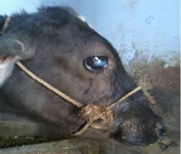
Theileriosis
Symptoms:
Corneal opacity in Theileria annulata infected calf.
Image source: Google image

Slide 31
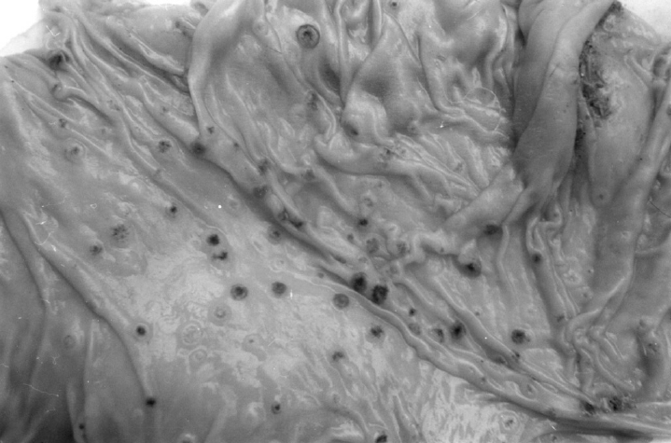
Theileriosis
Post-mortem lesions :-
Necrotic punched ulcers in the abomasums are characteristic post-mortem finding.
Generalized enlargement of lymph nodes, hepatomegaly and splenomegaly.
Necrotic punched ulcers
Image source: Google image

Slide 32
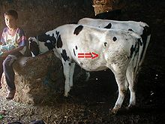
Diagnosis of Theileria
On the basis of cardinal clinical sign ( high fever, Enlargement of superficial lymph nodes etc.)
Image source: Google image

Slide 33
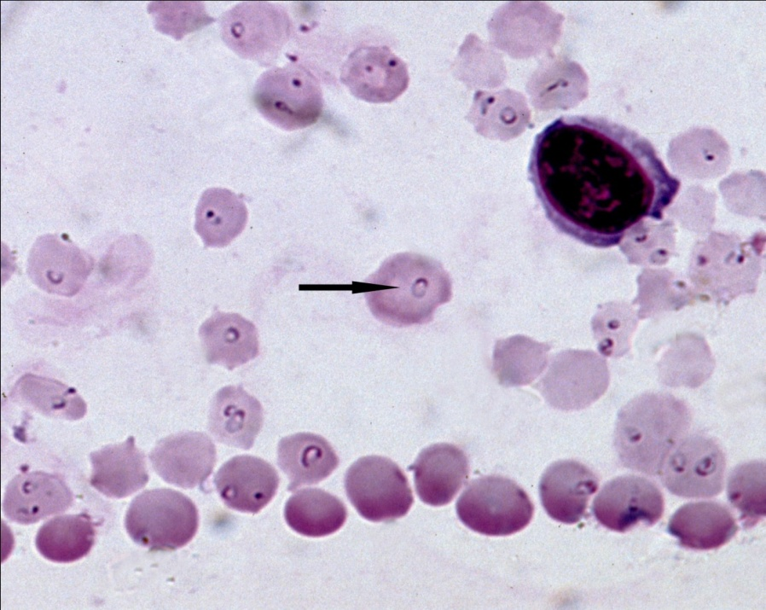
Diagnosis of Theileria
Microscopic examination of blood smear- Peripheral blood sample should be collected from the suspected animals at the of pyrexia. Giemsa/Leishman stained blood smear will show annular (ring shaped) piroplasm stage of Theileria organism mostly single inside the RBCs.
Piroplasm stage of T. annulata
(Ring shaped)
Image source: Google image

Slide 34
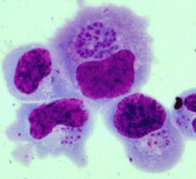
Diagnosis of Theileria
Lymph gland Biopsy smear – Lymph fluid aspirate from the infected lymph glands, then lymph smear prepared and stained with Giemsa stained revealed macroschizonts stage ( Koch’s blue bodies) inside the cytoplasm of Lymphocytes.
Serological test like CFT, IFA, ELISA etc.
Molecular test- Polymerase chain reaction (PCR) etc.
Koch’s blue bodies
Image source: Google image

Slide 35
Theileria equi
• In case of Theileria equi, sporozoites invade the lymphocytes and after development form Theileria-like schizonts in lymphocytes. The merozoites released from these schizonts invade red blood cells (RBCs) and transform into trophozoites which grow and divide into pear-shaped tetrad (‘Maltese cross’) merozoites.
Image source: Google image
Maltese cross

Slide 36
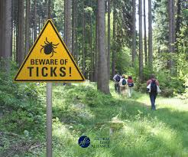
Thanks

