Slide 1
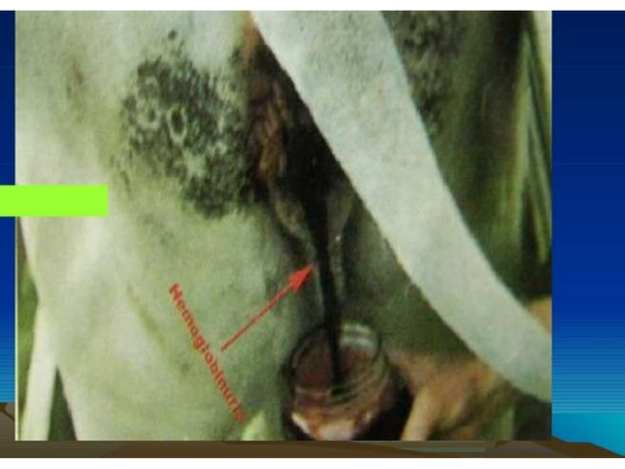
Department of Veterinary Medicine Bihar Veterinary College, Patna – 800 014 (BASU, Patna)
Post Parturient Haemoglobinuria (PPH)
Dr. Ranveer Kumar Sinha Assistant Professor cum Junior Scientist
E-mail: ranveervet@rediffmail.com

Slide 2
Introduction
Synonym:-
Hypophosphataemia, Metabolic or Nutritional Haemoglobinuria
Definition:-
It is a metabolic disease of high producing dairy cows and buffaloes, characterized by intravascular haemolysis, haemoglobinuria and anaemia.

Slide 3
Etiology
Def. of P in diet:-
Soil def. in P
Hay, straws & plant rich in oxalate are naturally deficient in P
Drought, reduces P content in forage
Impaired absorption of P:-
Excess Ca, Al & Fe in diet
Vit. D def.
Improper Ca:P ratio
Increased req. of P:-
Heavy loss through milk
For development of foetus

Slide 4
Etiology
Due to ingestion of some plants:-
Feeding cruciferous plants like cabbage, turnip, kales, rape, rye, alpha alpha e.t.c.
Kale contain thiocyanate, nitrates & sulphoxides
Cabbage contain thiouracil, form Heinz body in RBC.
Forage low in Cu, Se & Mo
Plant rich in saponin, oxalate e.t.c.
Saponin is a surface tension reducing agent that results in increased fragility of RBC & haemolysis

Slide 5
Epidemiology
Maharashtra, Haryana, Punjab, Gujarat & U.P.
Cattle & Buffaloes, Buffaloes are more susceptible than Cattle
More common during 3rd – 6th lactation & 5-10 years of age.
Mostly occur between 2-4 weeks after calving
Advance pregnant Buffaloes are affected
Heavy milker are more prone
Cold weather & Malnutrition predispose the disease

Slide 6
Pathogenesis
The cause of intravascular haemolysis of erythrocytes is "unexplained", but may be attributed to:-
Def. of P results in decrease in RBC glycolysis and ATP synthesis. Subnormal concentration of ATP predispose RBC to altered function & structure, so results in increased fragility & haemolysis
Increased fragility of RBC due to inadequacy of phosphorus due to loss of integrity of phospholipids membrane of erythrocytes.
Red cells which containing these Heinz-bodies are removed by spleen for haemolysis.

Slide 8
Clinical signs
The animal voiding "dark red-brown" to almost "black" urine.
Milk is yellowish or reddish in colour
The animal eat and milk normally for 24 hours after the appearance of haemoglobinuria.
Pale m.m., or even ecteric m.m. in severe cases (due to haemolytic jaundice).
Tachycardia, increased pulse and respiration rates above normal ranges, dyspnoea.
Normal/subnormal/slightly elevated rectal temperature.
The extremities and teats are cold to touch
Passage of pasty faeces with straining
Yellow staining of the conjunctival and vulvar m.m. in severe cases of hypophosphatemia
The disease slowly recovered, as convalescence is prolonged for up to 3-4 weeks (chronic cases) and pica is often observed during this stage
Ketosis commonly occur co-incidently
Death occur due to anaemic anoxia

Slide 9
Clinical Pathology
Serum level of P 0.5-1.5mg/dl(Normal 4-7mg/dl)
Haemoglobin drop to 6-8 gm% (Normal 10-12 gm%)
TEC drop to 2-3 millions/cumm of blood (Normal 5-8 millions /cumm of blood )
PCV drop to 2.5-15 (N= about 35)
Serum bilirubin and BUN raised.
Low Cu level of blood

Slide 10
Diagnosis
(I) History (II) Clinical signs(III) Laboratory diagnosis
Quick response to replacement therapy of P
Enlargement of liver & spleen
Differential diagnosis:-
Babesiosis
Leptospirosis
Bacillary haemoglobinuria(Clostridium haemolyticum)

Slide 17
Treatment
IV administration of 60 g of sodium acid phosphate in 300 ml of distilled water and a similar dose Sc, followed by further Sc injections at 12-hourly intervals on three occasions and similar daily doses by mouth for another 2 to 3 days.
Blood transfusion in severe cases. A minimum of 5 L of blood to a 450 kg cow is recommended. This will usually suffice for up to 48 h by which time an additional transfusion may be necessary if the cow is weak and the mucous membranes pale.
Fluid therapy for both supportive therapy and to minimize the danger of haemoglobinuric nephrosis
Oral dosing with bone meal (120 g twice daily) or dicalcium phosphate or a suitable source of Ca & P daily for 5 days is recommended
Haematinic like Feritas inj.
Tonophosphan 10-15 ml I/V or I/M for 4-5 days
Ascorbic acid(Vit. C) @15-20 mg/kg I/V daily for 3-4 days
Liver extract with B complex

Slide 18
Prevention & Control
Mineral mixture @30-40gm/animal/day
Preparation containing Ca, P & Vit. D
Protect recently calved & advance pregnant animals from cold stress

