Slide 1


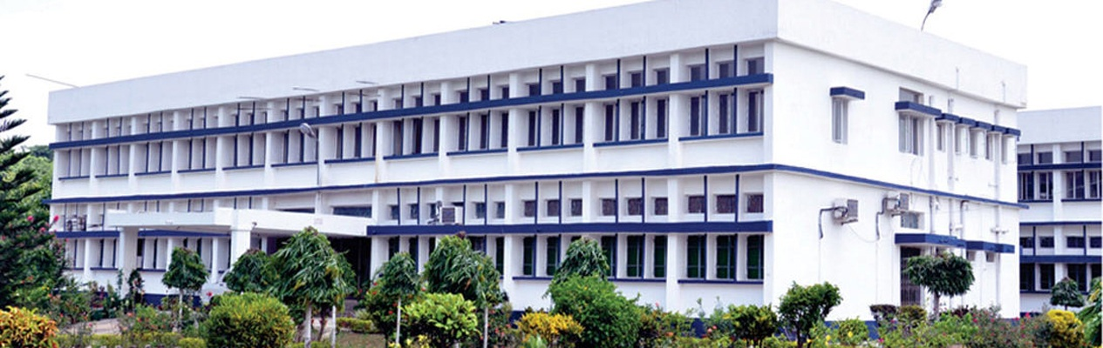
BIOCHEMISTY
Course No.-DTC-111, Credit Hours – 2 (1+1)
PROTEIN STRUCTURE
BINITA RANI
ASSOCIATE PROFESSOR (DAIRY CHEMISTRY)
FACULTY OF DAIRY TECHNOLOGY
S.G.I.D.T., BVC CAMPUS,
P.O.- BVC, DIST.-PATNA-800014

Slide 3
Protein - linear sequence of amino acids linked by peptide bonds.
• Peptide bond - covalent bond - α-amino group of one amino acid and the α-carboxyl group of another.
dipeptide - two amino acids
• oligopeptide - long, unbranched chain of amino acids (upto 25 amino acid residues)
• polypeptide - peptide chain >25 amino acids residues
Way of writing: free α-carboxyl group (C-terminal) on the right and free α-amino (N-terminal) on the left and a hyphen between amino acids => indicate peptide bonds.
tetrapeptide +H3N-serine- tyrosine- phenylalanine-leucine-COO-
  Ser-Tyr-Phe-Leu
  S-Y-F-L

Slide 4
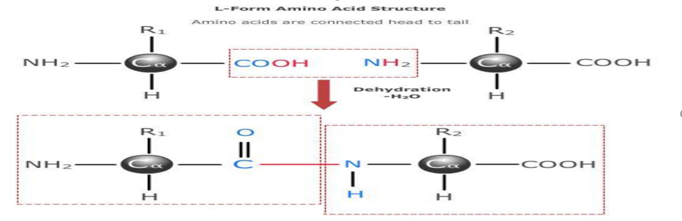
Formation of peptide bond by dehydration

Slide 5
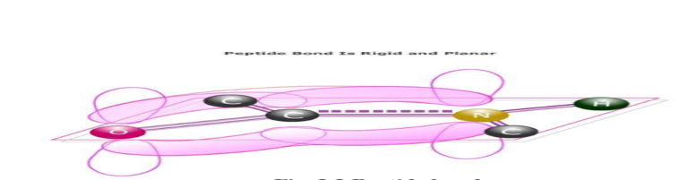
Peptide Bond
C-N bond length < normal C-N single bond and >C=O bond > normal >C=O bond.
  The peptide bond is relatively rigid and planner
  Free rotation takes place => about Cα-N and Cα-C bonds, permitting adjacent units to be at different angles.
H of the amino group is nearly always Trans to O of carbonyl group, rather than cis
Peptide Bond

Slide 6
Structure of proteins
❖ Proteins are polymers of amino acids and made up of one or more polypeptide chains .
The number and sequence of these amino acids in the protein are different in different proteins.
❖ Every protein in its native state has a unique three dimensional structure , referred to as its conformation.
❖The function of a protein arises from its conformation.
❖Protein structure can be classified into four levels of organization.

Slide 8
Four levels of structural organization of proteins
1.Primary structure: is determined by the number and sequence of amino acids in the protein.
2.Secondary Structures: is the conformation of polypeptide chain formed by twisting or folding . It occurs when amino acids are linked by hydrogen bonds to form -helix and -sheets .
3.Tertiary Structure: is the three dimensional arrangement of protein structure. It is formed when alpha-helices and beta-sheets are held together by weak interactions.
4.Quaternary structure: occurs in protein consisting of more than one polypeptide chain where certain polypeptides aggregate to form one functional protein.

Slide 9
Four orders of protein Structure
←Primarystructure is determined by the sequence of amino acids.
←Secondary Structures: It occur when amino acids are linked by hydrogen bonds to form α-helix and β-sheets .
↑Tertiary Structure: is the three-dimensional arrangement of protein structure.
↑Quaternary structure: occurs in protein consisting of more than one polypeptide chain where certain polypeptides aggregate to form one functional protein.

Slide 10
Protein Structure
Peptide chain forms a specific shape (conformation).
Conformation - three dimensional arrangement of atoms <= determined by the amino acid sequence.
Structure : Four levels - primary, secondary, tertiary and quaternary.
Primary structure
linear sequence of a a joined by peptide bonds.
Include disulfide bonds b/w cysteine residues => Formed by the oxidation of SH groups on cysteine residues => results in cystine residues
Disulfide bonds are => present in extracellular proteins
Secondary structure
Regular folding of regions of the polypeptide chain. Types => α-helix and β- Pleated sheet

Slide 11
Primary structure of protein

Slide 12
Primary and Secondary structure of Human Insulin

Slide 13
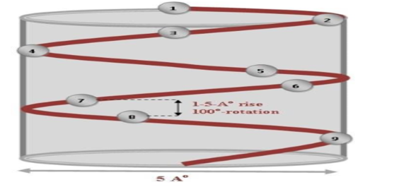
α-helix - regular helical conformation - in a rod shape.
carbonyl oxygen is hydrogen bonded - to H on the amino group of fourth amino acid
3.6 amino acids per turn of the helix
cover a distance of 0.54 nm and
each a a residue represents => 0.15 nm advance along helix axis.
side chain => positioned => outside of the cylindrical helix.
Pro is rarely found in α-helical regions - it can’t form the correct pattern of H-bonds - due to lack of a H atom on its N atom => Pro found at end of an α-helix - alters the direction of polypeptide chain and terminates helix .

Slide 14
Secondary structure of Protein with α-helix

Slide 15
β-pleated sheet
H-bonds form between the peptide bonds either
  in different polypeptide chains or
  in different sections of the same polypeptide chain.
Planarity of the peptide bond => directs polypeptide => pleated with the side chains (aa) protruding above and below the sheet.
Adjacent polypeptide chains in β-pleated sheet can be either
  parallel or
  antiparallel depending on directions
  fully extended, with a distance of 0.35nm from Cα atom to next.
  Sheets => slightly curved and,
  if several polypeptides are involved, the sheet can form a β-barrel.
Multiple β-pleated sheets => give strength and rigidity in structural proteins,
  e.g., silk fibroin => consists of antiparallel β-pleated sheet stacks

Slide 16
Parallel and anti-parallel beta-pleated sheet
Parallel beta-pleated sheet :same direction of N & C-terminal ends of peptide/Two polypeptide chains run in the same directions (parallel).
Anti-parallelbeta-pleated sheet: Opposite direction of N & C-terminal ends peptide/Two polypeptide chains run in the opposite directions (antiparallel).

Slide 17
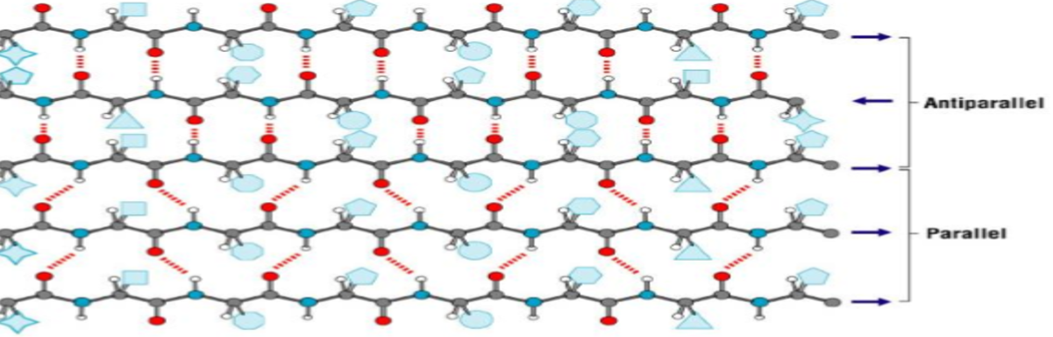
Secondary structure of Protein with β- sheet

Slide 18
Comparison of Alpha-helix and Beta-pleated sheet: secondary structures of proteins
Coiled rod like
Fully extended sheet like
hydrogen bonds are Parallel to polypeptide backbone
hydrogen bonds are Perpendicular to polypeptide backbone
Axial distance between amino acids 1. 5 A
Axial distance between amino acids 3. 5 A
One constituent polypeptide chain

Slide 19
Tertiary structure
Spatial arrangement of amino acids - far apart in linear sequence as well as residues - adjacent.
“Tertiary structure” - three dimensional conformation of a polypeptide.
  Indicates => in 3D space, how secondary structural features assemble => form domains and how these domains relate spatially to one another.
domain - a section of protein structure sufficient to perform a particular chemical or physical task -- binding of a substrate or other ligand.
  eg., myoglobin, a globular protein, polypeptide chain folds spontaneously so that
  majority of its polar , charged side chains are on the surface, and
  majority of its hydrophobic side chains are buried in the interior
Once folded , the 3D, biologically active (native) conformation is maintained by
  hydrophobic interactions,
  hydrogen bonding,
  electrostatic forces (including salt bridges, Vander Waals interactions), and
  covalent disulfide bonds.

Slide 20
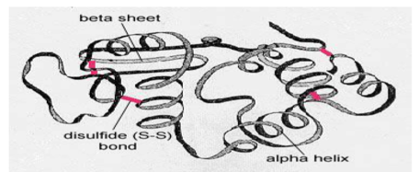
Tertiary structure of Protein

Slide 21
Quaternary structure
> one polypeptide chains
  such as haemoglobin => quaternary / tetrahedral structure.
spatial arrangement of the polypeptide subunits and
  the nature of the interactions between them.
These interactions may be covalent links or
  noncovalent interactions

Slide 22
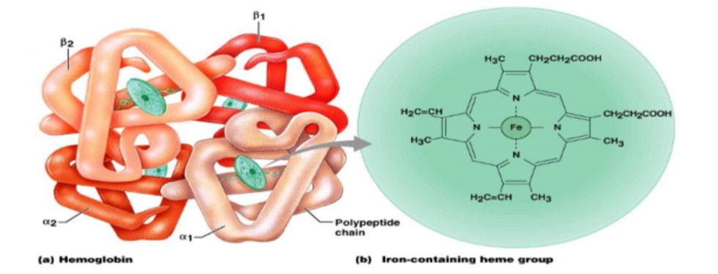
Quaternary structure of Protein

Slide 23
Haemoglobin has 4 Polypeptides chains (tetramer) associated by non-covalent bonds :
2 Alpha chains + 2 Beta chains
It possesses Quaternary structure
Each chain has one heme group and so one Fe2+ion

Slide 24
Structural Hierarchy of proteins
←Secondary structure
(bends /twist in walls)
↑ Aminoacids (Bricks )
↑ Primary structure (walls)
Four orders of protein structure:
Bricks
Wall
Rooms
Building
↑ Tertiary structure (self – contained room)
↑Quaternary structure(building with similar/dissimilar rooms

Slide 25
THANKS

