Slide 1
Concept of hepatic lobules and circulatory system

Slide 2
There are three concepts of hepatic lobule
1.Classical hepatic lobule
2.Portal lobule
3.Liver acinus
Classical hepatic lobule
It is the structural unit of liver which appears hexagonal in outline
It presents a central vein from which hepatic column radiate out through periphery
The columns are separated by sinusoids
Concept of hepatic lobules

Slide 3
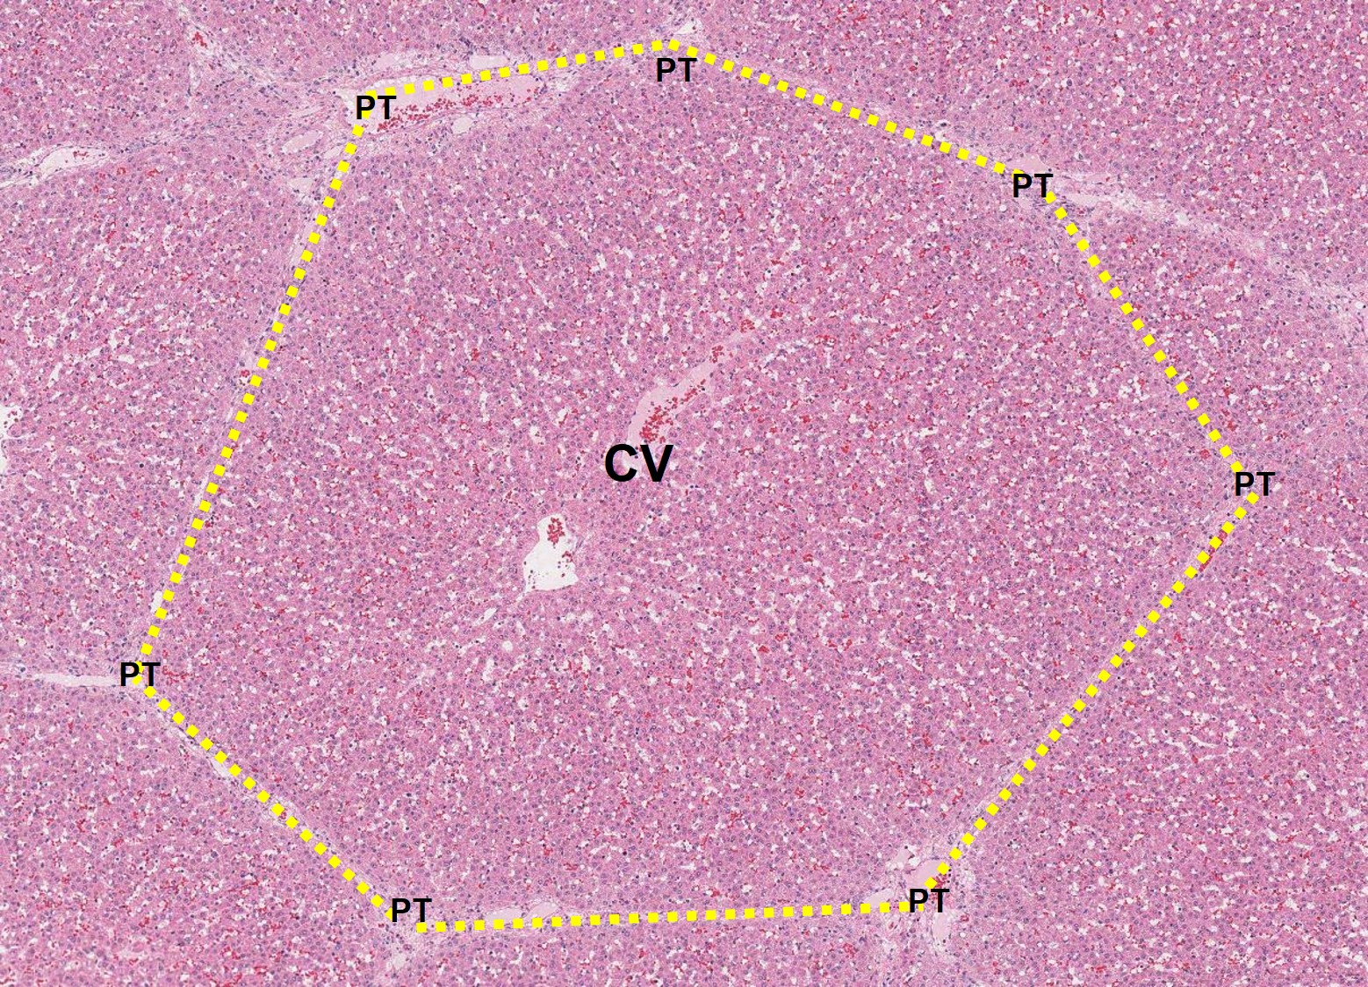
Classical hepatic lobule

Slide 4
The portal lobule is roughly triangular in outline having three central vein at their angle and are associated with secretion of bile
This is referred to as physiological unit of liver
Liver acinus
The area between two adjacent central vein covering the interlobular area containing blood vessels is designated as liver acinus
On each side of interlobular partition the acini is divided into three zones
Zone one is formed by the cells closer to blood vessels
Portal lobule

Slide 5
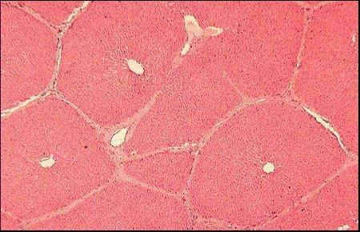
Portal lobule

Slide 6
Zone three is formed by cells closer to central vein and these cells receive very less nutrition and are prone to maximum damage caused by toxin
Zone two is formed by cells between zone one and zone three and these cells moderately get nutrition and are less prone to damage caused by toxin than zone three
This concept is referred to as pathological unit of liver
These cells are the first to get nutrition and are first to regenerate following damage by toxin

Slide 7
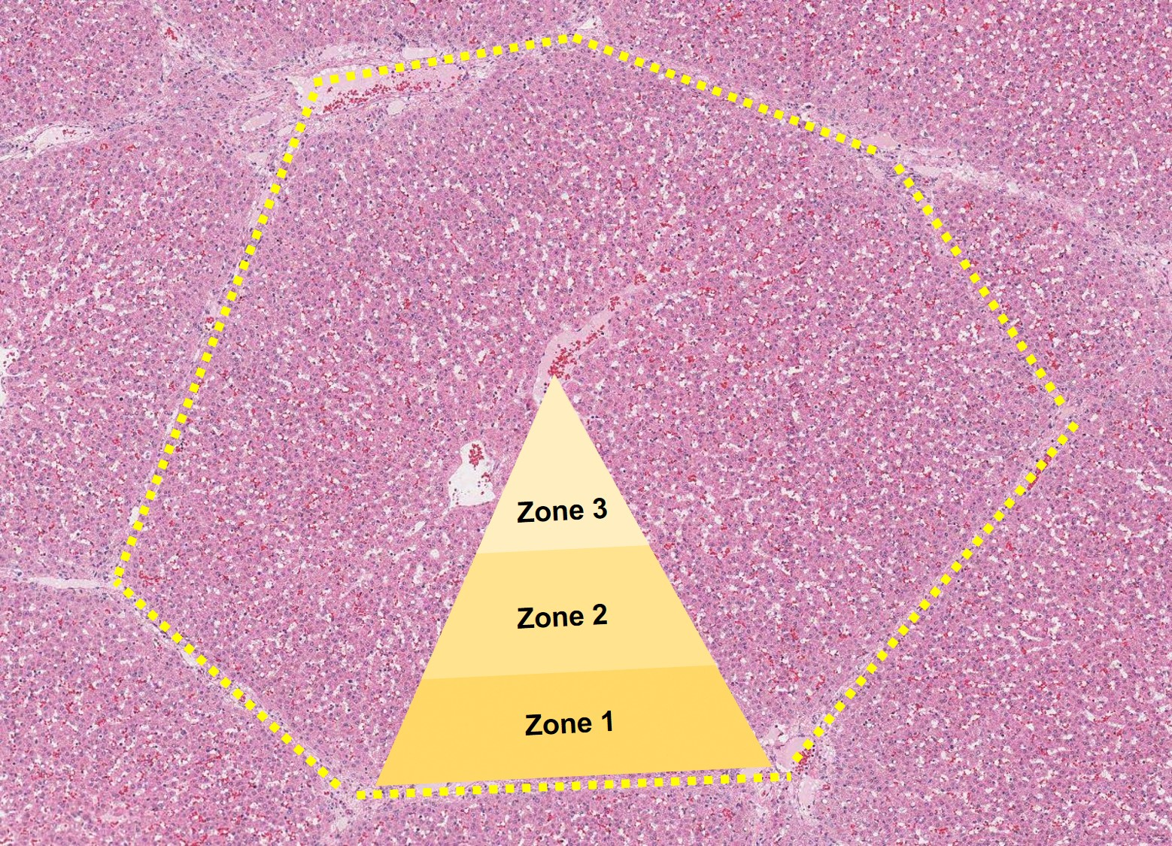
Hepatic acini

Slide 8
General outline about arteries,veins,lymphatics and heart
The inner lining is made up of simple squamous epithelium called endothelium
The basement membrane plus endothelium is known as tunica intima
The middle layer is known as tunica media and is muscular in nature and the thickness depends upon the vessels and its location
The tunica adventitia is outer layer and made up of connective tissue
The arteries which are elastic like pulmonary artery, aorta the tunica intima consist of elastic tissues
The tunica media consists of smooth muscles ,collagen fibers and elastic tissues
Circulatory system

Slide 9
In muscular arteries like femoral artery, radial artery the tunica intima and tunica media are separated by an elastic sheet called internal elastic lamina
The tunica media and tunica adventitia are seperated by elastic sheet called external elastic lamina
The tunica adventitia is thicker than tunica media
The capillaries are the smallest vessels and their endothelium rest over the basement membrane and occasional consist of pericytes
The diameter of a capillary is similar to the diameter of RBC
The vasavasorum is situated in outer layer of tunica media and tunica adventitia

Slide 10
The venules consist of tunica intima with no elastic component, tunica media with one or two layer of smooth muscle and tunica adventitia fused with the surrounding tissue
The arterioles have similar structure like that of arteries but the tunica media consists of one or two layer of smooth muscle
The veins have similar structure to that of artery but the elastic and muscular component are less prominent

Slide 11
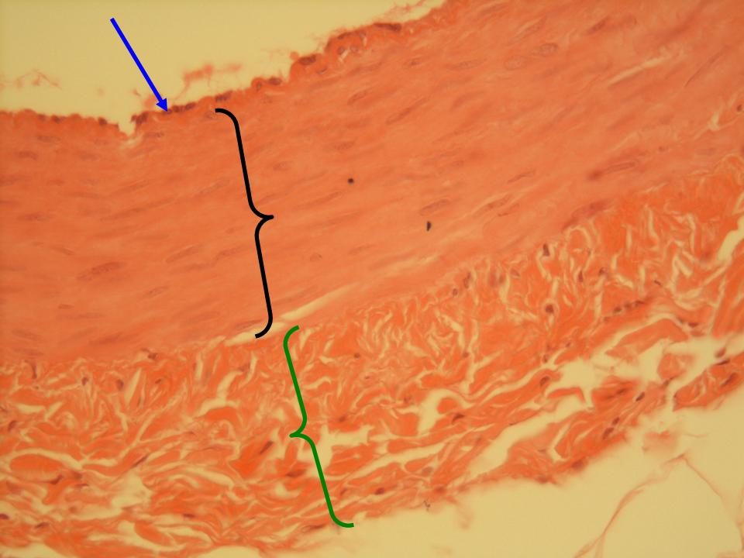
Three layers of a blood vessel

Slide 12
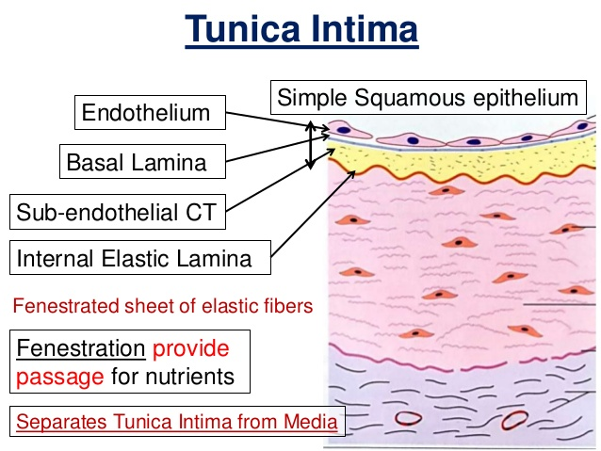
Structure of a muscular artery

Slide 13
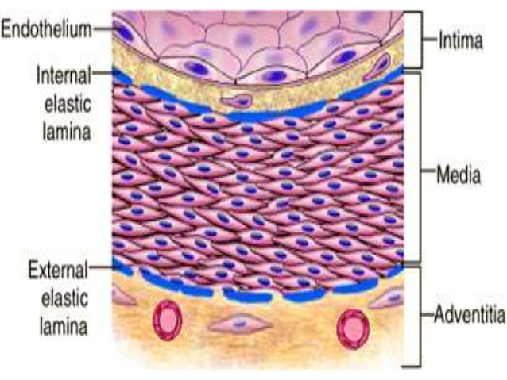
Cross section of a muscular artery

Slide 14
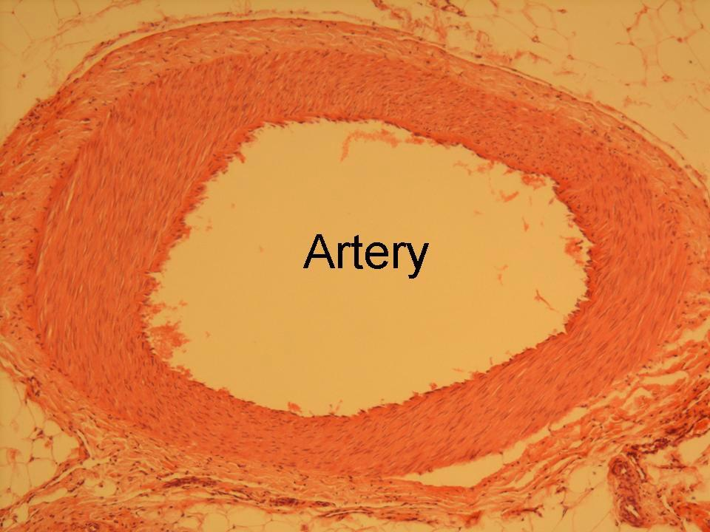
Cross section of an artery

Slide 15
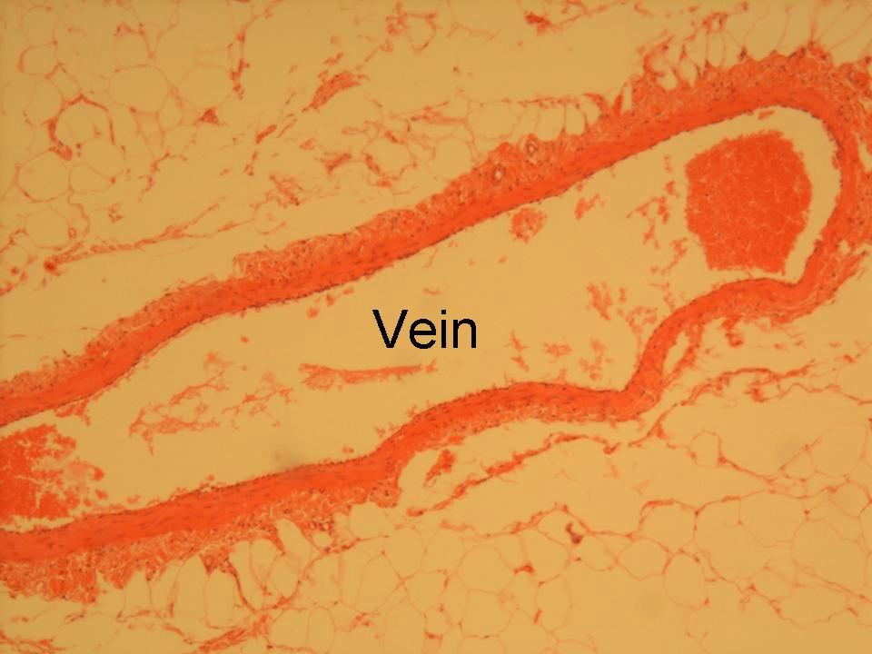
Cross section of a vein

Slide 16
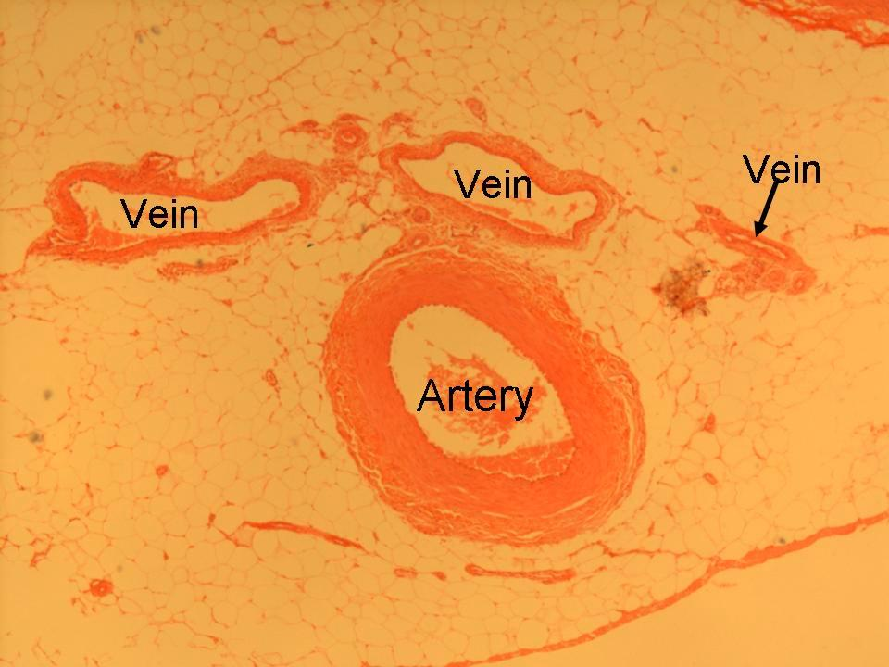
Cross section of an artery and a vein

