Slide 1
Eclampsia
Sonam Bhatt
Assistant Professor
Veterinary Medicine
BVC, Patna

Slide 2
Puerperal hypocalcemia
Periparturient hypocalcemia
Puerperal tetany

Slide 3
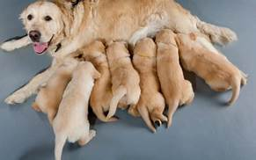
Acute, life-threatening condition that usually occurs 2-4 weeks after whelping
Small bitches with large litters are most often affected

Slide 4
PATHOPHYSIOLOGY
Involved in release of acetylcholine during neuromuscular transmission
muscle contraction & stabilizes nerve cell membrane by decreasing permeability to Na
During hypocalcaemia nervous system becomes more excitable due increases neuronal permeability
Then nerve fibres discharges spontaneously initiating impulses to skeletal muscles where they elicit tetanic contractions

Slide 5
CLINICAL SIGNS
Panting and restlessness
Tremors, twitching, tetany, muscle spasms, & gait changes (stiffness and ataxia) result from increased neuromuscular excitability
Hyperthermia may occur in severe cases

Slide 6
DIAGNOSIS
History
Clinical signs
Estimation of serum calcium level:- Serum calcium concentration <7 mg/dL

Slide 7
TREATMENT
Slow IV administration of 10% calcium gluconate @ 0.5-1.5 mL/kg slow IV
This usually results in rapid clinical improvement within 15 min
During administration of calcium, heart rate should be carefully monitored for bradycardia or arrhythmia by auscultation

