Slide 1
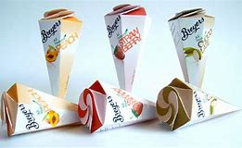
Packaging of Ice Cream
Department : Dairy Technology
Course Title : Ice Cream & Frozen Desserts
Course No. : DTT -222
Course Teacher: Bipin Kumar Singh

Slide 2
Packaging of Ice Cream
When ice cream is drawn from the freezer, it is put into containers that give it the desired form and size for convenient handling during the hardening, storage, shipping and marketing processes.

Slide 3
Factors that Need to be Considered In Selection of Ice Cream Container
Cost should be as minimum as possible
Should be protective against moisture loss,
Losses due to Temperature and contamination are as minimum as possible.
Ease to handling and disposal (i.e. ease of opening and reclosure, if required)
Should not effect upon the quality of ice cream
Appearance should be neat.
Package should provide all information as batch, date of manufacture and expire..
Storage problem.
Point of consumption in relation to the location of the factory.
Size of unit desired.
Minimum damage during transportation.

Slide 4
Types of Packaging
Bulk containers
Fiber board containers
Metals containers
Plastic (Polyethylene) containers
Wrappers
Plastic (polystyrene) or wax-coated paperboard
Steel cans

Slide 5
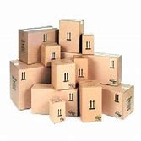
Fiber board containers
Corrugated fiberboard is a material consisting of a fluted corrugated sheet and one or two flat linerboards. It is made on "flute lamination machines" or "corrugators" and is used for making cardboard boxes. The corrugated medium sheet and the linerboard(s) are made of kraft containerboard, a paperboard material usually over 0.01 inches (0.25 mm) thick. Corrugated fiberboard is sometimes called corrugated cardboard, although cardboard might be any heavy paper-pulp based board.
Fiberboard Boxes, Cartons and Containers Paperboard is a paper-like material, usually over ten "mills" (0.010 inch) in thickness. Some types of paperboard (corrugating medium and linerboard) are used in the construction of corrugated fiberboard. Other types of paperboard are used in the manufacture of cartons, set-up boxes, partitions and other products.

Slide 6
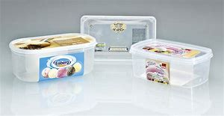
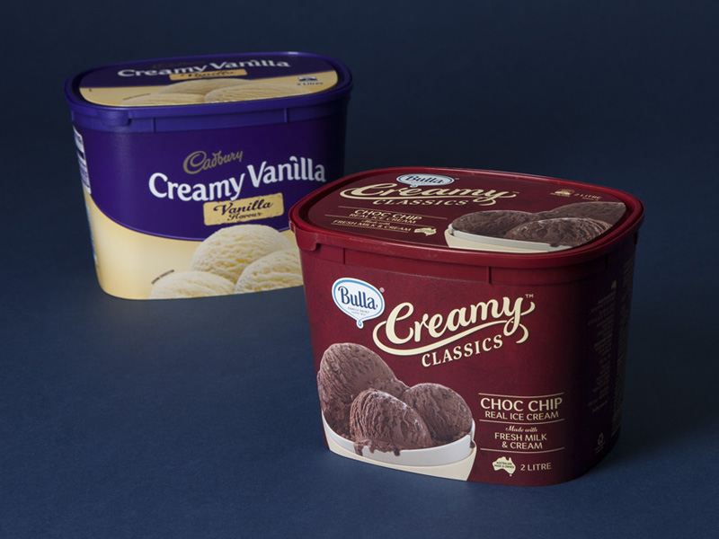
Plastic (Polyethylene) containers
Hi-density Polyethylene, or HDPE, is a popular choice for both containers and lids. It is flexible, strong and impact resistant, and can be formulated to withstand cold temperatures very well. It is lightweight, which can be a consideration when shipping costs are considered.
Plastic tubs are available for packaging ice cream, ranging in size from a few ounces for single serve portions, to several gallons for use in ice cream shops. These tubs are dimensionally stable, and work well with automated filling equipment. They can be printed in any number of ways: during the molding process; as they are going down the assembly line at the container manufacturer’s facility; or at the ice cream manufacturer’s facility, either with direct printing, or with a label applied during filling.

Slide 7
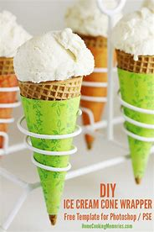
Wrappers
Step-by-step instructions to dress up any ice cream cone with wrappers
Print out the template of your choice. Standard printer paper should do the trick. Just be sure to print the proper template for your ice cream cone. There are different dimensions for sugar cones versus cake cones.
Carefully cut your wrapper out of the desired template. guidelines.
Wrap the sleeve around the ice cream cone.
Use double-sided tape or a dot of glue to adhere the edges.
Scoop your ice cream, add your toppings and enjoy!

Slide 8
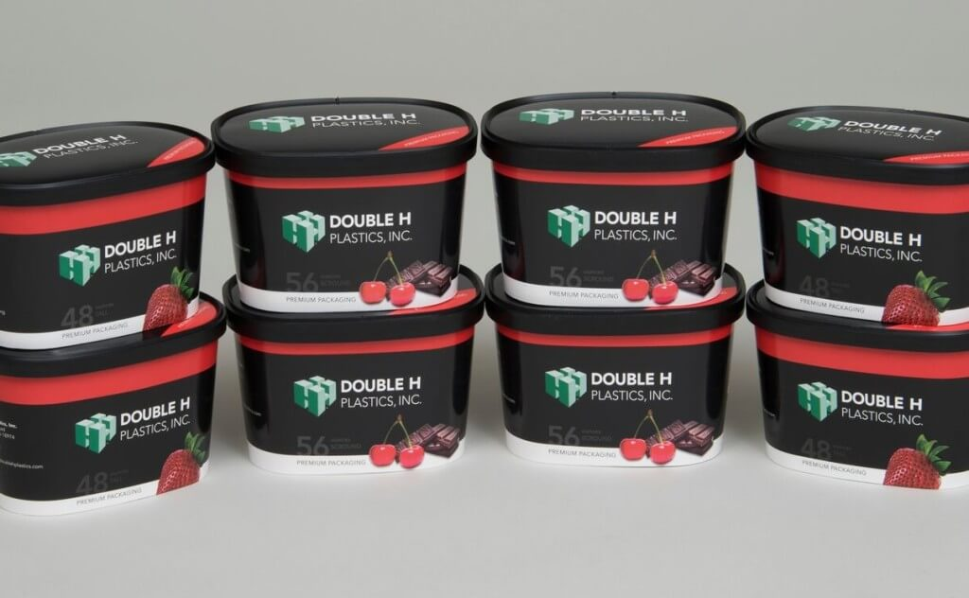
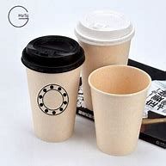
Plastic (polystyrene) or wax-coated paperboard
These include plastic-coated paperboard cups for hot beverages (both with and without a corrugated sleeve), plastic-coated and wax-coated cups for cold beverages, and fluted paperboard clamshells (p. ES-16; pp. 2-60 through 2-63). ¾ The study also compared 9-inch high-grade foam polystyrene plates with 9-inch high-grade molded pulp plates .
A wide variety of wax coated paperboard options are available to you, such as mechanical pulp, chemical pulp. You can also choose from specialty paper wax coated paperboard, as well as from offset printing wax coated paperboard, and whether wax coated paperboard is anti-curl, waterproof, or moisture proof.

Slide 9
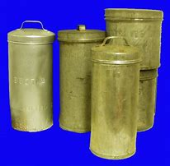
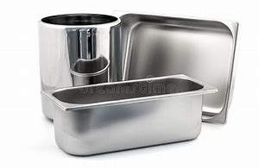
Metals containers
A metal is a material that, when freshly prepared, polished, or fractured, shows a lustrous appearance, and conducts electricity and heat relatively well. Metals are typically malleable or ductile. A metal may be a chemical element such as iron; an alloy such as stainless steel; or a molecular compound such as polymeric sulfur nitride.
Ice cream will melt faster in metal container because it is
a heat conductor so it gives heat away and absorbs heat from
surroundings.

Slide 10
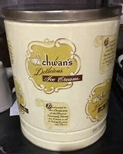
Steel cans
Stainless Steel Ice Cream Cans are an excellent alternative to plastic pails or cardboard tubs or boxes.
Requirement of steel cans:
a. 304 Stainless Steel
b. No welds or seams to trap food
c. Reusable and recyclable
d. Empty cans nest together for space-efficient stacking

Slide 11
Composite combinations for ice cream packaging
There is an ample choice of composites for ice cream packaging. There will be multiple factors taken into account to select the best combination that suits both packaging needs and vision. Each packaging solution is created individually, some schemes are Composite combinations for ice cream packaging demonstrated below.

Slide 12
Composite combinations for ice cream packaging
SCHEME 1. Packaging based on transparent and metallized polypropylene films offers high protection for the chocolate coating – the thin layer of aluminium foil provides good insulation from the environment, greatly improving shelf life and design options.
oriented transparent polypropylene film (good barrier properties against water vapours, high transparency)
oriented metallized polypropylene foil (good protection against moisture, reflects sunlight)

Slide 13
Composite combinations for ice cream packaging
SCHEME 2. Pearl-white polypropylene film is ideal for ice cream packaging: it has a porous foamed structure, which is light and looks extremely white, allowing for unrestricted design concepts.
Pearl-white polypropylene film (good water condensate blocking properties, high level of whiteness)

Slide 14
Composite combinations for ice cream packaging
SCHEME 3. This is a single-layer laminate. Oriented transparent polypropylene film is used to emphasize the attractiveness of the product.
oriented transparent polypropylene film (good barrier properties against water vapours, high transparency)

