Slide 1
Parafilariosis, Theilaziosis and Kumri
Dr. Pallav Shekhar
Asstt. Professor
Veterinary Medicine
UNIT-6

Slide 2
Parafilariasis
Bleeding point
Summer Bleeding
Haemorrhagic dermatitis

Slide 3
Etiology and Host
Parafilaria bovicola in Cattle and Buffalo
P. papillomatosis in Horses

Slide 4
L/C
Indirect L/C and fly act as I/H

Slide 5
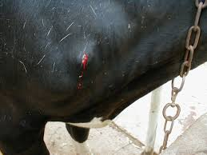
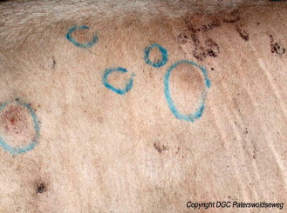
Clinical signs

Slide 6
Clinical signs
It produces nodules on the skin and there is rupturing of the skin and bleeding from the site.
The only external signs of infection in cattle are focal cutaneous hemorrhages (“bleeding spots”) that may ooze for some hours before clotting and drying in the matted hair of the coat.
Bleeding spots are induced by the female worm, which causes the formation of a small nodule, perforates the skin, and oviposits in the blood dripping from the central wound.

Slide 7
Diagnosis
Clinical Signs
Differential diagnosis of thorns, wire, ticks, or biting insects.
For differentiation, either fresh or dried blood should be mixed with water in a test tube and centrifuged.
The characteristic eggs are found on microscopic examination of the sediment.

Slide 8
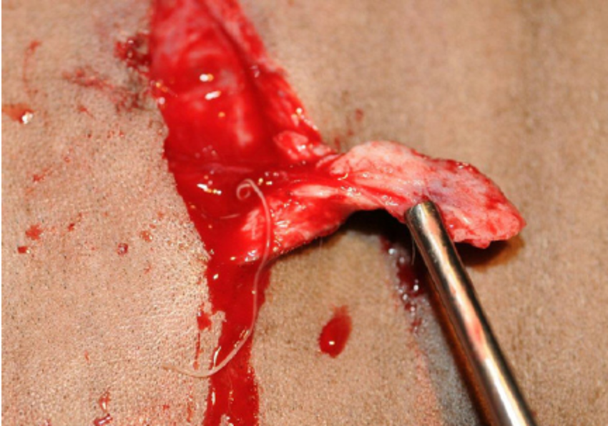
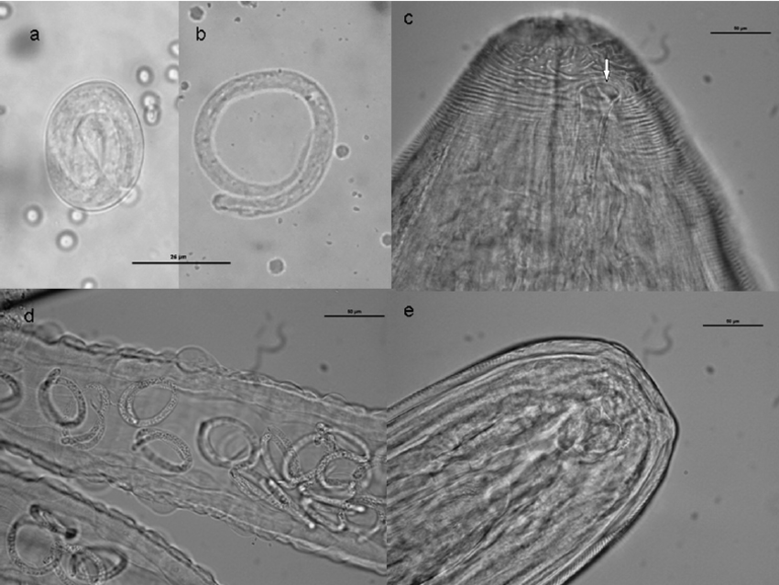

Slide 9
Treatment
Ivermectin 0.2mg/kg S/C
Levamisole -7.5mg/kg for 5 days
Nitroxynl – 20 mg /kg repeated after 3 days

Slide 10
Theilaziasis ( Eye Worm)
Etiology
Theilazia rhodesii
T. skrjabini
T. gulosa
T. leesei

Slide 11
Worms are usually 2cm long.
L/C indirect and musca or face fly act as I/H.
It is clinically characterized by excessive lacrimation, conjunctivitis, keratitis, corneal ulceration and abscess formation.
More common in cattle than horses

Slide 12
Treatment
Ivermectin.
Manual removal of the worms under the control of local anesthetic.
Levamizole @ 5mg /kg b.wt orally or 1:2000 aq. Soln of iodine or 3% soln. of Piperazine may be administered in nasolacrimally.

Slide 13
Kumri or Lumbar Paralysis Cerebrospinal nematodiasis
Etiology
Setaria spp. ( S cervi, S.equina, S. digitata, S. labiato-papillosa)
Parasite is 5-10cm long thread like

Slide 14
L/C indirect
I/H- Mosquito
Found in peritoneal cavity of most domestic animals

Slide 15
Pathogenesis
Adult female
Motile embryo or microfilaria
Circulate in peripheral blood of infected animals
Ingested by blood sucking mosquito
Infective larvae develops
Mosquito found on another host
(unnatural)
Man, goat, sheep, horses
Paralysis of hind legs

Slide 16
Treatment
Not effective
Ivermectin may be tried

