Slide 1
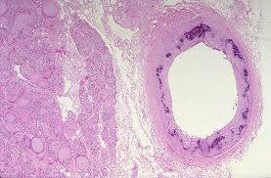
PATHOLOGICAL CALCIFICATION
KAUSHAL KUMAR
Assistant Professor & Head
Department of Veterinary Pathology
Bihar Veterinary College
Bihar Animal Sciences University, Patna

Slide 2
Pathological Calcification
It is a lesion in which calcium salts, usually in the form of calcium phosphate, are deposited abnormally in soft tissues.
There are two forms:
Dystrophic Calcification
Metastatic Calcification

Slide 3
Types of Pathological Calcification
DYSTROPHIC calcification
A localized lesion occurs in dying and dead tissues
With NORMAL serum calcium level & Ca Metabolism
METASTATIC calcification
Deposition of Ca salts in NORMAL tissues
Always reflects some derangement in Ca Matabolism & hypercalcemia

Slide 4
Types of Pathological Calcification
DYSTROPHIC calcification
A localized lesion occurs in dying and dead tissues
With NORMAL serum calcium level & Ca Metabolism
METASTATIC calcification
Deposition of Ca salts in NORMAL tissues
Always reflects some derangement in Ca Matabolism & hypercalcemia

Slide 5
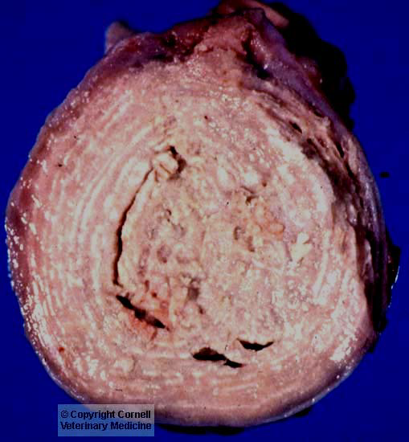
Dystrophic Calcification
Injured and dying cells are not able to maintain normal calcium homeostasis due to increased intracellular calcium levels.
Once calcification is initiated deposition of calcium continues.
Can occur with any type of tissue necrosis
Grossly visible calcification include heart and skeletal muscle and granulomas.
Lymph node from a goat with caseous lymphadenitis. The light zones in this photo are areas of dystrophic calcification.

Slide 6
Sites of Dystrophic Calcification
Necrotic Tissue
Caseous necrosis –TB, Caseous Lymphadenitis
Fat necrosis
Liqifactive necrosis (less Common)
Haematoma in vicinity of bone
Thrombus-phlabolith
Infarcts
Cyst-hydatid, cysticercosis
Heart valves (Subacute Infective Endocarditis)
Tumour-breast cancer- tumoral calcinosis.

Slide 7
Metastatic Calcification
When the homeostatic capacity of cells and tissues exceeds
Elevated extracellular levels of calcium (hypercalcemia)
Typically a generalized phenomenon

Slide 8
Metastatic Calcification
Hypercalcemia sufficient to cause metastatic
calcification mainly occurs in three situations
Hyperparathyroidism
Hypervitaminosis D
Diseases with extensive destruction of bone.
Notes:
Hypercalcemia sufficient to cause metastatic
calcification mainly occurs in three situations: 1) hyperparathyroidism, 2) hypervitaminosis
D, and 3) diseases with extensive destruction of bone.

Slide 9
Site of Metastatic Calcification
But there are specific tissues that are prone to become mineralized / calcification
Kidneys (nephrocalcinosis)
Lungs (alveolar walls)
Stomach (acid secreting fundal glands)
Blood vessels (internal elastic lamina)
Cornea
Synovium
Notes:
Hypercalcemia sufficient to cause metastatic
calcification mainly occurs in three situations: 1) hyperparathyroidism, 2) hypervitaminosis
D, and 3) diseases with extensive destruction of bone.

Slide 10
Differences
Features | Dystrophic Calcification | Metastatic Calcification
Definition | Deposition of calcium in dead and degenerated tissue | Deposition of calcium salts in normal tissue
Calcium Metabolism | Normal | Deranged
Serum Calcium Level | Normal | Hypercalcemia
Reversibility | Generally Irreversible | Reversible upon correction of metabolic disorder
Causes | Necrosis, infarcts, thrombi, cysts, tumours, old scars & haematoma e.t.c. | Hyperparathyroidism Hypervitaminosis, Prlonged immobilisation
Pathogenesis | Increased binding of phosphates with necrotic and degenerative tissue; which in turn bind to calcium to form Calcium Phosphate precipitate. | Increased precipitates of Cal. phosphate due to hypercalcaemia in lungs, stomach, blood vessels, cornea

Slide 11
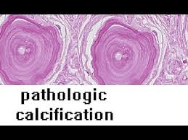
thanksthanka
Thanks

