Slide 1
UNIT-3
‘Zoonotic disease’
(Credit Hours-3+1)

Slide 2
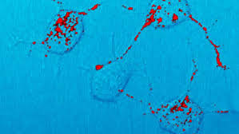
Prions diseases
Transmissible spongiform encephalopathies (TSEs)
Infectious amyloidosis
Unconventional slow virus degenerative encephalopathies

Slide 3
Introduction
Prions diseases/ TSE are a family of:
Rare, Neurological disorder
Effects both humans and Animals
Characterized by:
long incubation periods
Neuronal loss
Failure to induce inflammatory response
Prion diseases are usually rapidly progressive and always fatal

Slide 4
Causative agent
Causative agents of TSEs are believed to be “PRIONs”
Termed: Prusiner (1982)
Dia. 25-50 nm in size
Able to induce abnormal folding of specific normal cellular proteins called prion proteins
Prion proteins: most abundantly in the brain
Abnormal folding leads to brain damage
The prions is resistant to physical (high temp. UV rays) & chemical agents
It is non-immunogenic & highly stable molecule
It produces slow and progressive infection

Slide 5
Identified Prion Diseases
Animal Prion Diseases | Host effected
Bovine Spongiform Encephalopathy (BSE) | Cattle
Chronic Wasting Disease (CWD) | Deer
Scrapie | Sheep and Goats
Transmissible mink encephalopathy | Mink
Feline spongiform encephalopathy | Cat
Ungulate spongiform encephalopathy

Slide 6
Identified Prion Diseases
Human Prion Diseases
Creutzfeldt-Jakob Disease (CJD)
Variant Creutzfeldt-Jakob Disease (vCJD)
Gerstmann-Straussler-Scheinker Syndrome
Fatal Familial Insomnia
Kuru

Slide 7
Bovine Spongiform Encephalopathy (BSE)
Also K/as: Mad Cow Disease
Characterized by a progressive degenerating condition giving rise to spongiform appearance of the brain
Host: A progressive neurological disorder of cattle
Geographical Distribution: United Kingdom
History:
The first case of BSE in a cow: 1985
Officially Diagnosed in: 1986
BSE became a notifiable disease in: June, 1988
Feeding of cattle / sheep offal to other beef cattle was banned : July, 1988
Bovine offal was banned for human consumption in U.K. and Scotland from 1989

Slide 8
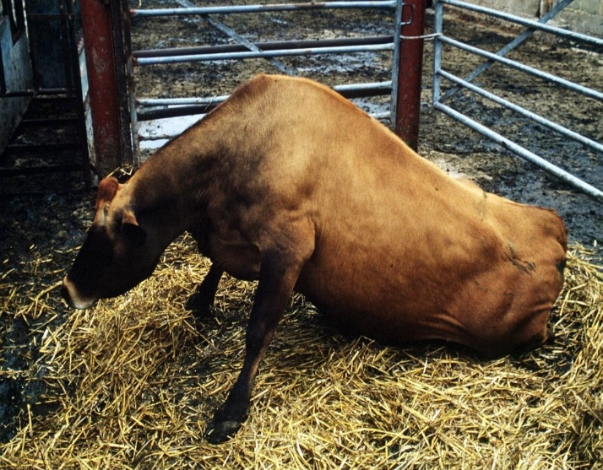
Bovine Spongiform Encephalopathy (BSE)
Symptoms:
Changes in mental state & behavior
Apprehension & excitability
Fixed gaze & humpback
Postural anomalies
Locomotor dysfunction
Ataxia
Tremor
Falling
Transmission: Consumption of beef or beef products

Slide 9
Bovine Spongiform Encephalopathy (BSE)
Diagnosis:
Clinical sign &symptoms
Based on histopathology
Prevention & Control:
Thoroughly cooked beef & beef products before consumption
Issue of animal health certificate from the government veterinary authorities of exporting countries
BSE free certificate: the animals imported from these countries into India
Create public awareness: education about it potential health hazards
Careful handling of animals/ meat: particularly the brain or spinal cord tissues

Slide 10
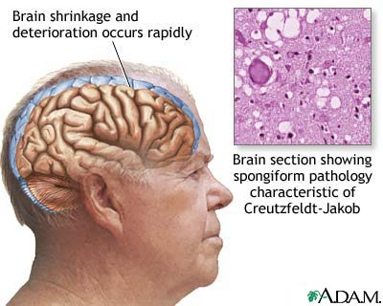
Creutzfeldt-Jakob Disease (CJD)
Subacute spongiform encephalopathy
Rare brain disease: Effects one person per million population/year
Etiology: Classic CJD
Host: Human
Geographical Distribution:
World wide mainly, United States
Higher incidence in cities
Sources of infection:
Ingestion of brain & other tissue of scrapie infected sheep
Disease:
Incubation Period: Infection with this disease leads to death usually within 1 year of onset of illness

Slide 11
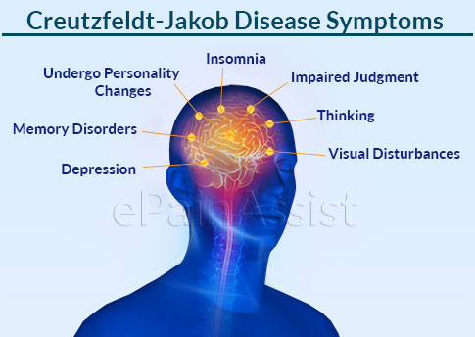
Creutzfeldt-Jakob Disease (CJD)
Symptoms:
Rapid onset of dementia,
a range of neurological symptoms
i.e. walking difficulties
Sudden jerky movements,
Sometimes,
Visual disturbances
Diagnosis:
Clinical sign
Histopathology-CNS
MRI
Treatment: Only supportive treatment
Prevention: Care during the handling of infected material & disinfection
CJD is not transmissible from person-to-person by normal contact

Slide 12
Variant Creutzfeldt-Jakob Disease (vCJD)
Characteristic | Classic CJD | Variant CJD
Median age at death | 68 years | 28 years
Median duration of illness | 4-5 months | 13-14 months
Clinical signs and symptoms | Dementia; early neurologic signs | Prominent psychiatric/behavioral symptoms; painful dyesthesiasis; delayed neurologic signs
Periodic sharp waves on electroencephalogram | Often present | Often absent
“Pulvinar sign” on MRI* | Not reported | Present in >75% of cases
Presence of “florid plaques” on neuropathology | Rare or absent | Present in large numbers
Immunohitochemical analysis of brain tissue | Variable accumulation | Marked accumulation of protease-resistance prion protein
Presence of agent in lymphoid tissue | Not readily detected | Readily detected
Increased glycoform ratio on immunoblot analysis of protease-resistance prion protein | Not reported | Marked accumulation of protease-resistance prion protein

