Slide 1
Introduction To chemotherapy Problems That Arises With The Use Of Antibiotics(Superinfection)
Dr. Rashmi Rekha Kumari
Asstt. Prof. cum Jr. Scientist
Deptt. Of Vety. Pharmacology and Toxicology
B.V.C, BASU,Patna

Slide 2
Superinfection
It refers to appearance of new infection as a result of antimicrobial therapy.

Slide 4
It is commonly associated with the use of broad/extended spectrum antibiotics, such as tetracyclines, chloramphenicol, ampicillins
Sites involved in superinfection are those that normally harbour commensals, i.e. oropharynx; intestinal, respiratory and genitourinary tract

Slide 5
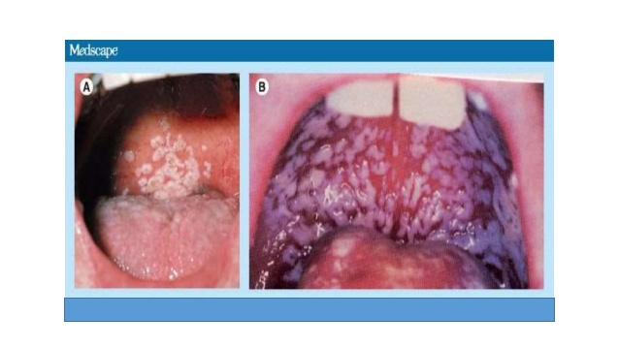
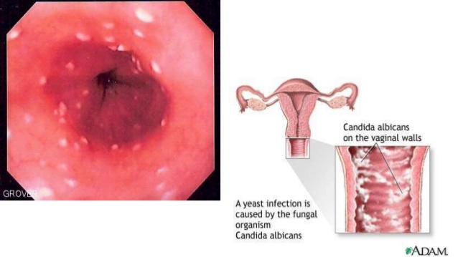
Mucocutaneous candidiasis
Vulvovaginal candidiasis

Slide 6
Condition predisposing to superinfection are
Prolonged corticosteroid therapy
AIDs
Leukaemia
Diabetes, Disseminated lupus erythematosus

Slide 7
Organisms involved
Candida albicans: Yeast
May cause monilial diarrhoea, thrus vulvovaginitis
Treated with Nystatin or clotrimoxazole
Resistant staphylococci:
Causes Enteritis
Treated by cloxacillin or its congener

Slide 8
Organisms involved
Clostridium difficile
Causes pseudomembranous enterocolitis
Metronidazole and vancomycin are drug of choice
Proteus
Urinary tract infection, enteritis
Treated with cephalosporin, Gentamycin.

Slide 9
Preventive measures
Use specific AMA whenever possible
Do not use AMA to treat trivial, self-limiting or untreatable infection
Do not unnecessary prolong antimicrobial therapy.

Slide 10
Nutritional deficiency
Some of the B complex group of vitamins and vitK synthesised by intestinal flora is utilised by man.
Prolonged use of antimicrobials which alter this flora may result in vitamin deficiency.

Slide 11
Masking of an infection
A short course of infection AMA may be sufficient to treat one infection but only briefly suppress another one contacted concurrently.
The other infection will be masked initially, only to manifest later in severe form.
Example: Tuberculosis short course of streptomycin given for trivial respiratory infection.

Slide 12
Thank You

