Slide 1
RANIKHET DISEASE IN POULTRY
Dr. SANJIV KUMAR
ASSTT. PROFESSOR,
DEPTT. OF PATHOLOGY, BVC, PATNA

Slide 2
INTRODUCTION
Newcastle disease is an acute highly contagious rapidly spreading viral disease of domestic poultry and many other bird species.
It is a worldwide problem that presents primarily as a respiratory disease, but depression, nervous manifestations, or diarrhoea may be the predominant clinical form with variable mortality.
Attenuated strain of the Newcastle virus can be used as an anticancer agent.
Zoonotic importance as causes transitory conjunctivitis in humans.

Slide 3
HISTORY
The first outbreak of the disease was recorded in 1926, in Java, Indonesia and in 1927 by Doyle in Newcastle -upon- Tyne , England .
In India , the disease was first recorded at Ranikhet in Kumoan hills (Nainital District, Uttaranchal) by Edward in 1927. Hence the name Ranikhet disease.

Slide 4
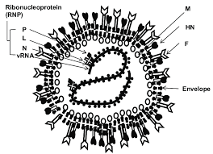
ETIOLOGY
Paramyxovirus type1 (PMV-1 belongs to the genus Avulavirus, family Paramyxoviridae).
It is a negative-sense, single-stranded RNA virus.

Slide 5
PATHOTYPES
Based on the disease produced in chickens, NDVs have been classified into five pathotypes:
o Viscerotropic velogenic: The NDVs cause a highly virulent form of the disease. Haemorrhagic lesions are characteristically present in the intestinal tract.
o Neurotropic velogenic: These NDVs cause high mortality following respiratory and nervous signs.
o Mesogenic: These NDVs cause low mortality following respiratory and some times nervous signs.
o Lentogenic: These respiratory NDVs cause mild or inapparent respiratory infection.
o Asymptamatic: The enteric NDVs cause inapparent enteric infection.

Slide 6
HOST
ND occurs in almost all avian species.
Chickens are the most susceptible.
Waterfowl the least susceptible.
Have zoonotic importance.

Slide 7
EPIDEMIOLOGY
Virulent NDV strains are endemic in poultry in most of Asia, Africa, and some countries of North, Central, and South America.
USA and Canada are free of those strains.

Slide 8
Transmission
Infected birds shed virus in exhaled air, respiratory discharges and feces.
Virus may also be present in eggs laid during clinical disease and in all parts of the carcass during acute virulent infections.
Chickens are readily infected by aerosols and by ingesting contaminated water or food.
In infective faeces, the virus are present in high titre,
Transfer of virus, especially by the movement of people and contaminated equipment is the main method of spread between poultry flocks.

Slide 9
PATHOGENESIS
The NDV genome encodes nucleus capsid protein (NP), fusion proteins (F), phosphoprotein (P), matrix protein (M), hemagglutinin neuraminidase (HN), and large RNA dependent polymerase protein (L).
The matrix proteins are part of a layer below the viral membrane and participate in viral assembly. The hemagglutinin neuraminidase (HN) and fusion (F) glycoproteins form part of the viral external envelope and participate in viral infection.
The cleavage site of the F protein determines the virulence.

Slide 10
In replication, a precursor glycoprotein (F0) is produced, this must be cleaved into F1 and F2 to exhibit virulence and become infectious.
This cleavage which is a part of post-translational modification is facilitated by host cell proteases.
The cleavability of the F0 molecule is linked with the virulence.
It has been studied that the F0 molecules of viruses if virulent and cleaved by host proteases it would damage vital organs of host.
In contrast, F0 molecules in viruses of less virulence leads to restriction in growth of as it has less sensitivity towards host proteases thus it would grow only in particular host types.
At the cleavage site in virulent viruses the multiple basic amino acids are present.

Slide 12
CLINICAL FINDINGS
Clinical manifestations vary from high morbidity and mortality to asymptomatic infections.
The severity of an infection is dependent on the nature of the infecting virus, its virulence and the age, immune status, and susceptibility of the host species.
Onset is rapid, the incubation period for the disease ranges from 4 to 6 days. .
Spread is slower if the fecal-oral route is the primary means of transmission, particularly for caged birds.
Young birds are the most susceptible.

Slide 13
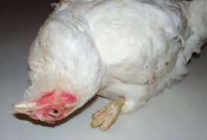

Slide 14
Observed signs depend on whether the infecting virus has a predilection for respiratory, digestive, or nervous systems.
Velogenic viruses
(High virulent)
Sudden death
Depression
Prostration
Diarrhoea
Facial edema
Cyanosis of comb
Mortality - 100%
Mesogenic viruses
(Moderately virulent)
Severe respiratory signs
Decreased nervous signs
Increased drop in egg production
Mortality - 10%
Lentogenic or low virulent viruses
Mild respiratory sign for short period

Slide 15
LESIONS
Macroscopic lesions (Velogenic form)
• Young chickens and those dying peracutely may have no lesions especially in birds that only show nervous signs.
• Remarkable lesions are usually observed only with VVND and they include
• Haemorrhage in intestine
• Petechial haemorrhage in proventiculus
• Enlarged and necrotic caecal tonsils
• Necrosis and haemorrhage in lymphoid aggregates in intestine
• Splenic necrosis on capsular surface
• Nervous system lesions are not seen regardless of pathotypes
The lesions in birds infected with lower virulence NDV strains may be limited to respiratory tract.

Slide 16
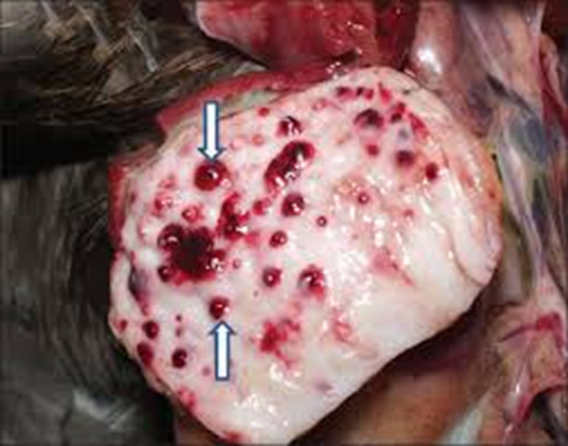

Slide 17
MICROSCOPIC LESIONS
Is variable, they are, therefore, of no value in the diagnosis.
Lesions in the central nervous system are those of non-purulent encephalomyelitis with neural degeneration, foci of glial cells, perivascular infiltration of lymphocytes, and proliferation of endothelial cells.
Regressive changes in the lymphopoietic system consist of disappearance of lymphoid tissue.

Slide 18
Necrotic lesions are found through out the spleen.
Marked degeneration of the medullary region of bursa.
The haemorrhagic necrotic lesions in the intestinal tract develop in lymphoid aggregates.
Lesions in the upper respiratory tract may be severe and related to the degree of respiratory distress.
Lesions may extend through out the length of the trachea. Cilia may be lost within 2 days of infection.
Edema, cell infiltration, and increased thickness and density of the air sacs may occur.

Slide 19
DIAGNOSIS
None of the clinical signs or lesions can be regarded as specific or pathognomonic.
Confirmation test by Haemagglutination-inhibition test, Single radial immunodiffusion, Agar gel precipition, Virus neutralization (VN) in chick embryo, ElLISA and plaque neutralization.

Slide 20
Samples
o Live birds - Both cloacal/ faeces or tracheal swabs, regardless of clinical signs.
o Dead birds - Intestines, intestinal contents and trachea should be collected together with affected organs and tissues.

Slide 21
DIFFERENTIAL DIAGNOSIS
Avian influenza,
Infectious laryngotracheitis,
Infectious bronchitis,
EDS-76,
Infectious coryza,
Fowl cholera,
Salmonellosis
Some of their lesions resembles those of ND.

Slide 22
PREVENTION
Live lentogenic vaccines, chiefly B1 and LaSota strains, are widely used and applied in drinking water or by spray, or, via the nares or conjunctival sac.
Healthy chicks are vaccinated as early as day 1-4 of life. However, delaying vaccination until the second or third week avoids maternal antibody interference with an active immune response.
Oil-adjuvanted inactivated vaccines are also used following live vaccine in breeders and layers and may be used alone in situations where use of live virus may be contraindicated.

