Slide 1
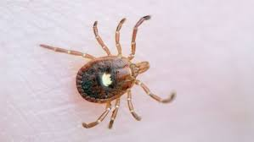
RICKETTSIAL DISEASES
KAUSHAL KUMAR
Assistant Professor & Head
Department of Veterinary Pathology
Bihar Veterinary College
Bihar Animal Sciences University, Patna

Slide 2
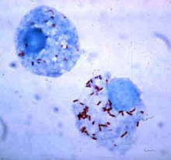
Rickettsia
A genus of nonmotile, Gram-negative, nonspore-forming, highly pleomorphic, cocci, bacilli and thread shaped bacteria.
Genus Rickettsia was named after Howard Taylor Ricketts, in honour of his pioneering work on tick-borne spotted fever.
Red-stained Rickettsia rickettsii visible in cells of an Ixodid vector tick

Slide 3
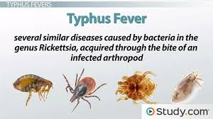
Rickettsial Diseases
Rickettsial diseases (rickettsioses) and related diseases (anaplasmosis, ehrlichiosis, Q fever, scrub typhus) are caused by a group of gram-negative, obligately intracellular coccobacilli. All, except for Coxiella burnetii, have an arthropod vector.
Notes:
Rickettsia, Orientia, Ehrlichia, Anaplasma, and Coxiella spp were once thought to belong to the same family but now, based on genetic analysis, are considered distinct entities. Rickettsia, Orientia, Ehrlichia, Anaplasma, and Coxiella spp were once thought to belong to the same family but now, based on genetic analysis, are considered distinct entities.
These organisms typically have an animal reservoir and an arthropod vector; exceptions are R. prowazekii, for which humans are the primary reservoir, and C. burnetii, which does not require an arthropod vector.
Rickettsial diseases cause fever and, depending on the disease, sometimes a local lesion (eschar), petechial rash, regional lymphadenopathy, encephalitic signs, vasculitis, gangrene of skin and tissues, organ dysfunction, and vascular collapse.

Slide 4
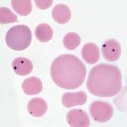
Anaplasmosis
Nature of the disease
A form of ‘tick fever’ in cattle,
Caused by: Rickettsia-like-Organism
Anaplasmcentrale (sometimes)
Anaplasma marginale (Usually) &
A parasite of a red blood cells
Characterized by
Initial high fever &
Progressive anaemia
Notes:
Anaplasmosis is a form of ‘tick fever’ in cattle, caused usually by the rickettsia Anaplasma marginale and sometimes by Anaplasma centrale. It is characterised by initial high fever and progressive anaemia.

Slide 5
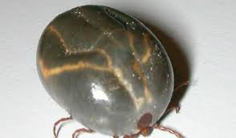
Anaplasmosis
Susceptible Species:
Cattle, Bos indicus (less susceptible)
Transmission:
Boophilus microplus (Cattle tick)-Major vector
Others - Boophilus, Dermacentor, Rhipicephalus, Ixodes, Hyalomma & Argas
Mechanical transmission via veterinary instruments
Notes:
Cattle, Bos indicus type cattle are less susceptible because of their greater resistance to tick infection.
Anaplasma is a parasite of red blood cells and vectors are necessary for its transmission between animals.
Transmisson:Ticks are the natural vectors and a range of tick species has been shown to be capable of transmitting infection (Boophilus, Dermacentor, Rhipicephalus, Ixodes, Hyalomma, Argas and Ornithodoros). In the absence of ticks, biting flies can maintain the disease though these are less efficient vectors.
The cattle tick, Boophilus microplus, is the major vector for anaplasmosis in Australia, Rhipicephalus sanguineus has also been shown to be capable of transmitting infection. Biting flies are considered important in the USA. Mechanical transmission of infected blood via veterinary instruments is also possible.

Slide 6
Anaplasmosis
Clinical Sign:
Steadily increasing temperatures
Anaemia, weakness and respiratory distress
Depression and anorexia
Jaundice marked
Brown Urine (presence of bile pigments)
Severely affected animals may die
Necropsy Lesion:
Gross findings are due to anemia and resulting anoxia.
Pale and jaundiced tissues
Spleenomegale (soft reddish-brown pulp)
Hepatomegale, (yellow-brown and mottled)
Notes:
Clinical Sign:
There is considerable variability in the severity of anaplasmosis with severity generally increasing with the age of the animal.
Affected cattle have:
Steadily increasing temperatures
Anaemia, weakness and respiratory distress particularly after exercise
Depression and anorexia become more obvious as the disease progresses
Jaundice and frequently a marked loss of condition
Urine is often brown due to the presence of bile pigments
Severely affected animals may die
Post-mortem findings
Gross pathology findings are due to anaemia and resulting anoxia. These include:
Pale and often jaundiced tissues
Watery blood and an enlarged spleen with a soft reddish-brown pulp
Liver is also enlarged , yellow-brown and often mottled

Slide 7
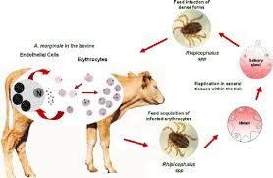
Anaplasmosis
Diagnosis:
Particularly in convalescent animals
Confirmed by microscopic examination of stained blood smears.
Serological testing for antibodies to A. marginale
Notes:
Particularly in convalescent animals-
Anaplasmosis can be confirmed by microscopic examination of stained blood smears.
Serological testing for antibodies to A. marginale may also be useful.

Slide 8
Canine Ehrlichiosis
Nature of the disease
A tick-born disease of dogs,
Also known as
Canine Rickettsiosis ; Canine Hemorrhagic Fever,
Canine Typhus ; Tracker Dog Disease &
Tropical Canine Pancytopaenia (TCP)
Caused by: Rickettsia-like-Organism
Ehrlichia canis
A parasite of a monocyte in the peripheral blood
Characterized by
High fever &
Lowered peripheral blood cell counts(pancytopenia),
Notes:
Canine ehrlichiosis (tropical canine pancytopaenia — TCP) is a tick-borne rickettsial disease of dogs caused by Ehrlichia canis.
In acute stage, disease can lead to fever and lowered peripheral blood cell counts due to bone marrow suppression.Also there will be Very low blood cell counts(pancytopenia), bleeding, bacterial infection, lameness, neurological and ophthalmic disorders, and kidney may get severly affected. Chronic ehrlichiosis can be fatal.

Slide 9
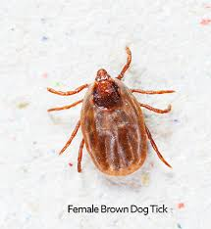
Ehrlichiosis
Susceptible Species:
Dogs and some species of wild canidae
German Shepherd-more susceptible
Transmission:
Rhipicephalus sanguineus (brown dog tick) -Major vector
Others - Boophilus, Dermacentor, Ixodes, Hyalomma & Argas

Slide 10
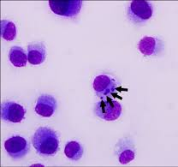
Ehrlichiosis
Clinical Sign: wide range of clinical syndromes
Acute stage, - Fever and epistaxis or other haemorrhages
Lowered peripheral blood cell
Subclinical phase-No outward signs and
Last for the rest of the dog's life-Carrier states
Chronic phase-The third and most serious stage
Pancytopenia,
Extensive haemorrhage (bleeding, )with epistaxis
bacterial infection, lameness,
Neurological, ophthalmic disorders, and kidney disease
Necropsy Lesion:
Emaciated carcase
Pale mucous membranes
Oedema of the limbs, ascites and hydro-pericardium
Haemorrhages in GIT, internal organs, s/c tissues and eye
Enlarged lymph nodes and spleen
Notes:
Clinical Sign:
There are three stages of ehrlichiosis, each varying in severity.
The acute stage, occurring several weeks after infection and lasting for up to a month, can lead to fever and lowered peripheral blood cell
counts due to bone marrow suppression.
the subclinical phase, has no outward signs and can last for the remainder of the dog's life, during which the dog remains infected with the
organism. Some dogs are able to successfully eliminate the disease during this time
the chronic phase: It is the third and most serious stage of infection. Here in clinically dog will have Very low blood cell counts (pancytopenia), bleeding, bacterial infection, lameness, neurological and ophthalmic disorders, and kidney disease, can result. Therefore, Chronic ehrlichiosis can be fatal.
Post-mortem findings
In severe form of the disease, the following may be seen:
Emaciated carcase Pale mucous membranes
Oedema of the limbs, ascites and hydro-pericardium
Haemorrhages in gastro-intestinal tract, internal organs, sub-cutaneous tissues and eye
Enlarged lymph nodes and spleen

Slide 11
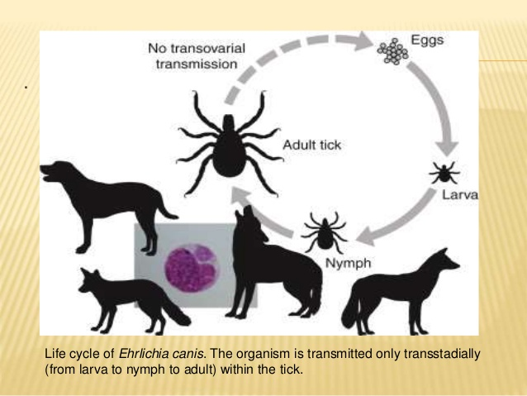
Ehrlichiosis
Notes:
Clinical Sign:
There are three stages of ehrlichiosis, each varying in severity.
The acute stage, occurring several weeks after infection and lasting for up to a month, can lead to fever and lowered peripheral blood cell
counts due to bone marrow suppression.
the subclinical phase, has no outward signs and can last for the remainder of the dog's life, during which the dog remains infected with the
organism. Some dogs are able to successfully eliminate the disease during this time
the chronic phase: It is the third and most serious stage of infection. Here in clinically dog will have Very low blood cell counts (pancytopenia), bleeding, bacterial infection, lameness, neurological and ophthalmic disorders, and kidney disease, can result. Therefore, Chronic ehrlichiosis can be fatal.
Post-mortem findings
In severe form of the disease, the following may be seen:
Emaciated carcase Pale mucous membranes
Oedema of the limbs, ascites and hydro-pericardium
Haemorrhages in gastro-intestinal tract, internal organs, sub-cutaneous tissues and eye
Enlarged lymph nodes and spleen

Slide 12
Ehrlichiosis
Diagnosis:
Blood smear Examination (Uncommon):
For the presence of the ehrlichia canis, within a white blood cell.
For abnormalities in the No. of RBC, WBC, and most commonly platelets
Serologic test: for the presence of Ab against the Ehrlichia organism
PCR:
To detect genetic material of the bacteria.
But yield a -ve result (subclinical and chronic phases)
Notes:
Blood smear Examination (Uncommon):A diagnosis can be made by looking under a microscope for the presence of the ehrlichia canis, within a white blood cell and for abnormalities in the No. of RBC, WBC, and most commonly platelets
Serologic test: Diagnosis is achieved most commonly by serologic testing of the blood for the presence of antibodies against the ehrlichia organism. But during the acute phase of infection, the test can give false negative result because the body will not have had time to make antibodies to the infection. As such, the test should be repeated again.
PCR:It can be performed to detect genetic material of the bacteria during acute stage of infection. But It is more likely to yield a negative result during the subclinical and chronic disease phases

Slide 13
Q. Fever
Nature of the disease
A zoonotic disease whose most common animal reservoirs are cattle, sheep, and goats.
well-recognized cause of abortions in Ruminants and pets
has been developed as a biological weapon
"Q" stands for "query
First described in slaughterhouse workers at Brisbane, State of Queensland.
Caused by: Coxilla Burneti
Closely related to the Rickettsiae, but as similar to Legionella and Francisella.
discovered in 1937, by Frank Macfarlane Burnet
Cox and Davis elucidated the transmission when they isolated it from ticks.

Slide 14
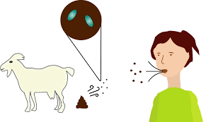
Q. Fever
Susceptible Species:
Cattle, sheep, goats, and other domestic mammals,
Other animals : dogs, cats, rabbits, horses, pigs, camels, buffalo, rodents, and some birds.
Transmission:
Inhalation of a spore-like small-cell variant,
Contact with the milk, urine, feces, vaginal mucus, or
semen of infected animals.
Rarely, the disease is tick-borne.

Slide 15
Q. Fever
C. burneti resides and reproduces in the acidified phagolysosomes of host monocytes and macrophages.
Clinical Sign:
Typical clinical signs :
Late Abortion,
Stillbirth,
Weak calves, and
Repeat breeding.
Moreover, experimental inoculation in cattle
respiratory disorders and cardiac failures (myocarditis)
frequent abortions and irregular repeat breedings.
Once a animal is infected, C burnetii can localize in mammary glands, placenta, and uterus, from which it may be shed in subsequent parturitions and lactations.
Notes:
The coxilla Burneti resides and reproduces in the acidified phagolysosomes of host monocytes and macrophages.
Two forms exist: the large cell variant is a vegetative form found in infected cells, and the small cell variant is the extracellular infectious form shed in milk, urine, and feces and found in high concentration (10⁹ ID₅₀/g) in placental tissue and amniotic fluid. The small cell variant is resistant to heat, drying, and many common disinfectants and remains viable for weeks to years in the environment. Once a domestic ruminant is infected, C burnetii can localize in mammary glands, supramammary lymph nodes, placenta, and uterus, from which it may be shed in subsequent parturitions and lactations.

Slide 16
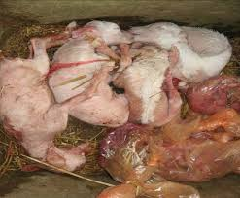
Q. Fever
Necropsy Lesion:
- Necrotsing placentitis in ruminants
Diagnosis:
Isolation and identification of organisms in case of infectious abortion
Immunohistochemical Test: for the presence of Ab against the C. burnetii
Immunofluoresence Test on Paired sera taken 2 week apart to detect recent infection
PCR:
To detect C. burnetii in tissue.

Slide 17
Thanks

