Slide 1
Shistosomosis
Dr. Pallav Shekhar
Asstt. Professor
Veterinary Medicine
UNIT-6

Slide 2
Nasa/Nakra/Sunsunna
Trematodal infection
Host: Cattle, Sheep, Goat, Pigs, Dogs and man
In human the infection is known as Bilharziasis.

Slide 3
Species
Shistosoma bovis
Schistosoma indicum
Schistosoma nasalis
Snail- Indoplanorbis exutus- Intermediate host

Slide 4
Life Cycle-Indirect
Eggs in Feces
Hatching in water
Miracedium
Snail
Development
Cercariae
Water
New host
Blood circulation
Nasal veins

Slide 5
Clinical Signs
Rhinitis
Sneezing
Snoring sound
Abscess on mucous membrane
Development of fibrous tissue
Cauliflower like growth in nasal passage
Nasal garnuloma

Slide 6
Human
Swimmers's itch
Hunter's itch
Rice paddy itch
Lake side itch

Slide 7
Diagnosis
Clinical Signs
Fecal examination
Nasal discharge examination

Slide 8
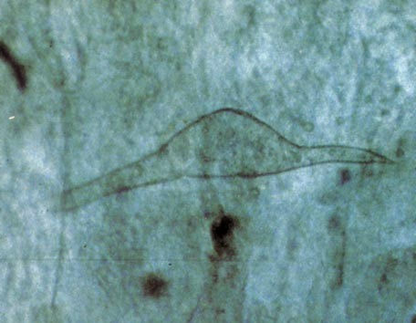

Slide 9
Treatment
Tartaemetic
Sodium antimony tartarate
Anthiomaline 1.7mg per kg
Praziquantel @ 25mg/kg body weight orally for 3 days

Slide 10
Control
Chemical Control: Copper sulphate, Sodium pentachlorphenate
Biological Control: Soap berry, Shikakais plant growth.
Larvae of Sciomyzid fly can kill planorbid snails
Rearing of ducks

