Slide 1
BIHAR ANIMAL SCIENCES UNIVERSITY, PATNA, BIHAR Bihar Veterinary College, Patna
Selection Index
Speaker: Ramesh Kumar Singh
Assistant Professor cum Jr. Scientist
Division of Animal Genetics and Breeding
Bihar Veterinary College, Patna

Slide 2
Selection Index or Index Selection or Total Score Method
The foundational method for overcoming the demerits of Tandem and Independent Culling Level (ICL) methods and for incorporating the economics of production into selection decisions and genetic improvement was developed by Hazel (1943) and is commonly referred to as selection indexes.
Hazel developed the concept of aggregate merit which represents the total monetary value of an animal in a given production system due to the genetic potential of that individual.
Selection Index method is used when more than one trait has to be selected at one go or simultaneously.

Slide 3
In this method, the animal is scored for its merit in each of the traits included in Selection.
Each trait is weighted, by giving score and an individual trait score is summed up to the total score for the each animal within the Selection criteria.
The score for each trait is added up and it is an selection index of the total performance of the animal.
Selection index is a single numerical value within the total scores given for each trait considered in the Selection.
The individual specification for a number of traits can vary greatly and is combined into one value for the animal called a Total score or an Index.

Slide 4
Information Needed to Form Selection Index
The traits of selection objective linked to the net phenotypic efficiency or profitability of the animal are listed in the order of preference and score fixed for each based on relative economic importance, heritability of the traits and genetic correlations between the traits.
The information and the score should be fixed based on
Variation seen in each trait – the phenotypic standard deviation
Heritability of the traits
Phenotypic and genetic relationships (correlation) between the traits
Relative economic value of the traits

Slide 5
Contd…
An index is simply a means of putting a whole lot of different information into one value.
The animals with the high index values are selected for future breeding.
This is the best method of Selection since it would permit high merit in one trait to make up slight deficiencies in the other traits.

Slide 6
Advantages
The high merit in one trait can certainly be used to compensate the deficiencies in other traits.
The aim in computing an index is to derive an estimate in which the various traits are approximately weighted to give the best prediction of the animal’s breeding value i.e. what it will produce when the animal breeds.
An advantage of this index is suppose if one component is missing then benefit can be obtained by predicting the missing one from the others that are present.

Slide 7
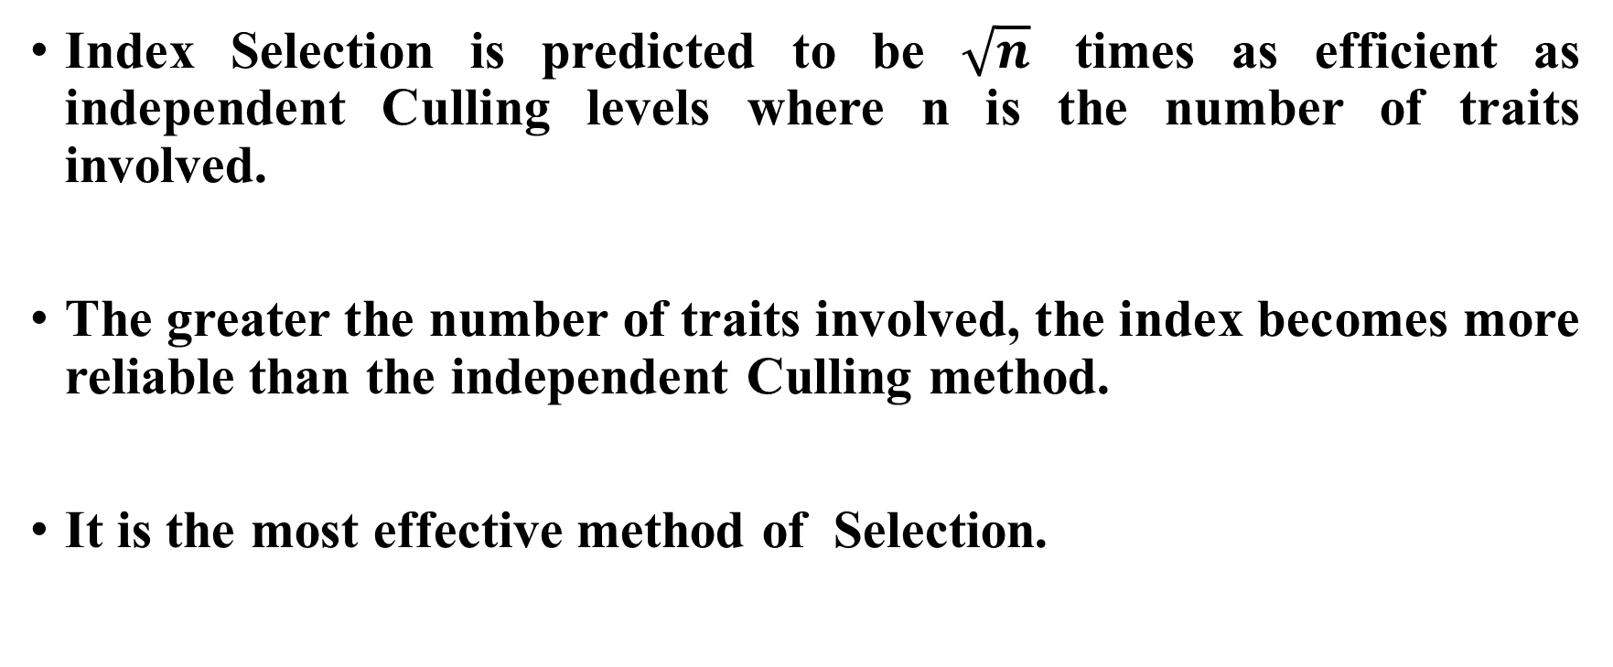
Contd…
Index Selection is predicted to be $\sqrt{n}$ times as efficient as independent Culling levels where n is the number of traits involved.
The greater the number of traits involved, the index becomes more reliable than the independent Culling method.
It is the most effective method of Selection.

Slide 8
To construct a Selection index the following are necessary:
Required information
Genetic and phenotypic variances for each trait
V_{A} = 4 σ² _{s} V_{P} = σ² _{s} + σ² _{d} + σ² _{w}
Genetic and phenotypic covariances between each trait
Cov_{A} = 4 CovS_{(xy)}
Cov_{P} = CovS_{(xy)} + CovD_{(xy)} + CovW_{(xy)}
Relative economic value of the traits
a₁, a₂, a₃, . . . . . . . ., a_{k}

Slide 9
Set up normal simultaneous equations to obtain partial regression coefficients (b) to get the index.
For Example, if n numbers of traits are taken in evaluation of evaluation
I = b₁X₁ + b₂X₂ + b₃X₃ + …….. + b_{n}X_{n}
Where,
I – Index value or genetic prediction
n – Number of traits of information
b₁ to b_{n} – Coefficients obtained based on the relative importance of heritability of each trait and genetic relationships of the traits concerned.
X₁ to X_{n} – Measurement of each of the traits incorporated (phenotypic values)

Slide 10
For example, if two traits are considered for Selection,
I = b₁X₁ + b₂X₂
where, X₁ and X₂ are phenotypic values of the traits
b₁ and b₂ are the regression coefficient for each trait
The normal simultaneous equation for two traits is,
V_{P (X1)} b₁ + Cov_{P (X1X2)} b₂ = V_{A (X1)} a₁ + Cov_{A (X1X2)} a₂ - Equation (I)
Cov_{P (X2X1)} b₁ + V_{P(X2)} b₂ = Cov_{A (X2X1)} a₁ + V_{A(X2)} a₂ - Equation (II)
where, V_{P(Xi)} = Phenotypic variance of i^{th} trait
V_{A(Xi)} = additive variance of i^{th} trait
Cov_{P(XiXj)} = phenotypic covariance of i^{th} and j^{th} traits
Cov_{A(XiXj)} = additive covariance of i^{th} and j^{th} traits
a_{i} = economic value for i^{th} trait
b_{i} = partial regression coefficient for i^{th} trait

Slide 11
Steps of Selection Index Estimation
Multiply the genetic parameters with their corresponding “a_{s}” and add.
Divide equation (I) by Cov_{P(X1X2)} and obtain equation (III).
Divide equation (II) by V_{P(X2)} and obtain equation (IV).
Subtract equation (III) from equation (IV) to get equation (V).
Solve for b₁.
Substitute b₁ in equation (III) and (IV) and solve for b₂.
Construct the Selection Index I = b₁X₁ + b₂X₂

Slide 12
Outcomes
The animals are arranged based on index values and those with the highest scores are kept for breeding purposes and the animals with lower index values are eliminated from the breeding population.
The net value of an animal is dependent upon several traits that may not be of equal economic value or that may be independent of each other.
Hence, it is necessary to select more than one trait at a time.
The desired traits will depend upon their economic value.
This method of Selection leads to most efficient improvement in livestock breeding.

Slide 13
Contd…
Selection Index has been more widely used with sheep and swine than in beef and dairy cattle.
Large volume of accurate data of population is necessary to provide information to compute the Selection Index.
Indices computed from inadequate or erroneous information can be ineffective in Selection.
A trait that is highly heritable can be given adequate weightage than one with low heritability.

Slide 14
Disadvantage
The only disadvantage is that the traits vary in importance from time to time and the index built at one time will not be applicable for all times. Hence, it has to be constructed and modified from time to time.

Slide 15
Conclusions
The Selection index is a total score that includes all the advantages and disadvantages of an animal for those traits considered for Selection.
The amount of weightage given to each trait depends on their relative economic value, heritability of the character and genetic correlation between characters.
A trait, which is highly heritable, can be given greater score than a trait, which has a low heritability.
The Selection Index Method is the most efficient (best method) among the three (Tandem, Independent Culling and Selection Index) methods because it results in better genetic improvement.
The index is the best estimate of an animal’s breeding value.

