Slide 1
VSR Unit 5: Surgical Affections of Female Genital System
Dr. Ramesh Tiwary
Assistant Professor
Deptt. of Veterinary Surgery and Radiology

Slide 2
Pyometra
Pyometra is a diestral disorder resulting from interaction of bacteria with an abnormal endometrium that is subjected to pathological changes caused by an exaggerated response to progesterone stimulation .
Collection of purulence within the uterus.
Open/Closed
Is a closed pyometra a true surgical emergency?
Yes. “The sun should never set on a closed pyometra.”

Slide 3
When is pyometra most frequently diagnosed?
• 1-4 weeks after estrus in intact female cats
• 4-8 weeks after estrus in intact female dogs
CBC
Leukocytosis
Neutrophilia
Nonregenerative anemia
Serum urea nitrogen Increased
Creatinine Increased
C-reactive protein Elevated

Slide 4
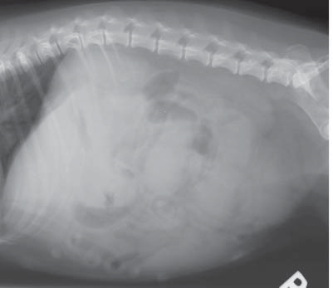
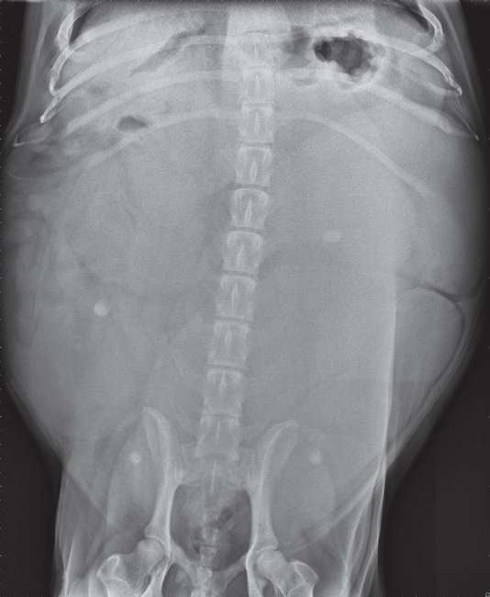
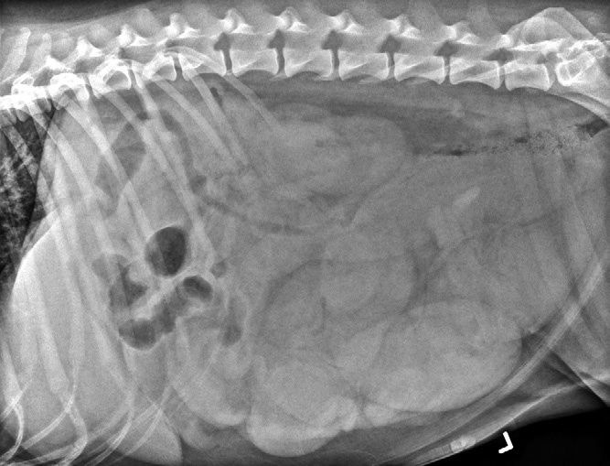
Radiography
LA/VD/DV Caudal Abdomen
LA
VD

Slide 5
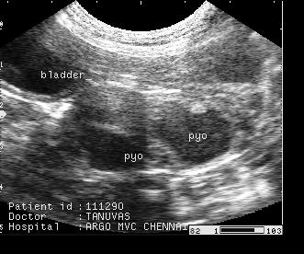
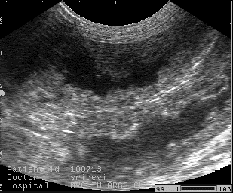
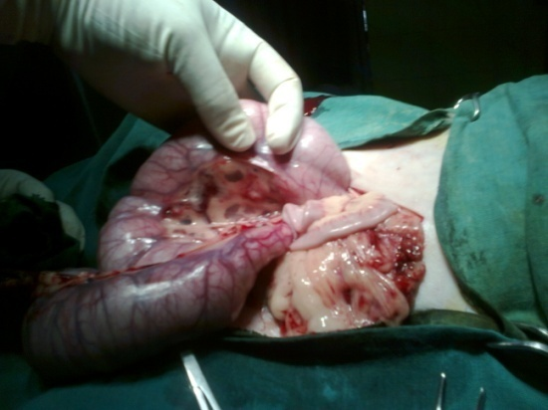
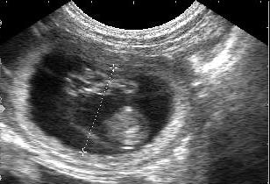
Ultrasonography
D. Diganosis: Pyometra,
CEH
PD
Pyometra
CEH
Pregnancy

Slide 6
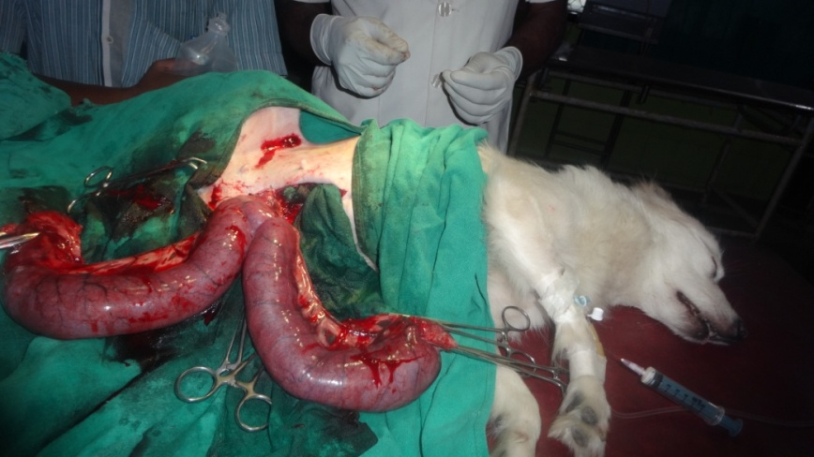
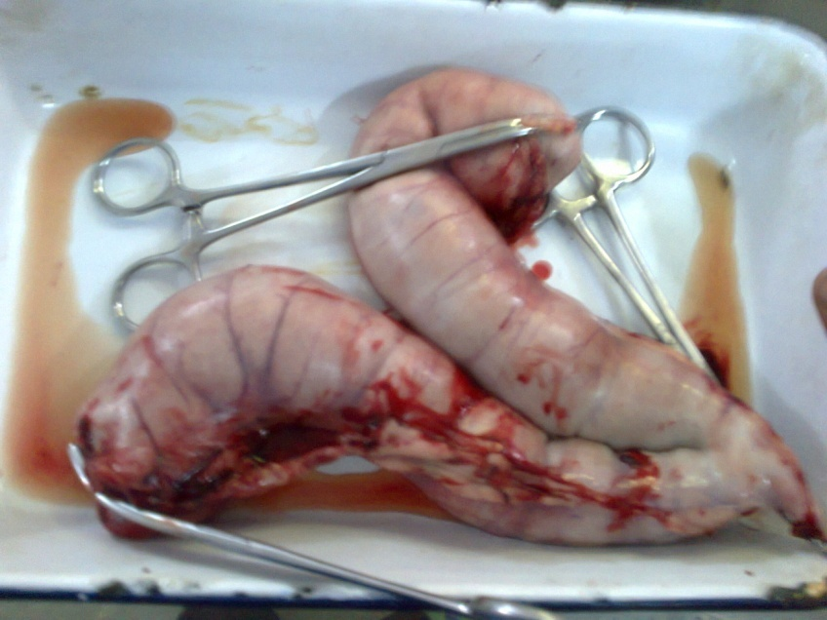
OVH: Midventral approach through linea alba

Slide 7
Prognosis
Persistent postoperative elevation of BUN ,CRP and and marked neutrophilia (continuing through day 3–4 postoperatively) may indicate poor prognosis or complicated recovery requiring more intense medical care

Slide 8
Uterine Stump Pyometra
Uterine stump pyometra: The animals have elevated blood progesaterone levels.
The source of progesterone may be from residual ovarian tissue (incomplete removal)
Exogenous, from progestational compounds used to treat dermatitis
Any remaining ovarian tissue should be removed.
Pus-fi lled residual uterine tissue excised at the level of,
or including, the cervix.
Prevented by complete removal of the ovaries during OVH.
Common problem in Dog with residual ovarian tissue

Slide 9
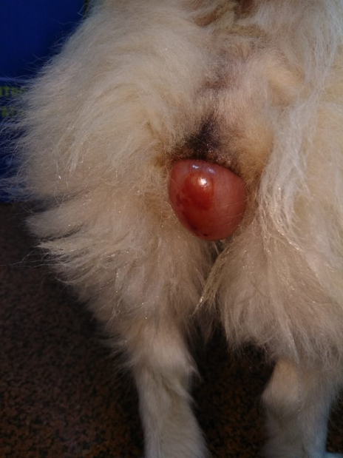
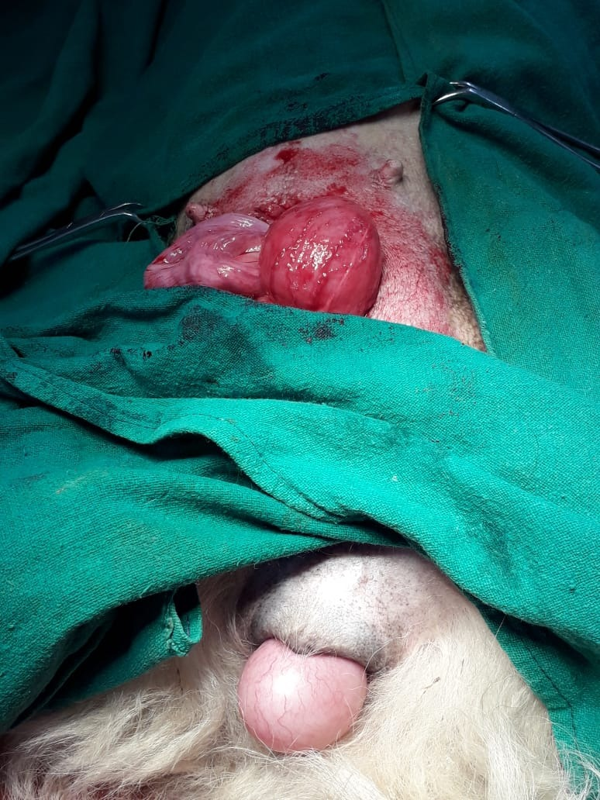
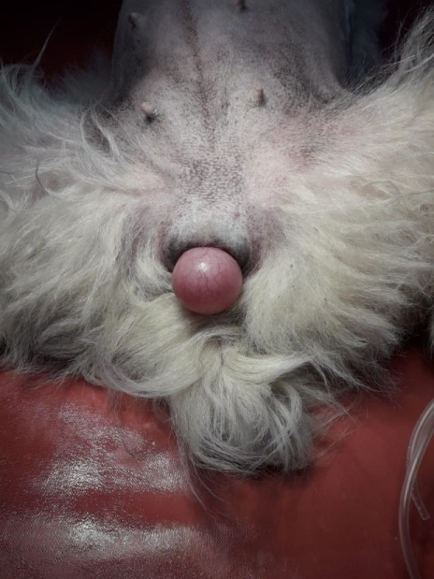
Vaginal Cyst
Drain cyst and inject irritant to destroy fluid secreting membrane

Slide 10
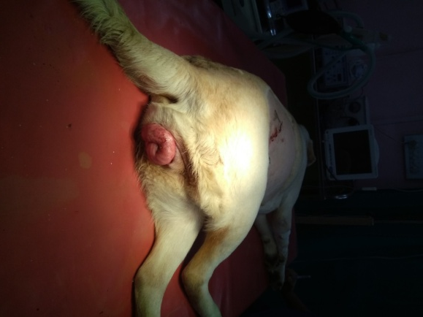
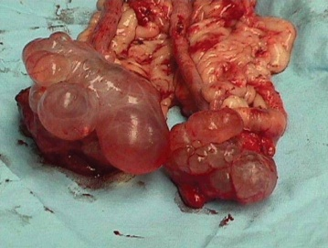
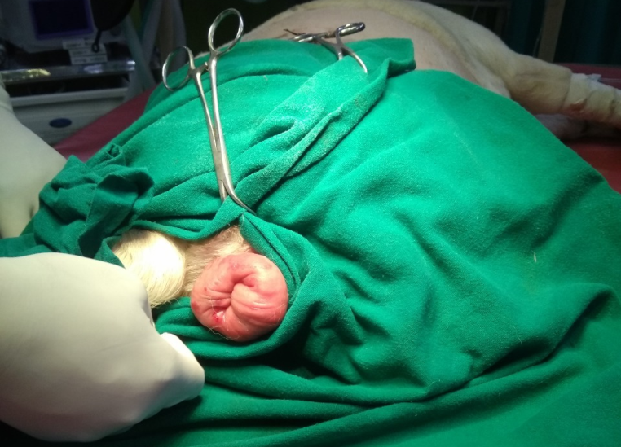
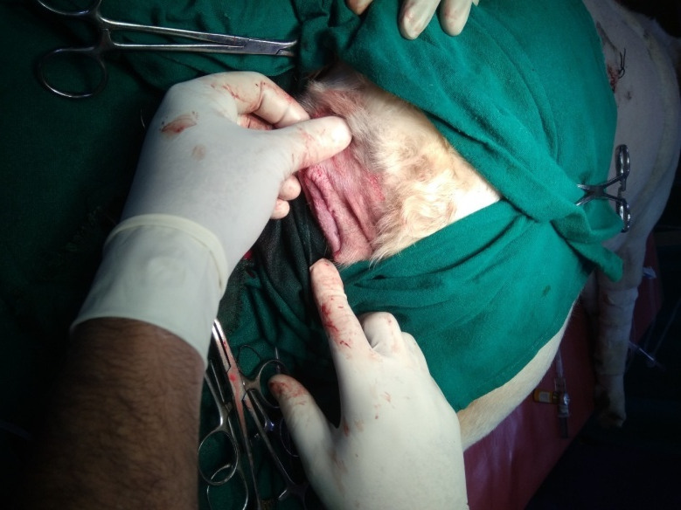
Vaginal Hyperplasia
Vaginal hyperplasia: originate from a stalk of mucosa on the floor of the vagina.
Vaginal prolapse involves the 360-degree protrusion of mucosa
Vaginal prolapse will spontaneously resolve when estrogen influence diminishes

Slide 11
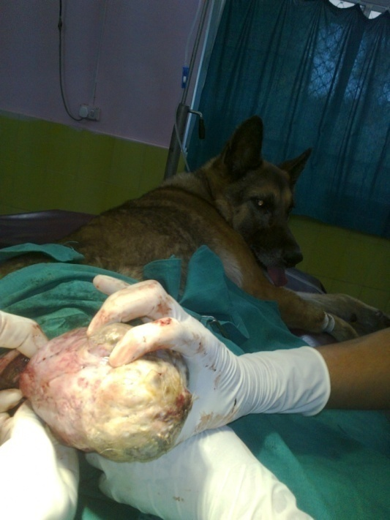
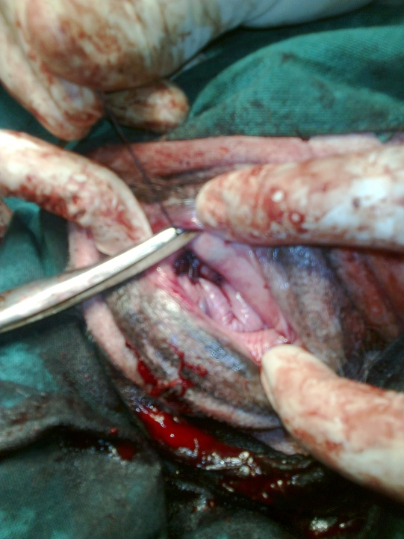
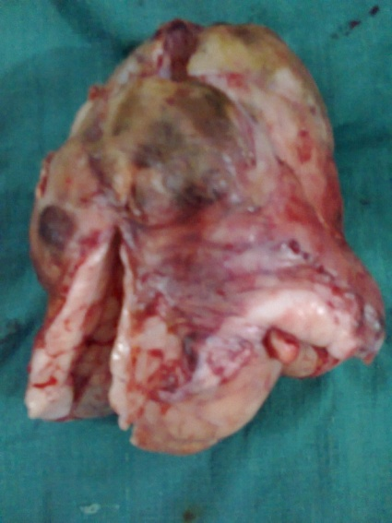
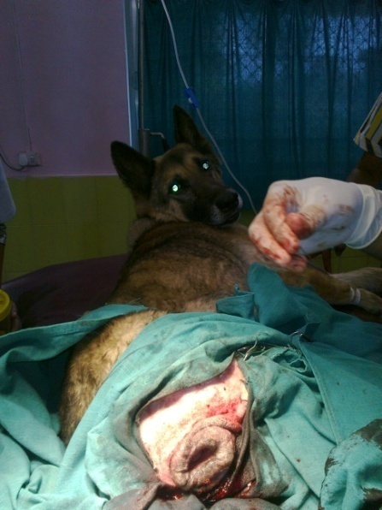
Vaginal Tumor
Most vulvar-vaginal tumors occur in old (10 years or older)
Benign vulvar-vaginal tumors are most common and respond to local excision
Fibroleiomyoma is the most common benign tumor.

Slide 12
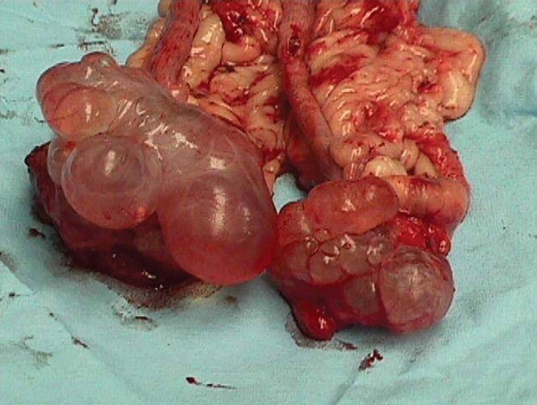
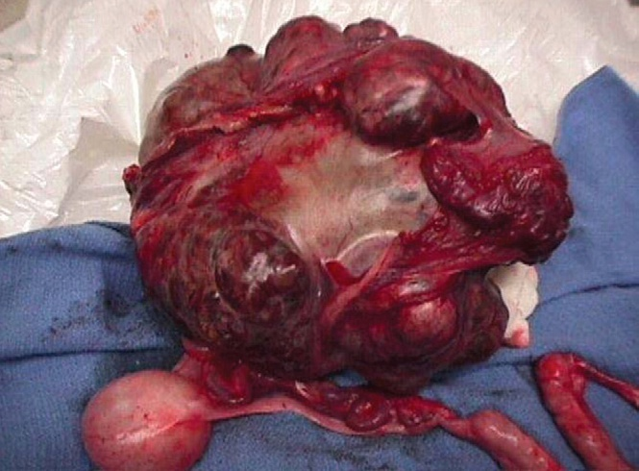
Cystic ovary/Tumor
Persistent signs of estrus can be present if a functional ovarian cyst or neoplasm develops in the ovarian tissue.

Slide 13
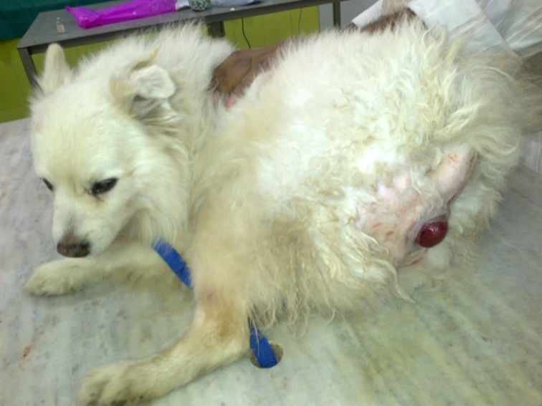
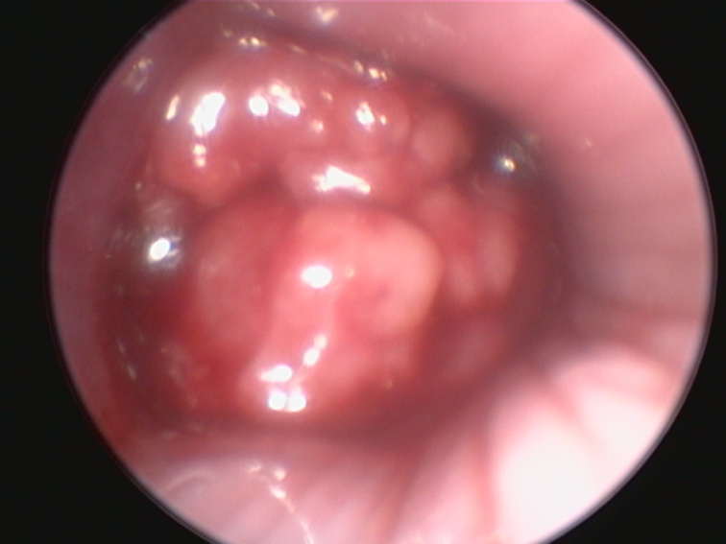
CTVT
Chemotherapy:
Inj. Vincritine sulphate @0.025 mg/kg body wt. IV (1mg=40 kg)
Extravascular injection creates severe tissue injury

Slide 14
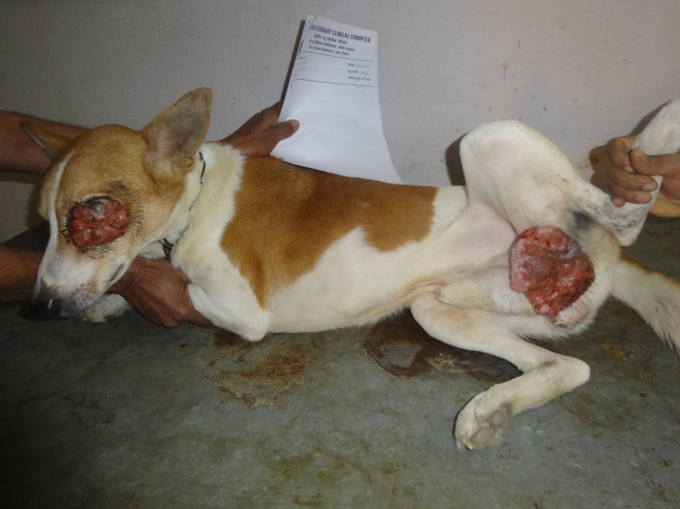
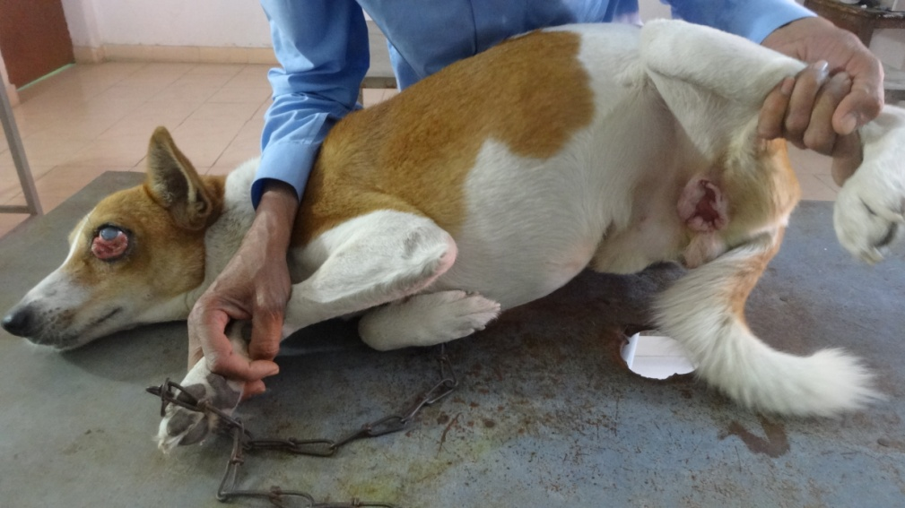
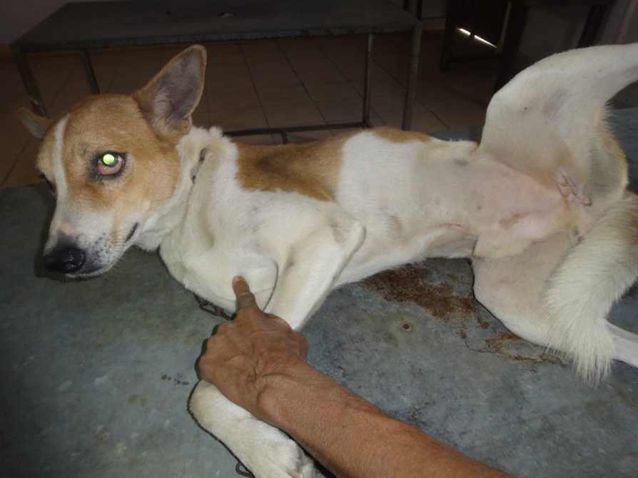
Extra-genital Transmissible Venereal Tumor In Male Dogs
2 WKs Post Treatment
4 WKs Post Treatment

