Slide 1
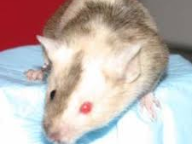
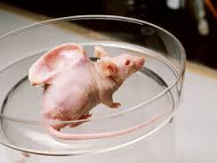
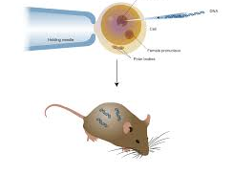
Animal Cloning: Transgenic Animal
Anil Gattani

Slide 2
Introduction
Animal models –
pivotal role in delineating etiology & progression of various diseases as well as to screen & develop new therapeutic strategies.
Till now …
Naturally occurring genetic variants
(spontaneously htn rats, hypercholesterolemic Watanabe rats etc)
Chemically/Physically-treated
(eg. Streptozotocin-induced DM & Adriamycin-induced dilated CMP)
Need of more accurate models of human disease
DM, obesity, CVDs, kidney ds, Alzheimer’s ds, AIDs, thalassemia etc

Slide 3
Transgenic Animal Technology
Gene cloning, chromosomal mapping, DNA sequencing etc
Introduce foreign DNA into chromosomes of the host species
Tissue-specific genetic alterations in animals
Specific disease condition.

Slide 4
Introduction
A transgenic animal is one that carries an exogenous DNA sequences that has been deliberately integrated into its germ line.
Transgenesis is the overall process by which genes are mixed up.
The DNA that is introduced id transgene
Foreign genes are inserted into the germ line of the animal, so it can be transmitted to the progeny.
Transgenic technology has led to the development of fishes, live stock and other animals with altered genetic profiles

Slide 5
Advantages
Increased growth rate
Improved disease resistance
Improved feed converstion rate
Increased muscle mass
Improved nutritionaql quality
Improved wool quality

Slide 6
History
Year | Achivment
1973 | 1st GMO (S. Cohen and H. Boyer)
1974 | 1st transgenic animals (mice) – Rudolf Jaenisch
1982 | world’s 1st ‘expressing’ transgenic animal Supermouse inserting a human growth hormone gene in mouse genome (Brinster and Palmiter) Gordon and Ruddle used the term ‘Transgenic’ for the first time
1985 | first transgenic livestock
2015 | FDA approved GMO for food (AquAdvantage salmon)

Slide 7
Animals used
Mice (most commonly)
Sheep & goats
Chickens
Fish
Pigs
Rabbits
Cows
Primates (monkeys)

Slide 8
Methodology
Step 1: Transgene construction
rDNA technology
Parts of transgene
Gene to be expressed
Vector DNA
Promoter & Termination sequence
Vector DNA | Promoter sequence | Gene | Termination sequence | Vector DNA

Slide 9
Step 2: Introduction of foreign gene into the animal
3 methods
Retroviral/Lentiviral vector method.
DNA Microinjection method (Pronucleus Method)
Embryonic stem cell-mediated site-directed mutagenesis

Slide 10
RETROVIRAL VECTOR METHOD
Retroviruses - vectors for integrating the transgene into the genome of a recipient cell.
Many limitations –
Transfers only small pieces of DNA
Risk of retroviral contamination – biggest drawback.
Not in regular use today

Slide 12
DNA microinjection method (pronucleus method)
Most reliable & commonly used technique (since 25 yrs)
Steps
FSH/hCG
Superovulation
Mating
Fertilized egg
Flushed from Oviduct
Transgenic pup

Slide 13
Embryonic stem cell-mediated, site-directed mutagenesis
Embryonic stem cells - cells which have the ability to differentiate into all other cell types. ‘Pluripotent
genetically engineered
Microinjection
By a retro virus
By electroporation
Selected and Culture
Transgenic Animal

Slide 15
Step 3: Selection of transgene-containing cells
Methods
Marker gene:
Enzymes
PCR
Some transgenes may not be expressed if integrated into a transcriptionally inactive site
Step 4: Further animal breeding is done to obtain maximal expression
Heterozygous offsprings are mated to form homozygous strains

Slide 17
Disadvantage
Multiple insertion – too much proteins
Insertion into an essential gene – lethality
Insertion into a gene leading to gene silencing
Insertion into a different area can affect the gene regulation
Low survival rate of transgenic animal

Slide 18
Transgenic sheep & lamb
1996: ‘Dolly’ the sheep was cloned using cells from a 6 yr old sheep’s udder by Somatic Cell Nuclear Transfer (SCNT) technology.
1997: World’s 1st transgenic lamb, ‘Polly’ was also created using SCNT. Contained human gene for blood clotting factor IX
Tracy: first transgenic sheep to produce recombinant protein in her milk
Cimen: the green sheep

Slide 19
Somatic cell nuclear transfer technology
(Transgene)
Cell Discarded

Slide 20
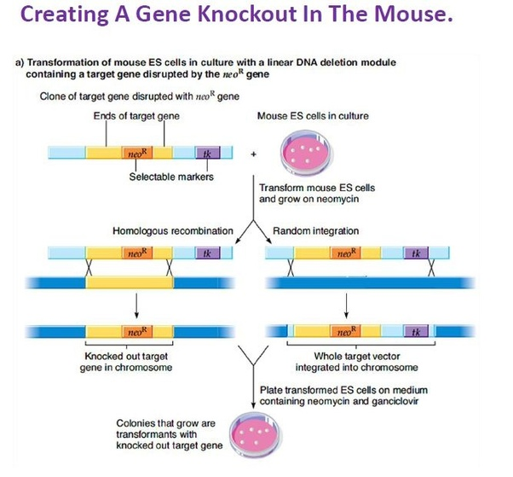
Gene knock-out
Targeted gene disruption by incorporation of a DNA sequence (selectable marker gene) into the coding region
Loss of function in the transgenic animals (‘knock-out mice’)
E.g. Rhodopsin knock-out mice
resembles Retinitis Pigmentosa

Slide 21
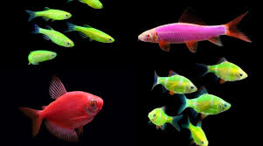
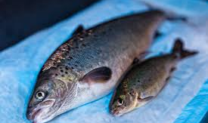
Transgenic Fish
Glo fish
Produce by integrating a fluorescent protein gene from jelly fish into embryo of fish
Superfish
Increased growth and size
Growth hormone gene inserted into fertilized egg

Slide 22
Transgenic mice
Oncomouse
Mouse model to study cancer
Made by inserting activated oncogenes
1st patented animal
Alzheimer’s mouse
In the brain of Alzheimer’s patients, dead nerve cells are entangled in a protein called amyloid.
Mouse made by introducing amyloid precursor gene into fertilized egg of mice

Slide 23
Transgenic pig
Sperm-mediated germ cell transfer
Fertilizing normal eggs with sperm cells that have incorporated foreign DNA (transgene)
Eg –
1. Enviropig -
created by introducing Phytase gene of E.coli
2. Pig for organ transplant
Source for organ transplantation for humans in future

Slide 24
Transgenic cattle
1990: World’s 1st transgenic cow – “Herman” the bull (Netherlands)
Herman carried the human lactoferrin gene (pronuclear microinjection)
Other RPs in transgenic cow’s milk – lysozyme, human lactalbumin, rATIII, Factors VIII & IX etc

Slide 25
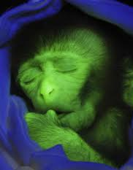
Transgenic Monkey (ANDi)
1st transgenic rhesus monkey (Oregon, 2000)
“inserted DNA” (spelled backward)
Green Fluorescent Protein (GFP) gene – extra glowing gene (taken from jelly fish)
ANDi proves that transgenic primates can be created and can express a foreign gene delivered into their genome.

Slide 26
Application
Transgenic animals are divided into 5 classes based on their purposes -
Disease models
Transpharmers
Xenotransplanters
Food sources
Biological models
Industry application- e.g. spider silk in goat milk

Slide 27
Issues in transgenic animal production
Blurring the lines between species by creating transgenic combinations
health risks associated with transgenics
long term effects on the environment when transgenic animals are released into the field
Various bioethicist argue that it is wrong to create animals that would suffer as a result of genetic alteration

