Slide 1
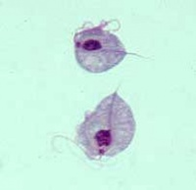
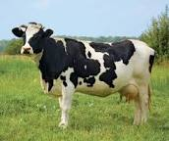
Trichomonads
Dr. AJIT KUMAR
HoD
Department of Parasitology
Bihar Veterinary College
Bihar Animal Sciences University
Patna-800014
Image source: Google image

Slide 2
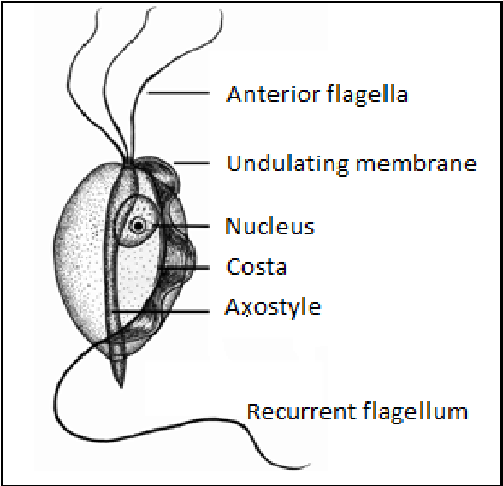
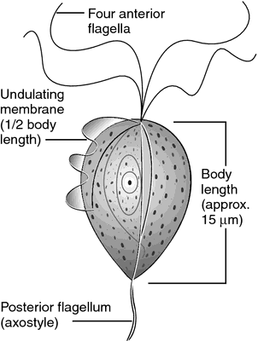
Family : Trichomonidae
Parasites commonly called trichomonads.
Usually found in digestive tract or some of the organisms may also present in the reproductive tract.
Body is pyriform shaped with rounded anterior end and pointed posterior ends.
Parasites have 3-5 flagella, undulating membrane, axostyle , costa and uninucleated.
Image source: Google image

Slide 3
Family : Trichomonidae
Genus and Species | Host | Location
Tritrichomonas foetus | Cattle, buffalo, pig, horse etc. | Reproductive tract
Trichomonas gallinae | Pigeon, turkeys etc. | Upper digestive tract
Trichomonas vaginalis | Man | Vagina and urethra

Slide 4
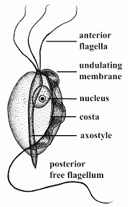
Tritrichomonas foetus
Morphological characters :-
Body is usually pear shaped.
It has three anterior flagella and a posterior flagellum that runs along the undulating membrane and then continues as a free flagellum.
A hyaline rod like structure known as axostyle which run through the midline of the cell and emerges posteriorly.
It has characteristic vigorous jerky movement.
Multiplication by longitudinal binary fission.
Sexual multiplication or cyst formation absent.
Image source: Google image

Slide 5
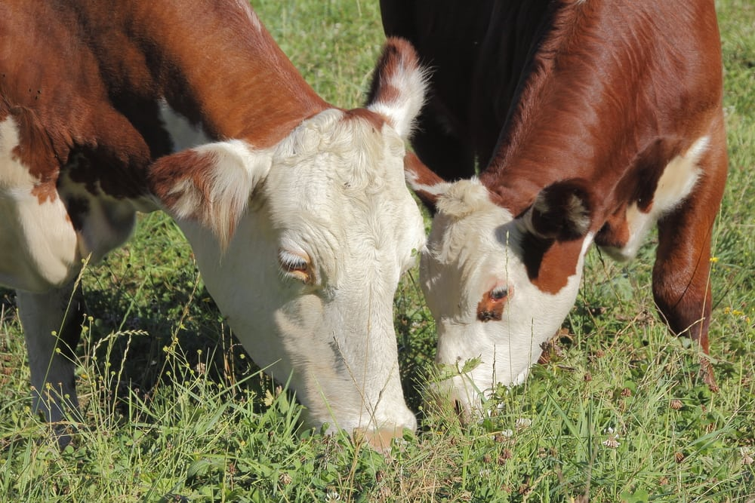
Tritrichomonas foetus
Host : It is mainly pathogenic in cattle but may also occur in buffalo, horse, pig and deer.
Location: vagina and uterus in cow whereas preputial cavity in bull.
Image source: Google image

Slide 6
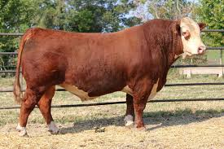
Tritrichomonas foetus
Transmission:
Organisms mainly transmitted through coitus
During Artificial insemination and gynecological examination, the parasites may transmitted.
Bulls, once infected, remain a permanent source of infection whereas in cows, the infection is self-limiting and parasites may gradually disappear.
Image source: Google image

Slide 7
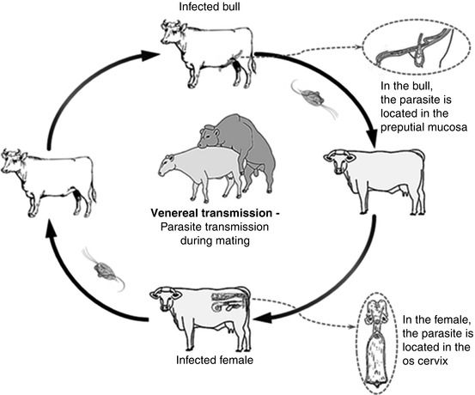
Transmission of T. foetus
Image source: Google image

Slide 8
Tritrichomonas foetus
Pathogenesis:
It causes the specific venereal disease, bovine trichomonosis or bovine trichomonad abortion in cattle.
Cows:
Vaginitis, endometritis, placentitis with detachment of the placental membranes and death of the foetus which lead to an early abortion usually 8-16 weeks after the infected service.

Slide 9
Tritrichomonas foetus
Pathogenesis:
Cows:
Sometimes foetus and foetal membrane retained leading to purulent endometritis.
When cervix is closed and corpus luteum is retained, then closed pyometra develops and uterus may contains several liters of greyish-white fluid swarming with trichomonads, which will give the appearance of pregnancy.
In long standing case, the trichomonads may disappear from the uterine fluid so disappear is self-limiting in cows.

Slide 10
Tritrichomonas foetus
Pathogenesis:
Bulls:
Small red nodules in the mucous membrane.
Mucopurulent discharge from the preputial cavity.
Above signs disappeared from 1-2 weeks after the infection.
Spontaneous recovery is rare and bulls remain permanently infected

Slide 11
Tritrichomonas foetus
Symptoms:
Cows:
Early abortion(usually 8-16 weeks after conception).
Vaginal discharge, mucopurulent endometritis, anestrous, irregular hear period.
Bulls :
Pain during micturition, disinclination to serve cows and preputial discharge.

Slide 12
Early Abortion due to T. foetus
Image source: Google image

Slide 13
Tritrichomonas foetus
Diagnosis:
Herd history (early abortion, failure of conception, increase vaginal discharge and incidence of pyometra in the herd etc.).
Microscopic examination of vaginal discharge or washing, uterine discharge, preputial discharge, stomach contents of aborted foetus, amniotic fluids etc. reveled T. foetus with characteristic vigorous jerky movement.
Serological test like cervical mucus agglutination ands skin test`
Image source: Google image

Slide 14
Tritrichomonas foetus
Treatment:
Since the infection in self-limiting in cows, infected animals should be given breeding rest to cure the infection.
Use of Acriflavin ointment in infected bull with the help of pudendal anesthesia.
Berenil or Dimetridazole is also used in the treatment

Slide 15
Tritrichomonas foetus
control:
Infected bulls must be either castrated or slaughtered.
Avoid breeding between susceptible cow and infected bull and vice–versa.
Aborted cows should be given breeding rest for three consecutive estrous periods.

Slide 16
Trichomonas gallinae
Host : Pigeons , turkey and chicken.
Location: Upper digestive tract
Organism has only four anterior flagella.
Organism transmitted from adult pigeons to their offsprings through infected pigeons crop milk.
Adults pigeons cat as carrier but nestling pigeons (squabs) are highly susceptible.
It causes yellow necrotic lesions (yellow buttons) in the mouth, oesophagus, crop and proventriculus.

Slide 17
THANK YOU

