Slide 1
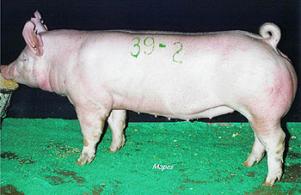
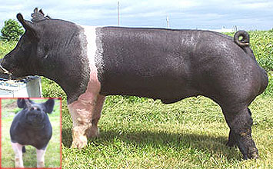
Breeds of Hogs
White vs. dark breeds
Maternal vs. Terminal breeds
Pictures from Burzlaff Show Pigs and Cain Farms

Slide 2
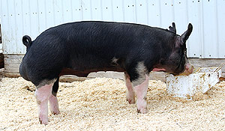
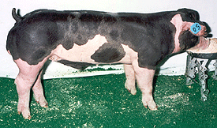
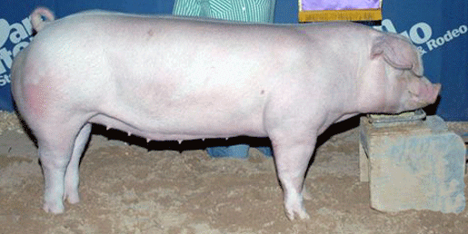
Breed Identifiers
Color
  Watch for “points”
Head
  Ears
Pictures from: Conover Show Pigs, Eddie Farms, Olson Spot Farm, Stephens Farm

Slide 3
Important breeds of Pig
BERKSHIRE
Developed in England
Came to U.S. in 1823
Medium size hog
Erect ears, short snout
6 white points

Slide 4
CHESTER WHITE
Developed in PA.
Drooped ears
Known for mothering ability

Slide 5
DUROC
Developed in eastern U.S.
Drooped ears
Red in color
One of the most popular breeds in U.S.

Slide 6
HAMPSHIRE
Developed in England
Erect ears
White band circling the body
Know for lean meat

Slide 7
POLAND CHINA
Developed in Ohio
Black with six white points
Drooping ears
One of the larger breeds of hogs
Used in cross breeding programs

Slide 8
SPOTTED BREED
Developed in Indiana
At least 20% of body must be either black or white
First known as the Spotted Poland China

Slide 9
TAMWORTH:
Originated in England
Brought to U.S. in 1882
Red in color
Lean meat
Excellent mothering ability

Slide 10
YORKSHIRE
Developed in England
Came to U.S. in 1800s
Erect ears
Sometimes has black freckles

Slide 11
AMERICAN LANDRACE
Developed around 1895
Long body length
Ears large and drooping
Sows noted for good milk production

