Slide 1


Unit I
Lecture 2: Plants containing nitrates/ nitrites
VPT-609 (2+0)
Toxicology of Plants and Toxins
Dr. Kumari Anjana
Asstt. Prof. cum Jr. Scientist
Deptt. Of Vety. Pharmacology and Toxicology
B.V.C, BASU,Patna

Slide 2
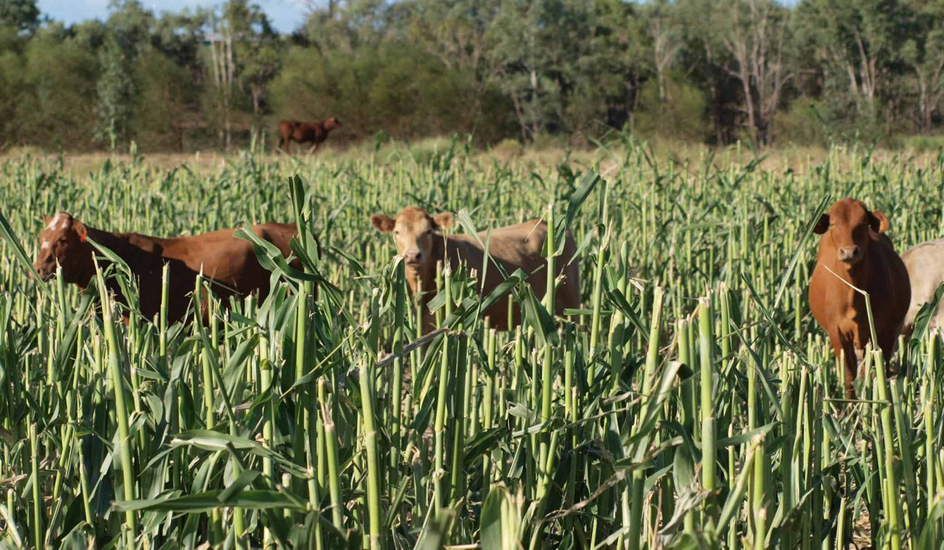
Plants containing Nitrates/Nitrites

Slide 3
Sources
Ingestion of nitrate/nitrite through forage and plants.
Improperly stored hay (damp) or silage: microbial reduction of nitrate to nitrite.
Phenoxy acetic acid derivative herbicides: 2,4-D and 2,4,5-T increase nitrate content of grasses.
Agricultural Source: Fertilizers: Runoff water from agricultural fields sprayed with nitrate fertilizers contaminating water in ponds.
Accidental ingestion of nitrate fertilizers.
Chronic drinking of well water in nitrate rich areas.
Excess use of Na nitrite in HCN poisoning.
Drinking refuge water from meat processing plants: nitrates/nitrites used in pickling and curing brines for preserving meats.

Slide 4
Sources : Nitrate rich plants
Amaranthus,
Astragalus,
Brassica,
Ipomoea,
Sorghum,
Chenopodium Spp,
Beta vulgaris,
Zeamays etc.
barley,
wheat,
rye
Sudan grasses,
corn,
beets,
rape,
docks,
sweet clover
nightshades.

Slide 5
Species Variation
Ruminants are more sensitive than nonruminants: Ruminal microfloral reduction of nitrate to nitrite (intermediate of ammonia formation).
Cattle are the most susceptible.
Among nonruminants: Young pigs: reduction of nitrate to nitrite by intestinal microflora, but not in adults (age limited pathway).
Simultaneous feeding on subabul increases nitrate toxicity: favours conversion of nitrate to nitrite.
Pre-existing anaemia aggravates nitrate toxicity.
Cereal based/concentrate diets reduce nitrate toxicity (carbohydrate rich diets).

Slide 6
Toxicokinetics
Normally nitrates ingested in limited quantities are utilized for synthesis of proteins through reduction to nitrite and formation of ammonia with the help of ruminal microflora.
Ruminal microfolora Ruminal microflora
Nitrate nitrite NH2OH Ammonia
                Rate limiting reaction
Protein synthesis
If excess nitrates are ingested or the reduction of nitrate exceeds the ruminal microbial reduction of nitrite to ammonia, nitrites accumulate in rumen and absorbed resulting in toxicity.

Slide 7
Mechanisms of Toxicosis
Mathaemoglobinaemia and Vascular Shock.
Nitrite combines with Haemoglobin: tissue hypoxia/anoxia. Tissue death due to oxystarvation.
Hypotension: Nitrite ions (NO⁻) formed from nitrate relax vascular smooth muscles: Dilatation of blood vessels: pooling of blood in large blood vessels: decreased venous return: reduced cardiac out put (Vascular shock).

Slide 8
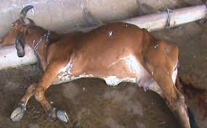
Clinical Signs
Acute: Signs appear if 20-40% haemoglobin is converted to methaemoglobin.
The signs are respiratory distress (hypoxia/anoxia), gasping, rapid respiration and heart rates, rapid and weak pulse, terminal convulsions, coma and death.

Slide 9
Other signs: Salivation, diarrhoea, colic, muscular weakness, ataxia.
Pregnant animals: abortion (due to decrease in progesterone concentration) and also the nitrites cross placenta and cause foetal death.
Chronic: Hypothyroidism, Vitamin A deficiency, infertility, immunosuppression.

Slide 10
Necropsy:
Chocolate or coffee colored blood. Generalized cyanosis.
Diagnosis:
Analysis of rumen contents for nitrate/nitrite: Blood (> 20 µg/ml).
If PM delayed specimens for toxic analysis: aqueous humour or CSF.

Slide 11
Treatment
Specific Antidotal Therapy: Regeneration of haemoglobin from methaemoglobin:
Reduction
Methylene Blue Leuco Methylene Blue (reducing agent)
↓ Activation of
Nitrite ↓ Diaphorase I and II +
Haemoglobin (Fe⁺⁺) → Methaemoglonin (Fe⁺⁺⁺) → Haemoglobin (Fe⁺⁺)
Oxidation Reduction
Leuco methylene blue activates Diaphorase I and II, which facilitate reduction of methaemoglobin to haemoglobin.
Methylene blue as 1% sol by slow iv injection @ 8.8 mg/kg in ruminants or 4.4 mg/kg in nonruminants. Repeat after 16-30 min if clinical response is not satisfactory.
Ascorbic acid as reducing agent 5 – 20 mg/kg iv.

Slide 12
Supportive treatment
Blood transfusion.
Shock therapy (adrenaline to increase BP).
Broad spectrum antibiotics through large volumes of water into rumen to reduce ruminal microfloral reduction of nitrates to nitrites.
Mineral oil (liquid paraffin) or saline purgatives to expel nitrates/nitrites from GIT.

Slide 13
Thank You

