Slide 1
Biochemistry
UNIT-III
Diabetes Mellitus

Slide 2
What is diabetes?
Diabetes mellitus (DM) is a group of diseases characterized by high levels of blood glucose resulting from defects in insulin production, insulin action, or both
The term diabetes mellitus describes a metabolic disorder of multiple aetiology characterized by chronic hyperglycaemia with disturbances of carbohydrate, fat and protein metabolism resulting from defects in insulin secretion, insulin action, or both
The effects of diabetes mellitus include long–term damage, dysfunction and failure of various organs

Slide 3
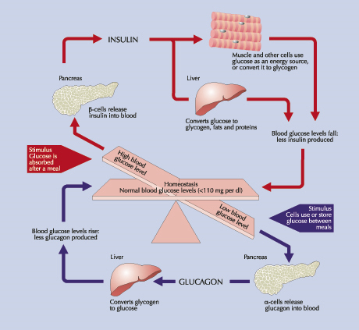

Slide 4
Insulin
Produced by the β cells in the islets of Langherans of the pancreas
Promotes glucose transport from the bloodstream across the cell membrane to the cytoplasm of the cell
Analogous to a “key” that unlocks the cell door to allow glucose inside
↑ Insulin after a meal:
Stimulates storage of glucose as glycogen
Inhibits gluconeogenesis
Enhances fat deposition in adipose tissue
Fasting state
Counter-regulatory hormones (especially glucagon) stimulate glycogen → glucose
When glucose unavailable during fasting state
Lipolysis (fat breakdown)
Proteolysis (amino acid breakdown)

Slide 5
Symptoms
Diabetes mellitus may present with characteristic symptoms such as thirst, polyuria, blurring of vision, and weight loss
In its most severe forms, ketoacidosis or a non–ketotic hyperosmolar state may develop and lead to stupor, coma and, in absence of effective treatment, death
Often symptoms are not severe, or may be absent, and consequently hyperglycaemia sufficient to cause pathological and functional changes may be present for a long time before the diagnosis is made

Slide 6
ALTERED CHO METABOLISM
↓ Insulin
↓
↓ Glucose Utilization
+
↑ Glycogenolysis
↓
Hyperglycemia
↓
Glucosuria
(osmotic diuresis)
Polyuria*
(and electrolyte imbalance)
↓
Polydipsia*
* Hallmark symptoms of diabetes

Slide 7
ALTERED PROTEIN METABOLISM
↓ Insulin
↓
↑ Protein Catabolism
↓
↑ Gluconeogenesis
(amino acids → glucose)
↓
Hyperglycemia
↓
Weight Loss and Fatigue

Slide 8
ALTERED FAT METABOLISM
↓ Insulin
↓
↑ Lipolysis
↓
↑ Free fatty acids + ketones
↓
Acidosis + Weight Loss

Slide 9
Types of Diabetes
Type 1 Diabetes Mellitus
Type 2 Diabetes Mellitus

Slide 10
Type I diabetes
Was previously called insulin-dependent diabetes mellitus (IDDM) or juvenile-onset diabetes
Type 1 diabetes develops when the body’s immune system destroys pancreatic beta cells, the only cells in the body that make the hormone insulin that regulates blood glucose
This form of diabetes usually strikes children and young adults, although disease onset can occur at any age
Type 1 diabetes may account for 5% to 10% of all diagnosed cases of diabetes
Type 1 diabetes is common is dog

Slide 11
Type II diabetes
Was previously called non-insulin-dependent diabetes mellitus (NIDDM) or adult-onset diabetes
Type 2 diabetes may account for about 90% to 95% of all diagnosed cases of diabetes
It usually begins as insulin resistance, a disorder in which the cells do not use insulin properly. As the need for insulin rises, the pancreas gradually loses its ability to produce insulin
Type 2 diabetes is associated with older age, obesity, family history of diabetes, history of gestational diabetes, impaired glucose metabolism, physical inactivity, and race/ethnicity
Type 2 diabetes is Common in Cat

Slide 12
Comparisons of Type 1 & Type 2
Type 1 (5-10%)
Sudden onset
Severe symptoms
Weight loss
Lean
Ketosis
Absent C-peptides
Markers of autoimmunity present
Family history uncommon
Onset usually in the young
Most common in dog
Type 2 (90-95%)
Gradual onset
May be Asymptomatic
Often no weight loss
Usually obese
Not ketotic
C-peptide detectable
No markers of autoimmunity present
Family history
Onset usually >40 years old
Most common in dog
Notes:
Insulin resistance is a characteristic feature of both obesity and diabetes - there are fewer insulin receptors as well as there being faults potentially with the receptors so the body is not able to respond adequately
Insulin resistance is thought to be caused by both genetic factors and lifestyle. Modern lifestyles with rich diets and little exercise have been linked to insulin resistance and Type 2 diabetes. An increase in body weight can trigger insulin resistance in people who are genetically prone to the condition. More than 25 % of people worldwide are estimated to be insulin resistant, although this does not mean that they have diabetes.
Insulin resistance is also linked to other conditions, such as high blood pressure and cholesterol problems, which can lead to heart and circulation problems. This may be why people with Type 2 diabetes are more likely to suffer from heart disease or stroke. In fact, heart disease is the most common cause of death amongst people with Type 2 diabetes.
Syndrome X is a cluster of features such as glucose intolerance, obesity, hypertension, accelerated atherosclerosis,low HDL and high triglycerides and VLDL. Other abnormalities are increased clotting due to increased levels of fibrinogen.

Slide 13
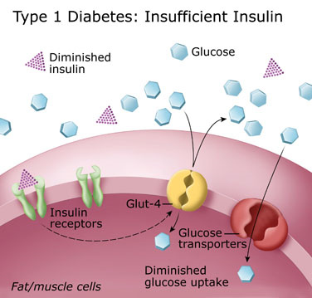
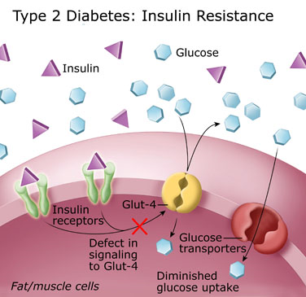

Slide 14
Diagnosis
Blood glucose
Fasting blood glucose-less than 120mg/dl
Post-prandial (PP) glucose-less than 140mg/dl
Renal threshold level- 180 mg/dl
Urine glucose
Glucose is present in urine when blood glucose level exceeds renal threshold level
Benedict test

Slide 15
Glucose tolerance test (GGT)
Oral Glucose tolerance test (OGGT)
Intravenous Glucose tolerance test (IGGT)

Slide 16
Oral Glucose tolerance test
Overnight (at least 12 hr) fasting state
Oral glucose bolus of 4 g/kg body weight given as a 50% w/v solution
Blood and urine samples are collected at 30 minute intervals for at least 180 minutes
Blood samples are subjected to glucose estimation
Urine samples are qualitatively tested for glucose

Slide 17
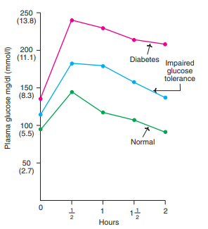
Fasting plasma glucose level is 80–120 mg/dl
Peak value (140 mg/dl) is reached in less than an hour Returns to normal by 2 hours
Glucose is not detected in any of the urine samples

Slide 18
Intravenous Glucose tolerance test (IGGT)
Overnight (at least 12 hr) fasting state
Glucose bolus of 500 mg/kg body weight as a 50% solution, administered into a cephalic forelimb vein over 30 s
Blood and urine samples are collected at 15 minute intervals for at least 120 minutes
Blood samples are subjected to glucose estimation
Urine samples are qualitatively tested for glucose.

Slide 19
Insulin Tolerance test
Overnight (at least 12 hr) fasting state
0.1 unit of crystalline zinc insulin per kilogram body weight is injected intramuscularly
Blood and urine samples are collected at 30 minute intervals for at least 180 minutes
Blood samples are subjected to glucose estimation

Slide 20
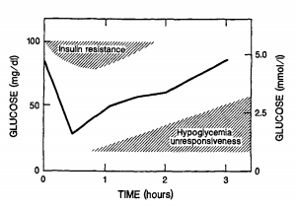
Normally, the blood glucose level falls to 50% of its fasting level in 20-30 minutes and returns to its fasting level in 1.5-2 hours

Slide 21
Hemoglobin Alc
Glycated or glycosylated hemoglobin refers to the glucose derived products of normal adult hemoglobin (HbA)
Glycation is a post-translational, nonenzymatic addition of sugar residue to amino acids of proteins
Among the glycated hemoglobins, the most abundant form is HbA1c
In the case of canine HbAlc where the canine erythrocyte has a lifespan of 100 days and a half-life of about 60 days, HbAlc reflects the average blood glucose over the previous 2 months prior to sampling

Slide 22
Hemoglobin Alc
In the cat, with an erythrocyte lifespan of 70 days and a half-life of about 40 days, HbAlc could be used as a measure of the average blood glucose over the previous 6 weeks.
Normally, HbA1c concentration is about 3–5% of the total hemoglobin
In diabetic patients, HbA1c is elevated (to as high as 15%)

Slide 23
Fructosamine
Glycated serum proteins (fructosamine) can also be measured in diabetics
Total serum proteins or albumin have life span and half-lives of 2-3 weeks and 7-9 day
fructosamine can be used to mesure average blood glucose over the previous 2 weeks

Slide 24
Microalbuminuria
Microalbuminuria is defined as the excretion of 30-300 mg of al
Predicts impairment in renal function in diabetic patientsbumin in urine per day
Serum lipid profile: Triglycerides, Cholesterol, LDL, VLDL, HDL

