Slide 1
VBC-605 Unit II Enzyme kinetics

Slide 2
Factor affecting enzyme kinetics
1. Enzyme concentration
2. Temperature
3. Hydrogen ion concentration or pH
4. Substrate concentration
5. Inhibitors
6. Product concentration
7. Activators
8. Physical agents

Slide 3
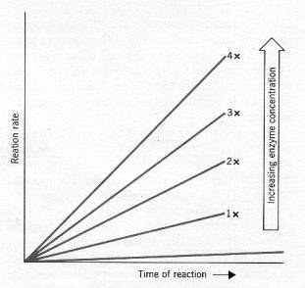
Enzyme concentration
The rate of enzyme catalyzed reaction is directly proportional to the concentration of enzyme.
The plot of rate of catalysis versus enzyme concentrations a straight line

Slide 4
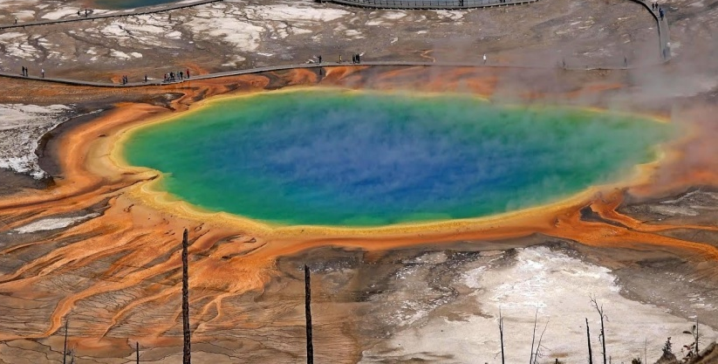
Temperature
Increase with temperature
Bell shape curve
Q10 (temperature coefficient)- factor by which the rate of biological reaction increases for a 10ºC increase in temperature
Optimum temperature
Mostly at body temperature
Some enzyme may be active above body temperature e.g. sanke venom phosphokinase, muscle adenylate kinase, urease, enzymes in thermophillic bacteria

Slide 5
Rise or fall in enzyme activity with temperature is prominent survival feature in “Cold blooded” animals
In mammals- assumes physiological importance e.g. fever, hypothermia

Slide 6
pH
Bell shape curve
Optimum pH
Most show at neutral pH (6-8)
Since enzymes are proteins pH changes affect.
1. Charged state of catalytic site
2. Conformation of enzyme molecules

Slide 7
Optimum pH for various enzyme
Trypsin- 7.6
Pepsin- 2-2.5
Acid phosphatase- 5
Alkaline phosphatase- 9-10
Enzymes from fungi- 4-6

Slide 8
Product concentration
Accumulation - decreases the velocity
In biological system this is prevented by quick removal of product

Slide 9
Activators
Inorganic metallic cation/anions acts as activators by combining with substrate, ES complex, change in conformation of active site
Metal activated enzymes- e.g. ATPase, Enolase
Metalloenzyme- e.g.Pyruvate oxidase, cytochrome oxidase

Slide 10
Inhibitors
Make active site unavailable to substrate or
Change enzyme structrure

Slide 11
Physical agents
Light, radiation ( u.v., X- rays, gamma rays etc)
e.g. salivary amylase- activity increased by red/ blue light whereas decreased by u.v. light

Slide 12
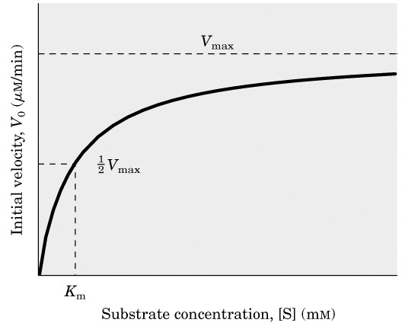
Substrate concentration
Rectangular hyperbola (Michaelis plot)
Initial velocity- velocity when little substrate is reacted

Slide 13
Reasons for the three phases of the curve can be interpreted
1. In the first phase, substrate concentration is low and most of the enzyme molecules are free so they combine with the substrate molecules. Therefore, velocity is proportional to substrate concentration. At this state, enzymatic reaction shows first-order kinetics
2. In the second phase, half of the enzyme molecules are bound to substrate, so the velocity is not proportional to substrate concentration. At this stage, enzymatic reaction shows mixed-order kinetics
3. In the third phase, all the enzyme molecules are bound to substrate, so velocity remain unchanged because free enzyme is not available though the substrate is in excess. At this stage enzymatic reaction shows zero-order kinetics

Slide 14
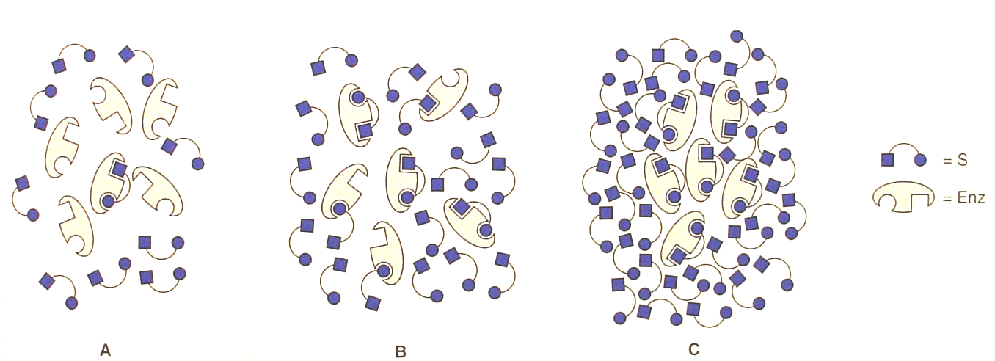
A. Low [S] B. 50% [S] or K_{m} C. High, saturating [S]

Slide 15
Steady State Assumption
The M-M equation was derived in part by making several assumptions. An important one was: the concentration of substrate must be much greater than the enzyme concentration.
In the situation where [S] >> [E] and at initial velocity rates, it is assumed that the changes in the concentration of the intermediate ES complex are very small over time (v_{o}).
This condition is termed a steady-state rate, and is referred to as steady-state kinetics. Therefore, it follows that the rate of ES formation will be equal to the rate ES breakdown.

Slide 16
Michaelis-Menten Equation Derivation
3
2
4
Rate of ES formation = k1([ET] - [ES])[S] (where [ET] is total concentration of enzyme E and k₄ is considered neglible)
Rate of ES breakdown to product = k 2[ES] + k3[ES]

Slide 17
Thus for the steady state assumption:
k₁([E_{T}] - [ES])[S] = k₃[ES] + k₂[ES]
This equation is the basis for the final Michaelis-Menten following algebraic rearrangement and substitution of K_{m} and V_{max} terms

Slide 18
Michaelis-Menten Equation
In which:
v initial reaction velocity at [S]
K_{M} the Michaelis constant
v_{max} the maximum possible initial reaction velocity

Slide 19
Michaelis Constant (K_{m} )
The substrate concentration that produces half the maximal velocity (Vmax/2) is known as Michaelis constant (K_{m} )

Slide 20
Meaninig of K_{m}
Michaelis constants have been determined for many of the commonly used enzymes. The size of K_{m} tells us several things about a particular enzyme:
A small K_{m} indicates that the enzyme requires only a small amount of substrate to become saturated. Hence, the maximum velocity is reached at relatively low substrate concentrations.
A large K_{m} indicates the need for high substrate concentrations to achieve maximum reaction velocity.
The substrate with the lowest K_{m} upon which the enzyme acts as a catalyst is frequently assumed to be enzyme's natural substrate, though this is not true for all enzymes.
A K_{m} of 10⁻⁷ M indicates that the substrate has a greater affinity for the enzyme than if the K_{m} is 10⁻⁵ M.

Slide 21
Significance of K_{m}
1. enzyme kinetic constant.
2. Indicates the substrate concentration required for the enzyme to work efficiently
3. Low K_{m} indicates high affinity of enzyme towards substrate. And vice-versa. Hence,(Km α 1/affinity)
e.g. Hexokinase and glucokinase
K_{m} of hexokinase is low (1 × 10^{–5} M) whereas K_{m} of glucokinase is high (2.0 × 10^{–2} M)
4. Km is required when enzymes are used as drugs
5. Use of enzymes in immunodiagnostics (ELISA) require Km of the enzyme

Slide 22
The Catalytic Constant k_{cat}
At high substrate concentration the overall velocity of the reaction is V_{max} and the rate is determined by the enzyme concentration.
The rate constant observed under these conditions is called the catalytic constant, k_{cat,} defined as:
k_{cat} indicates the maximum number of substrate molecules converted to product each second by each active site. This is called turnover number.
The catalytic constant measures how fast a given enzyme can catalyze a specific reaction (describing the effectiveness of an enzyme)
The unit for k_{cat} is s⁻¹ (for the most enzymes, k_{cat} is 10² to 10³ s⁻¹)

Slide 23
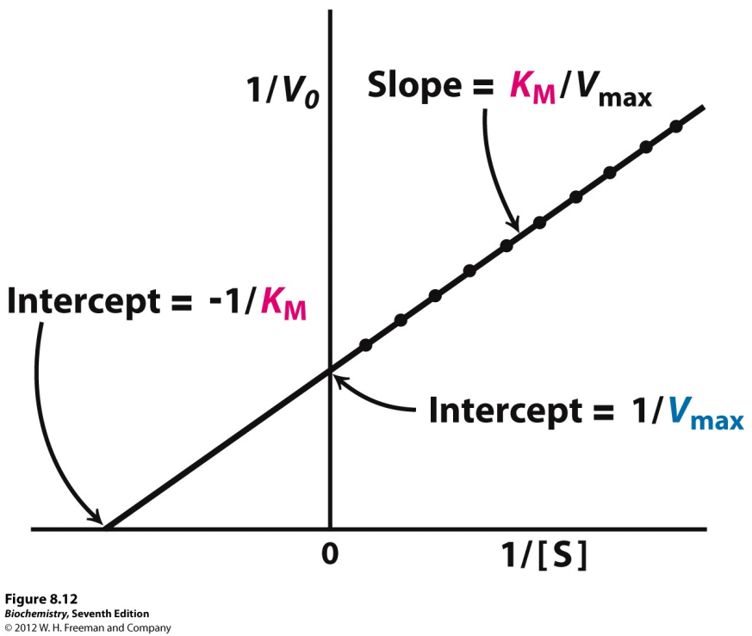
Lineweaver-BurK Plot
V = reaction velocity (the reaction rate),
Km = Michaelis-Menten constant,
Vmax = maximum reaction velocity
[S] = the substrate concentration

