Slide 1
VBC-606 Unit II Glycogenesis: formation of glycogen

Slide 2
The metabolism of glycogen in animals
Glycogenesis: formation of glycogen (de novo or enlarge)
Glycogenolysis: mobolizing glycogen
Dietary glycogen breakdown

Slide 3
Structure of glycogen particles
Glycogen can represent up to 10% of the weight of the liver and 1%~2% of the weight of the muscle.
The elementary particle of glycogen (β-particle) is about 21nm in diameter, consists of up to 55,000 glucose residues with about 2,000 nonreducing ends. Twenty to 40 of these particles cluster together to form α-rosettes (fig. 15-2, p. 562).

Slide 4
Glycogenolysis: mobilizing glycogen
While liver glycogen can be depleted in 12 to 24 hours, muscle glycogen will not last for an hour.

Slide 5
Glycogenolysis
To mobilizing glycogen, three enzymes are required: glycogen phosphorylase, debranching enzyme, and phosphoglucomutase.
The end product of glycogenolysis is glucose 6-phosphate.

Slide 6
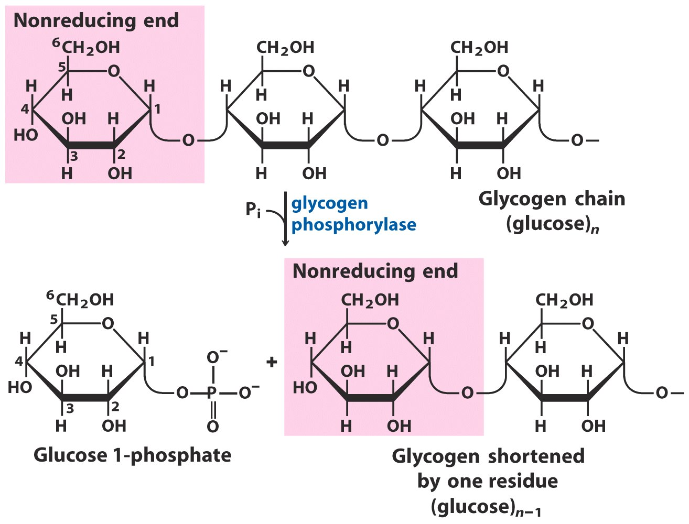
Glycogen phosphorylase use inorganic phosphate to attack nonreducing ends
phosphorolysis

Slide 7
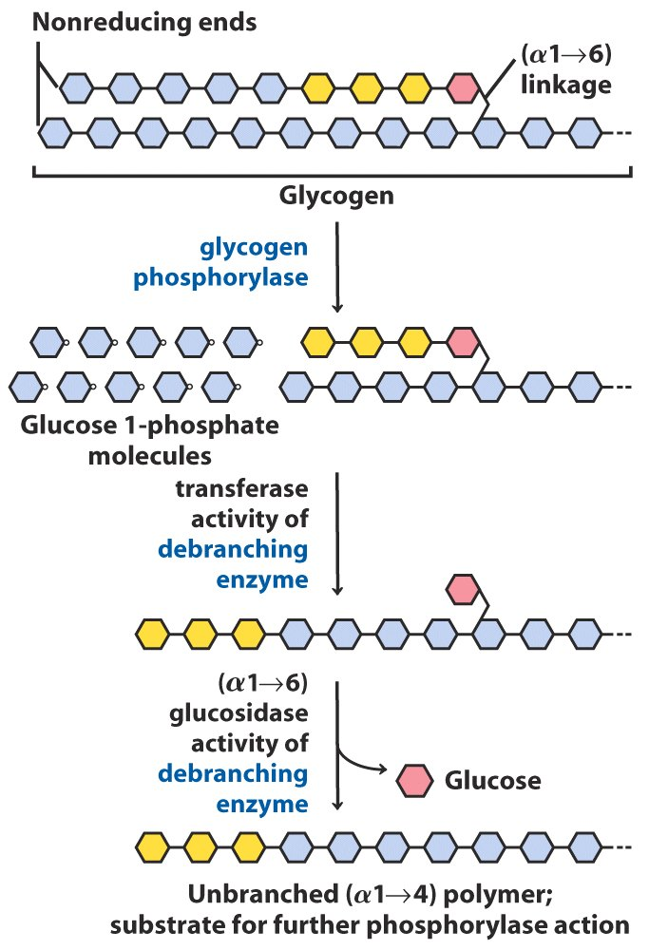
Debranching enzyme
Debranching enzyme transfer the  as whole from the branch to the main chain, then it will use its (α1→6) glucosidase activity to hydrolyze the  from glycogen for glycogen phosphorylase.

Slide 8
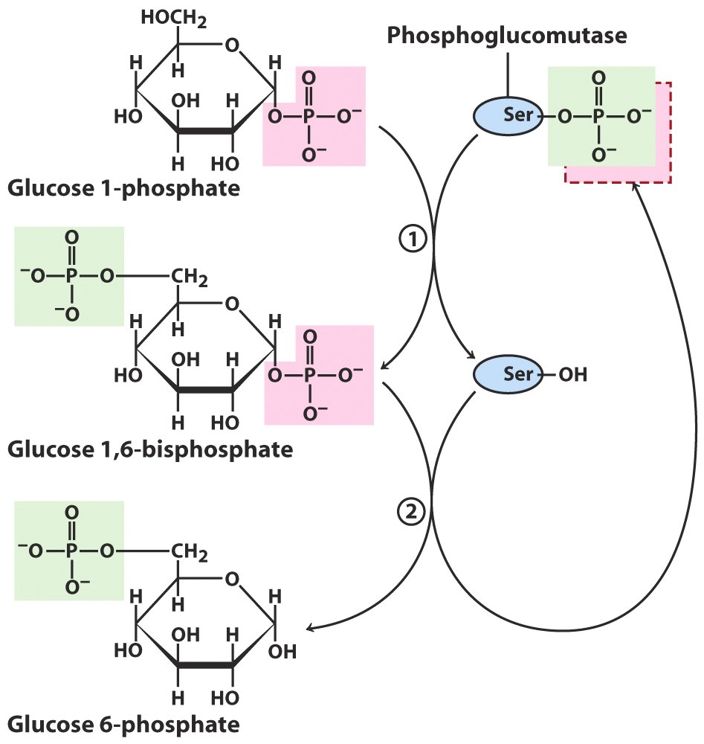
Phosphoglucomutase
Phosphoglucomutase use its phosphorylated Ser residue to convert G-1-P to G-6-P.

Slide 9
Glucose 6-phosphate
G-6-P formed in the muscle can enter glycolysis (energy source).
G-6-P formed in the liver will not enter glycolysis. Instead, it is transported into lumen of the ER, where it will be converted to glucose by glucose 6-phosphatase.

Slide 10
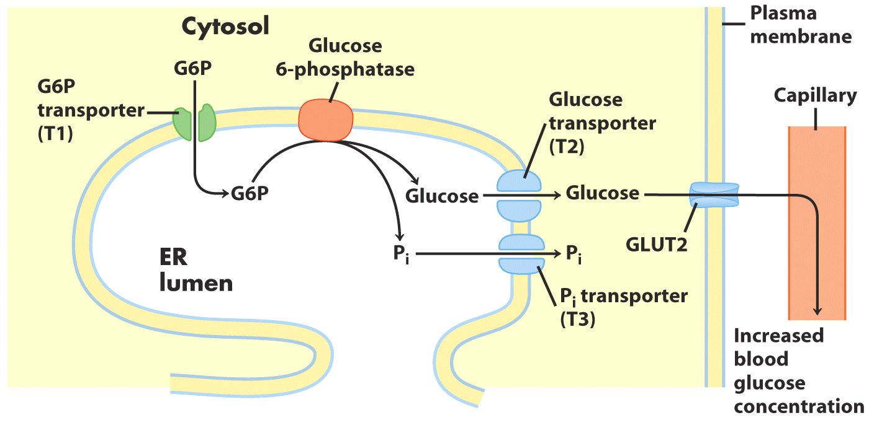
Glucose 6-phosphatase
Glucose 6-phosphatase converted T1 transported G-6-P to glucose and Pi. Then glucose and Pi are transported to cytosol by T2 and T3, and glucose leave the hepatocyte by GLUT2 transporter.

Slide 11
Glycogenesis: formation of glycogen
Glycogenin, glycogen synthase, glycogen-branching enzyme, and UDP-glucose pyrophosphorylase are required for the formation of glycogen.

Slide 12
Glycogenesis
Glycogenesis can be separated into two issues: formation of new glycogen particle and enlargement of existing glycogen particle.
Both of them require UDP-glucose as precursor, which is synthesized by UDP-glucose pyrophsphorylase.

Slide 13
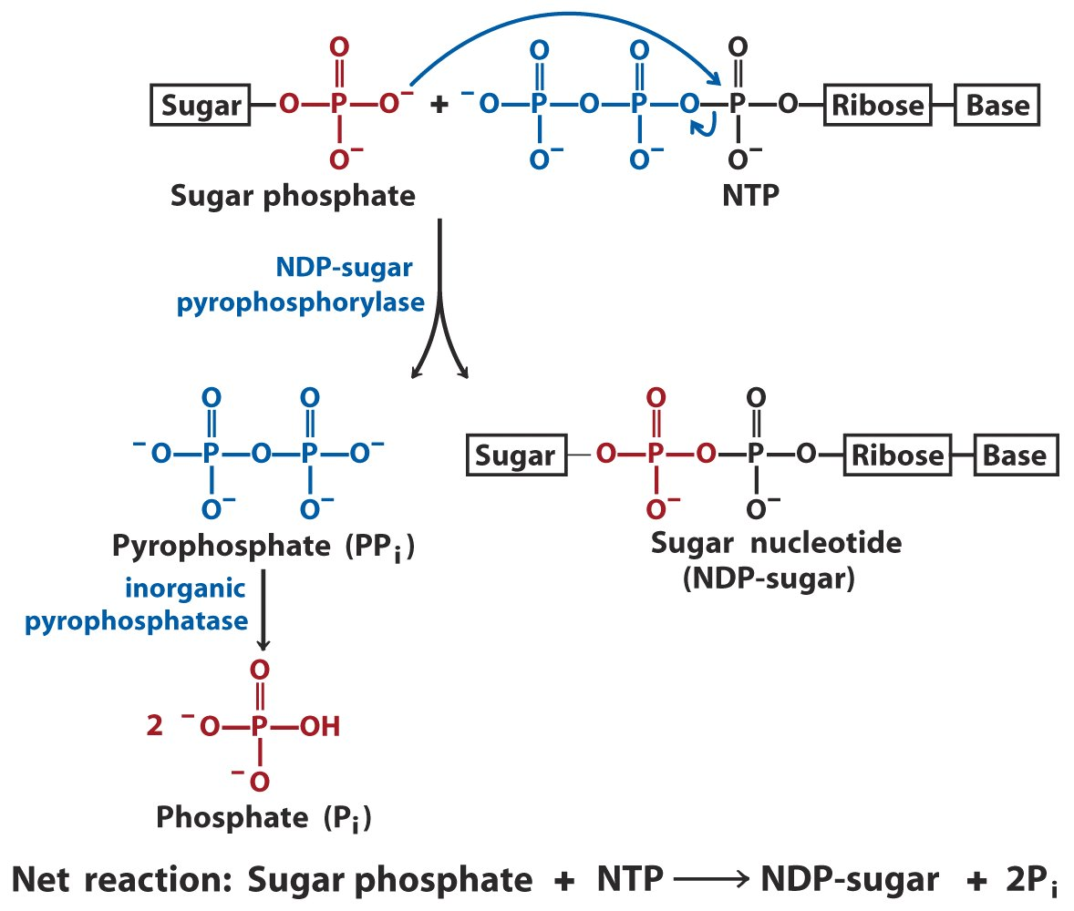
Formation of UDP-glucose
This reaction is irreversible because pyrophosphate is removed by inorganic pyrophosphatase as soon as it was generated.

Slide 14
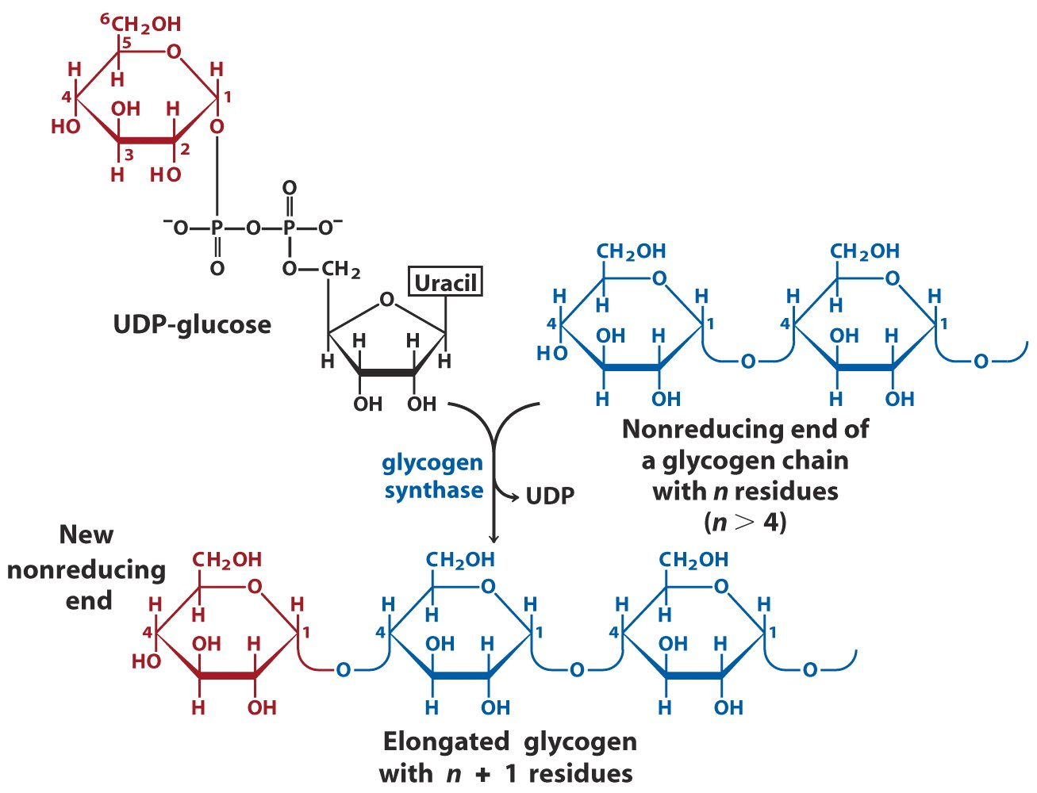
Enlargement of existing glycogen particle

Slide 15
Branching by glycogen-branching enzyme
Glycogen-branching enzyme transfer of a terminal fragment of 6 or 7 glucose redisues from the nonreducing end of a glycogen branch having at least 11 residues to the C-6 hydroxyl group of a glucose residue at a more interior position of the same or another glycogen chain.

Slide 16
Formation of new glycogen particle
Although glycogen synthase can enlarge existing glycogen particles, it cannot synthesize new glycogen particle because it need nonreducing ends from existing glycogen as primer.

Slide 17
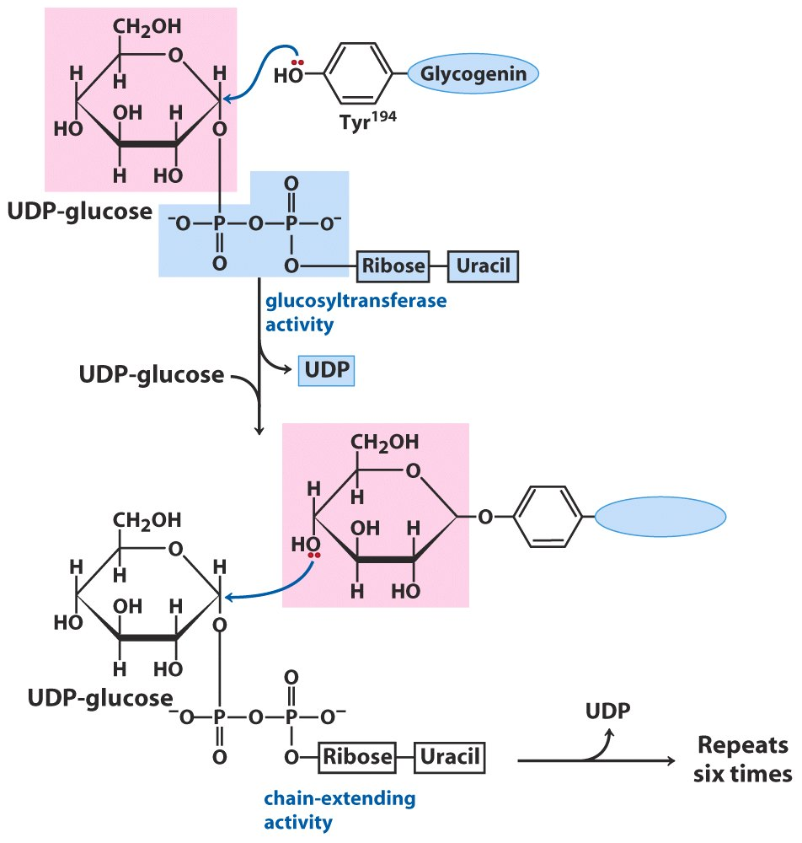
Glycogenin serves as primer for synthesis of new glycogen particles

Slide 18
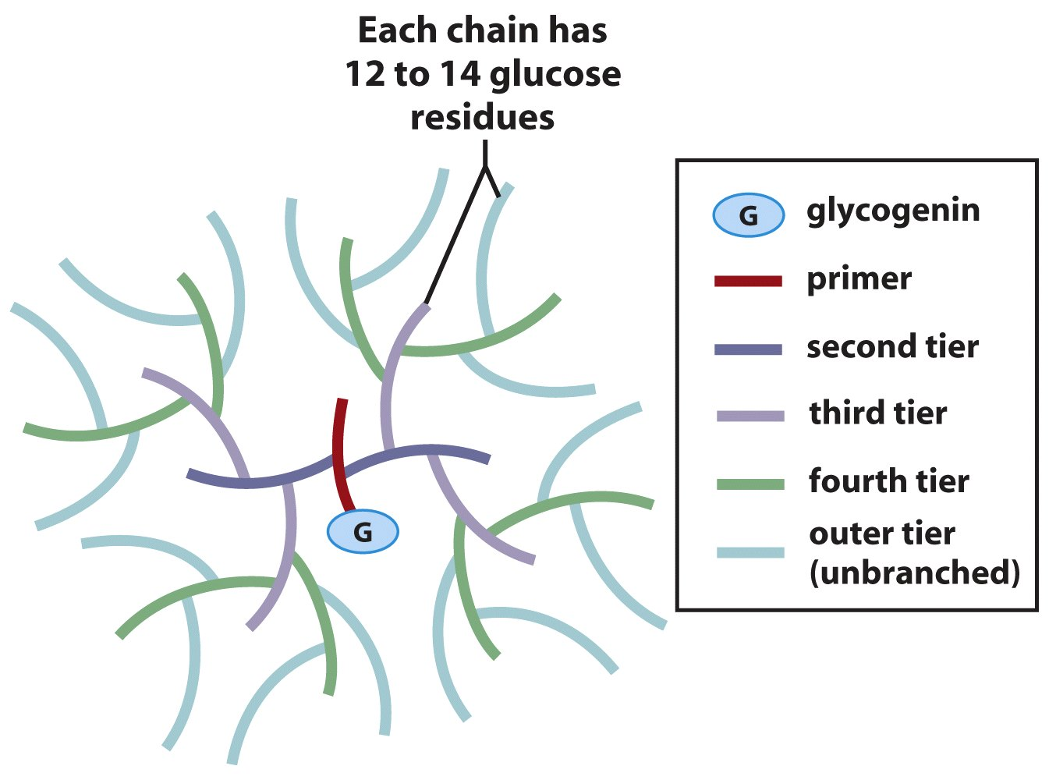
Every glycogen particle has a glycogenin buried inside

Slide 19
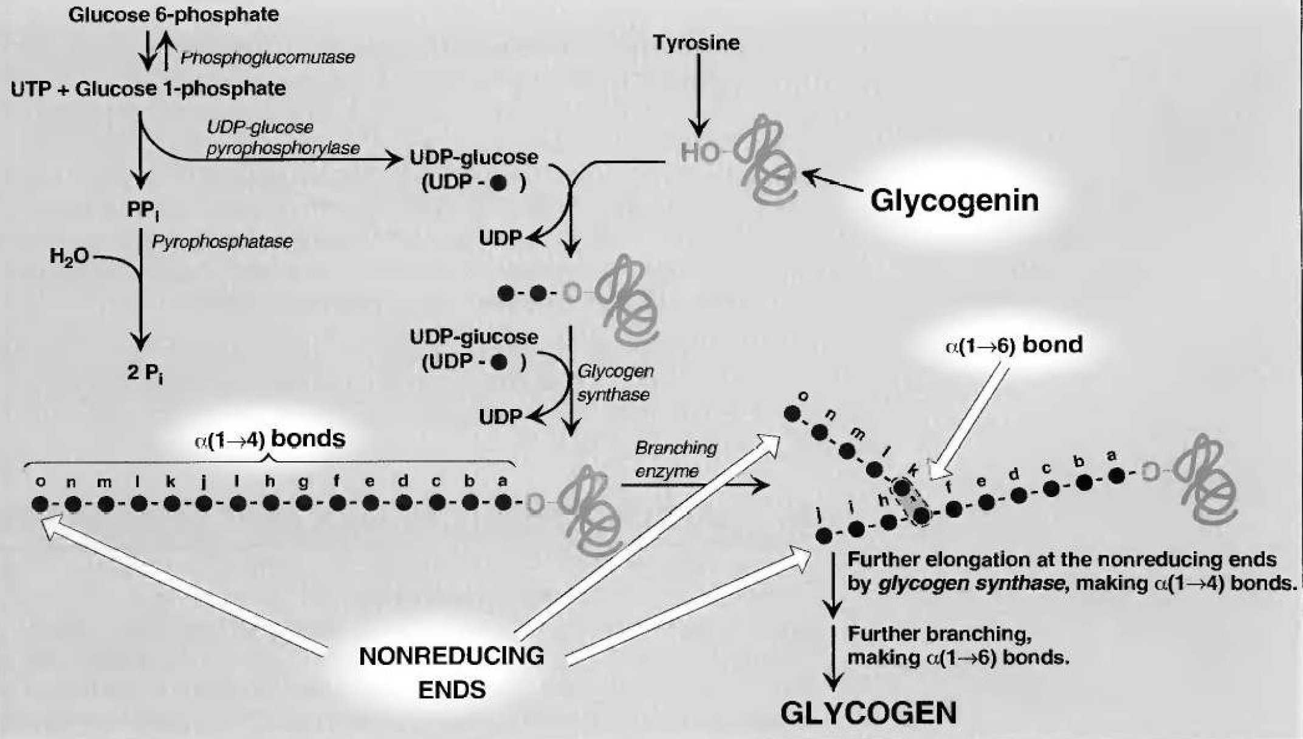
Glycogenesis

