Slide 1
Vesicular Disease
Dr Deepak Kumar
Assistant professor
Department of Veterinary Pathology
Bihar Veterinary College, Patna
Bihar Animal Sciences University, Patna - 14

Slide 3
Etiology
The family Rhabdo viridae ( G. rhabdo = rod, figuratively bullet-shaped) contains a large number of enveloped, single-stranded, negative-sense RNA viruses.
The family have two genera :
1. Vesiculovirus &
2. Lyssavirus.

Slide 4
Vesicular Disease
The three most important diseases of animals caused by rhabdoviruses are :
1.) Vesicular stomatitis from the genus “ Vesiculovirus”
2.) Rabies from the genus “Lyssavirus” &
3.) Bovine ephemeral fever from unclassified rhabdoviruses.

Slide 5
Resistance to physical and chemical action
Temperature: Inactivated by 58°C for 30 minutes
pH: Stable between pH 4.0 and 10.0
Chemicals/Disinfectants: Sensitive to formaldehyde, ether and other organic solvents; chlorine dioxide, formalin (1%), 1% sodium hypochlorite, 70% ethanol, 2% glutaraldehyde, 2% sodium carbonate, 4% sodium hydroxide, and 2% iodophore disinfectants, all effective disinfectants.
Survival: Inactivated by sunlight; survives for long periods at low temperatures

Slide 7
Etiology Foot-and-mouth Disease virus (FMDV)
Genus : Aphthovirus Family : Picornaviridae
7 serological types:
Type A – ( Among which A 22, A 5 & A 10 subtypes are more commonly occur.)
Type O,
Type C,
South African Territories (SAT) 1,
South African Territories (SAT) 2,
South African Territories (SAT) 3,
and Asia 1

Slide 8
Pathogenesis
Virus is Epitheliotropic
Virus invades epithelial cells, multiplies resulting in vesicle formation finally causing focal areas of degeneration & inflammation.
Invades lymph and blood results in viremia and reaches epithelium of other mucous membrane, interdigital space, dorsum of tongue, gums etc. producing vesicles
The cells undergo vacuolation. Pyknosis of nuceli & loosening of cell connection together with leucocytic infiltration.
The most favorable cells for the reproduction virus in middle layer of stratum spinosum.
Causes myocardial degeneration in young calves

Slide 9
Vesicular Stomatitis Synonyms : Sore mouth, Pseudo foot and mouth disease, Mouth thrush, sore nose
Vesicular stomatitis is an infectious diseased caused by vesiculovirus, & characterized clinically by the development of vesicles on the mouth and feet.
Thus, it has close similarities to foot and mouth disease & vesicular exanthema.
While primarily a disease of horses, it has come to assume major importantance as a disease of cattle & pigs.

Slide 11
There are three serotypes of the virus named as
1.)Indiana strain, 2.) NewJersey strain and 3.)Trinidad strain or Eocal strain.
The strains can be separated from each other by serum neutralization and complement fixation test.
The indiana serotype is comprised of four sub types. New Jesrsey strain is more virulent over other strains.

Slide 13
Vesicular Stomatitis
The disease was characterized by blisters; eruptive lesions in coronary bands, lips, mouth, and muzzle; salivation; claudication and loss of condition.
Swollen lower limbs and lips, and ulcerated and erosive areas in the lips and muzzle were observed in some horses.

Slide 15
Host Range
This febrile disease affects mainly horses, donkeys and cattle and pigs.
Other susceptible species include camels, several wildlife species and humans.
Vesicular stomatitis is clinically similar to foot and mouth disease.
The disease is limited to the western hemisphere and the infection is endemic in Central America and in regions of South America

Slide 16
Transmissions
The virus can be biologically transmitted by black flies (Simulium vittatum) and mechanically by Culicoides, houseflies ( Musca domestica & M. autumnalis)

Slide 18
Figure - Adapted diagram of the life cycle of VSV
1 – Binding to cell surface; 2 – Endocytosis; 3 – Fusion and uncoating; 4 – Transcription from (-) genomic RNA; 5 – G mRNA; 6 - Synthesis and glycosylation of G protein; 7 – Delivery of G protein to plasma membrane; 8 – N mRNA; 9 – P mRNA; 10 - M mRNA; 11 – M protein; 12 – M protein migration to the inner plasmatic membrane; 13 – N:P complex; 14 – (+) Replicate intermediate; 15 – (-) Progeny genome; 16 – Formation of bud site; 17 – Budding, and 18 – Progeny virion.

Slide 22
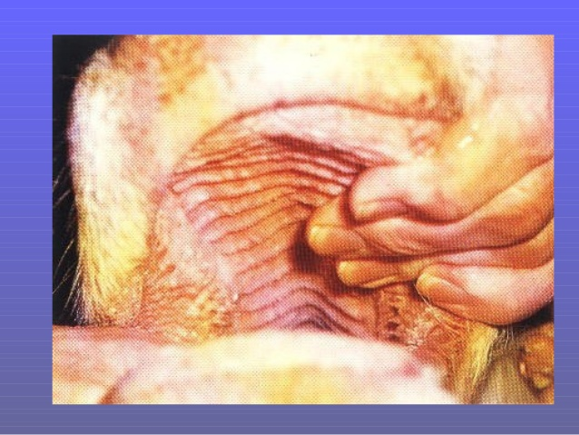
Vesicular stomatitis

Slide 25
Lesions of Vesicular stomatitis swollen 1.lips presence of erosions and vesicles in the skin (arrow) 2. severe erosive lesions of the skin of the upper lip and face.

Slide 26
Changes in Microscopic slid
Vesiculopustular dermatitis with severe infiltration by neutrophils in the dermis. Hematoxylin and eosin (HE).
necrotizing vesiculopustular dermatitis with severe infiltration by neutrophils. Ballooning degeneration and necrosis are observed in the epidermis. HE. Bar = 100 µm.

Slide 27
Diagnosis
Specimens for isolation of virus -epithelium from lesions and vesicular fluid
Prompt laboratory confirmation is required because of similarities between vesicular stomatitis, foot-and-mouth disease and swine vesicular disease.
If horses present with vesicular lesions, infection with vesicular stomatitis virus should be considered
Antigen detection- CFT or ELISA.
FAT, ELlSA, CFT or the virus neutralization tests are suitable for identification of the isolates

Slide 28
Vesicular Stomatitis In Humans
Vesicular stomatitis in humans tends to cause severe flu-like symptoms such as headache, fever, muscle aches, and extreme fatigue. People rarely develop blisters in their mouths. However, if you experience influenza-like symptoms after working with a VS-infected horse.

Slide 29
Swine vesicular disease
This disease is caused by Swine vesicular disease virus (SVDV) of Entero virus genus, Family Picornaviridae.
The SVD virus is closely related to the human enterovirus, Coxsackie B-5 virus.
This disease was first reported in feeder pigs in Italy in 1966. It has since been reported in Great Britain (declared free in 1980), several European countries, and Asia.
There have been reports of aseptic meningitis in humans caused by SVDV.
Spread is by direct contact and fomites. Several outbreaks have been traced to uncooked or insufficiently cooked pork in garbage

Slide 30
Clinical Sign.
Clinically indistinguishable from foot-and-mouth disease (FMD), vesicular stomatitis (VS), and vesicular exanthema (VE). Epithelial tissue is initially involved, followed by viraemia with generalized infection of lymphoid tissues
The first signs - reduced feed intake, lameness and tenderness of the feet, fever up to 106°F, and the formation of vesicles on the feet, snout, tongue, mouth, nostrils, and teats.
The prognosis is favorable, but in most countries infected animals are slaughtered.

Slide 34
Inoculation and susceptibility
DISEASE | CATTLE | HORSE | PIG | SHEEP | GUINEA PIG | MAN
FMD | + | - | + | + | + | +
VESICULAR STOMATITIS | + | + | + CATTLE ONLY | + CAN-LINGUAL | + BE ROUTE | + INFECTED
VESICULAR EXANTHEMA | - | CAN BE INFECTED | + | - | - | -

