Slide 1
Abattoir Effluent Treatment (A part of Unit III- 3rd Prof. Year)
By
Dr. Gargi Mahapatra
Assistant Professor cum Junior Scientist
Bihar Veterinary College
B.A.S.U., Patna.

Slide 2
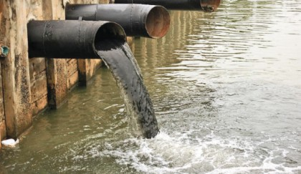
What are effluents?
Effluents are liquid wastes (treated/ not treated) which are passed through a plant’s sewer pipe, to
be discharged into
water bodies

Slide 3
Composition effluents
General
Fats/ Oils/ Greases (FOGs),Chemicals, Detergents, Heavy Metal Rinses, Living Tissues, Solids, Food Wastes, Microbes, Toxins, Organic Matter etc….
Abattoirs & Meat Plants
Elevated level of concentrated nutrients including FOGs, organic matter, micro-organisms, suspended solids, and detergents
All components of effluents have a potential to pollute natural waters.

Slide 4
Why The effluents need to be treated?
Effluent
generated although
non toxic but has large
amount of organic matters &
suspended solids. Direct discharge
of these effluents into the water bodies
causes depletion of Dissolved Oxygen (D.O.)
as well as disturbs the pH of the environment in
which the aquatic organisms thrive.

Slide 5
Points of effluent production in an abattoir
Lairage
Bleeding
Dressing
Paunch Handling
Processing
By-Product Handling
Cleaning

Slide 6
Terminologies Defining Quality of Waste water
Chemical Oxygen Demand
The amount of dissolved oxygen required for the chemical oxidation of total organic matter in water. A chemical oxidation process
COD >
Bio-chemical Oxygen Demand
The amount of dissolved oxygen which is consumed by bacteria while decomposing organic matter under aerobic conditions. A biological oxidation process
BOD

Slide 7
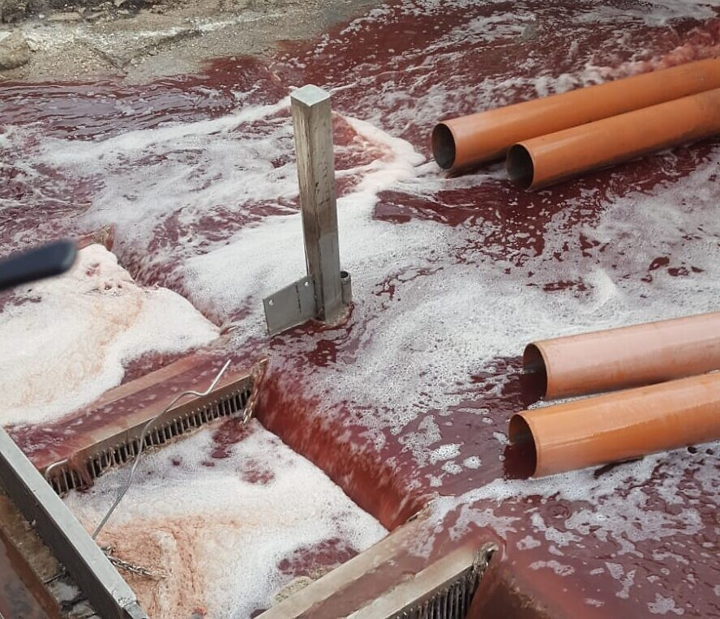
BOD of effluents produced in abattoirs and meat plants.
Poultry Meat Plant- 1000-1200 ppm
Pig Meat Plant- 1500-2000 ppm
Cattle & Sheep- 1400-3200 ppm
Meat Plant
Fish - 1000-3000 ppm
Processing
Dairy - 600-1300 ppm
Plant

Slide 8
Steps of Effluent Treatment
Stage I
(Screening of solids and
Removal of fats)
Stage II I
(Biodegradation of Organic Matter)
Stage III I
(Sedimentation and Disinfection)

Slide 9
Stage I of Effluent Treatment
Primary Filtration
(Effluent passed through strong steel mesh)
Secondary Filtration
(Re-filteration by vibrating screen with a fine mesh arranged at an angle)
Fat Separation
(Water agitated and air pumped, Fat rises upwards which is skimmed)
Equalization
(Activated sludge, a biological stimulant added in small quantity)
**End of this step 65%nof solids & 90% of fat is removed reducing the BOD by 35% .

Slide 10
Stage II of Effluent Treatment Biological Oxidation
Aerobic Process
Occurs in open areas.
Pond of 1 m depth filled with waste water and is agitated in presence of ample air supply
* For meat plants a combination of both used
Anaerobic Process
Occurs in closed areas.
Deep tank having 4-5 m depth is filled with waste water and is agitated.
Results in 60% reduction in BOD of treated water.

Slide 11
Stage III of Effluent Treatment Sedimentation and Disinfection
Sedimentation:- The un-oxidized organic matter and other suspended material is removed through gravitational force and supernatant fluid is directed towards the disinfection tank or the sewer line.
Disinfection:- The supernatant is then disinfected with chlorine treatment UV treatment etc. and then discharged to water bodies through sewer lines.

Slide 12
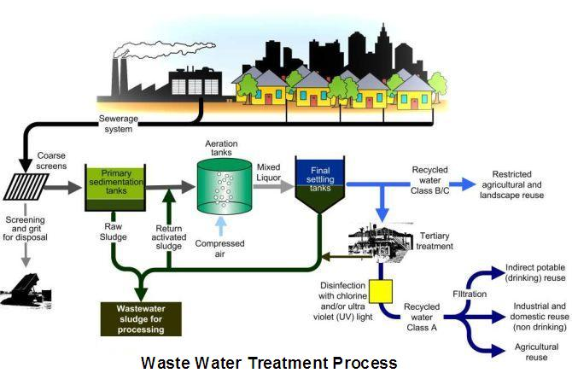
Abattoir effluent treatment plant
Sludge Semi-solid Fertilizer/ Composting
Dried Sludge Landfill/ Fuel

Slide 13
Thank You

