Slide 1
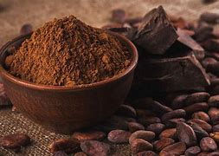
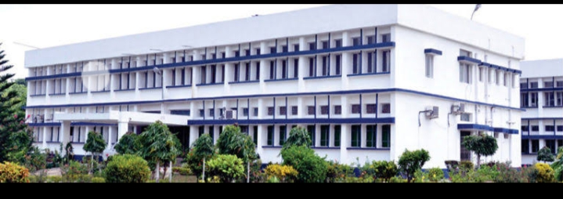
Department : Dairy Technology Course Title : Food Technology I Course No. : DTT -322 Course Teacher: Bipin Kumar Singh
COCOA POWDER

Slide 2
Processing of Cocoa Bean
Roasting
Objectives of Roasting
Reduction of moisture
Release of the beans from the shell
Develop chocolate flavour
Changes the colour of the beans (nibs) affecting the appearance of the finished chocolate.

Slide 3
Roasters
Batch or Continuous roasters
§ Hot air treatment
§ Saturated steam treatment
§ Infra-red treatment
Depending on the bean type, the beans are heated to 110-220oC. Temperatures from 70-200oC are reported depending on machine, and also on the use that will be made of the beans.
Certain type of milk chocolate requires beans with a very mild roasting. When pressing process is involved, a high roast is used to:
(i) obtain sufficient reduction in bacteria count, and
(ii) good reduction in thermo-resistant spores.

Slide 4
Contd…
Flavour generation: Maillard browning forms glucosylamines or fructosylamines Other compounds formed include pyrazines, pyrroles, pyridines, imidazoles, thiazoles andoxazoles.
Production of aldehydes from amino acids plays an important role in flavour balance of final chocolate; generation of carbonyls also takes place.

Slide 5
Roasting methods
Bean roasting:
Advantage Loosens the shell making it easier to remove.
b) Disadvantages
i. Shells from raw cocoa beans contain in dry state about 2% fat vs. 5-6% in roasted beans.
ii. Combustion gases produced foreign materials on shell which is detrimental to flavour of cocoa mass.
iii. Energy is lost when the shell is removed
ii) Nib roasting:
Advantage
i. Particles roasted are of more uniform size.
ii. Poorer cocoas can be upgraded by use of reducing sugar solutions or other treatments during roasting

Slide 6
Contd…
b) Disadvantage
It is necessary to remove the shell from unroasted beans.
iii) Mass roasting:
Advantages
i. Uniformity of heat treatment is ensured.
ii. Bacteria on shell gets inactivated; lower initial bacterial count; better microbiological status.

Slide 7
Grinding
The cocoa nib consists of 55% cocoa butter and 45% solid material coming from plant cells; the latter is ground finely. When eating chocolate or drinking chocolate milk, no grittiness should be felt in the mouth.
Grinding confers the following advantages:
Facilitates pressing operation.
Improves the rheological properties of chocolate.
Several grinding steps are followed;
Desired fineness is 15-70 um. Pre-grinding is carried out with Disc mills, hammer mill, pin mill. Ultimate fineness is achieved with Triple stone mill, Vertical ball mills (attrittors).

Slide 8
Types of cocoa mass
Cocoa mass may be used for the production of:
Chocolate or
(b) For pressing i.e. production of cocoa butter and cocoa powder.
Cocoa powder is either alkalized or non-alkalized. Alkalized cocoa powder contains potassium carbonate, sodium carbonate, sodium hydroxide or magnesium, all of which neutralizes the naturally occurring acids and make the powder easier to dissolve in liquids. Cocoa powder may also contain added starch (i.e. corn starch) to keep it free from caking during storage. Unsweetened cocoa powder is used primarily in baking. Sweetened cocoa powder is often mixed with hot milk or water to product „hot chocolate‟ or „hot cocoa‟.

Slide 9
Quality criteria for cocoa mass
PARAMETERS | VALUE
Fat | 50-58
Moisture | Max. 2.50
PH | 5.2-6.0
Shell content , % max | 1.75
Total bacteria | Max. 10000/g
Moulds | Max. 50/g
Yeasts | Max. 50/g
Enterobacteria/g | Negative
E.coli/g | Negative
Salmonella/25g | Negative

Slide 10
Cocoa Powder
Dry cocoa solids are the components of cocoa beans remaining after cocoa butter, the fat component, is extracted from chocolate liquor, roasted cocoa beans that have been ground into a liquid state. Cocoa butter is 50% to 57% of the weight of cocoa beans and gives chocolate its characteristic melting properties. Cocoa powder is the powdered form of the solids sold as an end product.

Slide 11
Cocoa Powder(Production)
Alkalizing
Pressing
Blending
Grinding
Cooling
Packaging
Storage

