Slide 1
DNA REPLICATION

Slide 2
Central dogma
Replication
Transcription
Translation
DNA
RNA
PROTEIN
Reverse transcription

Slide 3
DNA replication is a biological process that occurs in all living organisms and copies their exact DNA. It is the basis for biological inheritance.
Replication is the process of synthesis of daughter DNA from parental DNA by the enzyme DNA Polymerase.
( dNMP )_{n} + dNTP
DNA
( dNMP )_{n+1}+ PPi
Lengthened DNA

Slide 4
DNA Replication
Parental strand
Daughter stand

Slide 5
DNA Replication
A reaction in which daughter DNAs are synthesized using the parental DNAs as the template.
Transferring the genetic information to the descendant generation with a high fidelity.
Replication
Parental DNA
Daughter DNA
6

Slide 6
Characteristics of Replication
Semi-conservative replication
Bidirectional replication
Semi-continuous replication
High fidelity
10

Slide 7
Three possible replication patterns:
Semiconservative replication
Conservative replication
Dispersive replication

Slide 8
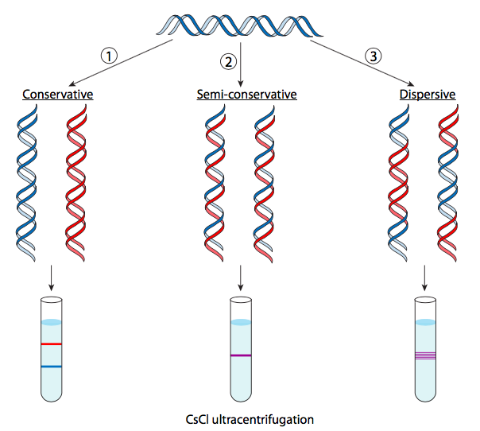

Slide 9
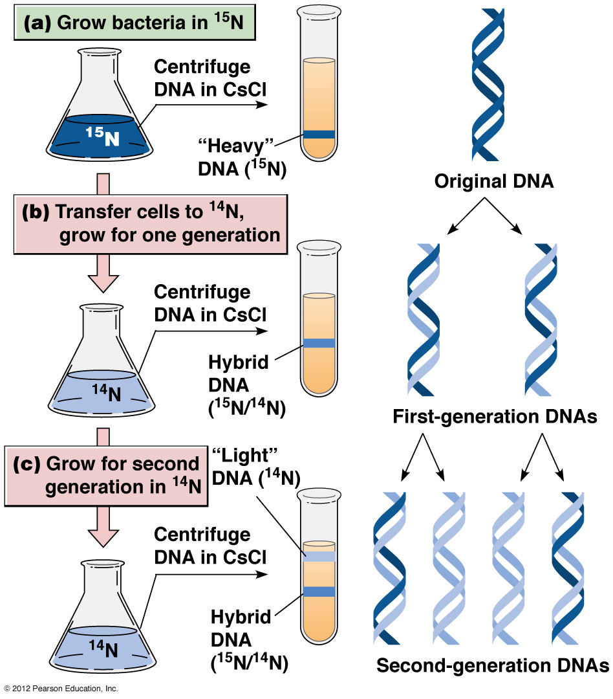
Meselson and Stahl experiment [1958] demonstrated semiconservative replication
0 min
20 min
40 min

Slide 10
Original DNA
0 min
Three rounds of replication:
1st Round:
20 min
₂nd Round:
40 min
60
min?
₃rd Round:

Slide 11
5’ 3’
Identical base sequences
5’
3’
3’
5’
3’

Slide 12
Semiconservative Replication
Half of the parental DNA molecule is conserved in each new double helix, paired with a newly synthesized complementary strand. This is called semiconservative replication.

Slide 13
Direction of the DNA Replication

Slide 14
Bidirectional Replication
Replication starts from unwinding the dsDNA at a particular point (called origin / ori site), followed by the synthesis on each strand.
The parental dsDNA and two newly formed dsDNA form a Y-shape structure called Replication fork.

Slide 16
Replication Enzymes & Proteins
DNA Polymerase - Matches the correct nucleotides then joins / polymerizes adjacent nucleotides to each other in 5’ to 3’ direction.
Helicase - Unwinds the DNA and melts it.
Primase - Provides an RNA primer to start polymerization.

Slide 17
Single Strand Binding Proteins - Keep the DNA single stranded after it has been melted by helicase
Topoisomerase - A topisomerase that Relieves torsional strain in the DNA molecule.
Ligase - Joins adjacent DNA strands together (fixes “nicks”)
Telomerase - Finishes off the ends of DNA strands in Eukaryotes

Slide 18
Enzymes and proteins of DNA Replication
Protein | M_{r}W | Sub units | Function
Dna A protein | 50,000 | 1 | Recognizes ori sequences
Dna B protein | 300,000 | 6 | Unwinds/opens dsDNA
(DNA Helicase)
Dna C protein | 29,000 | 1 | Assists Dna B to bind at ori-site
DNA polymerases |  |  | Synthesizes the new DNA strands
Dna G protein | 60,000 | 1 | Synthesize RNA primer
(DNA Primase)
Single Strand Binding Proteins (SSB) | 75,600 | 4 | Binds single-stranded DNA
DNA Gyrase | 400,000 | 4 | Relieves torsional strain
(DNA Topoisomerse)
generated by unwinding

Slide 19
DNA Polymerases of Prokaryotes
DNA Polymerase-I
The first DNA- dependent DNA polymerase ( DNA Pol -I ) was discovered in 1958 by Arthur Kornberg who received Nobel Prize in physiology & medicine in 1959.
DNA Polymerase is considered as Kornberg Enzyme.

Slide 20
Later, DNA-Pol II and DNA-Pol III were identified.
All of them possess the following biological activity.
5’ to 3’ Polymerase activity
Exonuclease activity

Slide 21
Comparison of DNA Polymerases of E. coli

Slide 22
Exonuclease functions
5´→3´ exonuclease activity
removes primer or excise mutated segment
5'
C T T C
3´→5´ exonuclease activity
excise mismatched nuleotides
3'
A G G A
A A G T C C G G C G
3' ^{G}
5'

Slide 23
DNA Polmerase - I
Mainly responsible for proofreading and filling the gaps, repairing DNA damage
30

Slide 24
N-end
DNA-pol Ⅰ
C-end
Cleavage
Small fragment
Large fragment
Small fragment (323 AA): having 5´→3´ exonuclease activity
Large fragment (604 AA): called Klenow fragment, having DNA polymerization and 3´→5´exonuclease activity

Slide 25
DNA Polymerase - II
Temporarily functional when DNA-pol I and DNA-pol III are not functional.
Still capable for doing synthesis on the damaged template.
Participates in DNA repair process.

Slide 26
DNA Polymerase - III
A heterodimer enzyme composed of ten different subunits
Having the highest polymerization activity (10⁵ nt/min)
The true enzyme responsible for the elongation process

Slide 28
Structure of DNA-pol III
α： has 5´→ 3´ polymerizing activity
ε：has 3´→ 5´ exonuclease activity and plays a key role to ensure the replication fidelity.
θ: maintain heterodimer structure

Slide 29
Nucleotides are always added to the growing strand at the 3’ end – the end at which the DNA strand has a free –OH group on the 3’ carbon of its terminal deoxyribose
Free 3’- hydroxyl group

Slide 30
RNA Primase
Also called DnaG
Primase is able to synthesize primers using free NTPs as the substrate and the ssDNA as the template.
Primers are short RNA fragments of a several nucleotides long.

Slide 32
Primers provide free 3´-OH groups to react with the α-P atom of dNTP to form phosphodiester bonds.
Primase, DnaB, DnaC and an origin form a Primosome complex at the initiation phase.

Slide 33
Helicase
Also referred to as DnaB.
It opens the double strand DNA with consuming ATP.
The opening process with the assistance of DnaA and DnaC

Slide 34
SSB protein
Single Strand DNA Binding protein.
SSB protein maintains the DNA template in the single strand form in order to
prevent the dsDNA formation;
protect the vulnerable ssDNA from nucleases.

Slide 35
DNA Topoisomerase (Gyrase)
It cuts phosphoester bonds on both strands of dsDNA, releases the supercoil constraint, and reforms the phosphodiester bonds.
It can change dsDNA into the negative supercoil state with consumption of ATP.

Slide 36
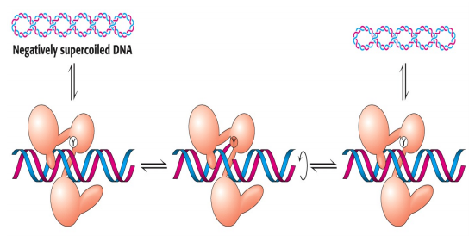
Topisomerase I
binds and cleaves one stand
leads to partial or complete relaxation of a supercoil

Slide 37
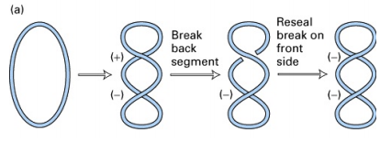
Topoisomerase- II
cleaves both strands

Slide 38
DNA Ligase
3'
5'
5'
3'
RNAase
3'
5'
5'
3'
OH
P
dNTP
DNA polymerase
3'
5'
5'
3'
P
ATP
DNAligase
3'
5'
5'
3'

Slide 39
Connect two adjacent ssDNA strands by joining the 3´-OH of one DNA strand to the 5´-P of another DNA strand.
Sealing the nick in the process of Replication, Repairing, Recombination, and Splicing.

Slide 40
Replication Fidelity
Replication based on the principle of base pairing is crucial to the high accuracy of the genetic information transfer.
Enzymes use mechanisms to ensure the replication fidelity.
Proofreading and real-time correction

Slide 41
Proofreading and Correction
DNA-pol I has the function to correct the mismatched nucleotides.
It identifies the mismatched nucleotide, removes it using the 3´- 5´ exonuclease activity, add a correct base, and continues the replication.

Slide 42
DNA Replication Process

Slide 43
STAGES
Initiation
Elongation Termination

Slide 44
Three Stages of replication
Initiation
occurs at the origin of replication
separates dsDNA, primer synthesis
Elongation
involves the addition of new nucleotides (dNTPs ) based on complementarity of the template strand
forms phosphoester bonds, correct the mismatch bases, extending the DNA strand, …
Termination
stops the DNA Replication occurs at a specific
termination site

Slide 45
Genome of E. coli
ori-Site

Slide 46
Initiation
The replication starts at a particular point called origin of Replication (or) ori-Site.
The structure of the origin is 248 bp long and AT-rich.
13 mer- sequence
9 mer- sequence

Slide 47
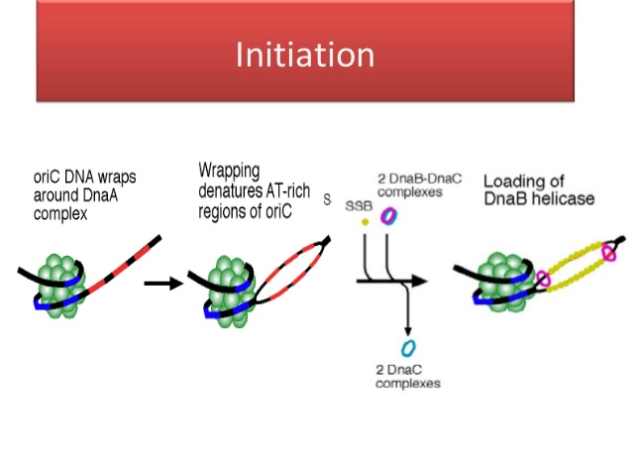
Formation of Preprimosome
13 mers
9 mers

Slide 48
Formation of Replication fork
DnaA recognizes ori C.
DnaB ( Helicase ) and DnaC join the DNA- DnaA complex, open the local AT-rich region, and move on the template downstream further to separate enough space.
DnaA is replaced gradually.
SSB protein binds the complex to stabilize ssDNA.

Slide 49
Primer synthesis
Primase joins and forms a complex called primosome.
Primase starts the synthesis of primers on the ssDNA template using NTP as the substrates in the 5´- 3´ direction at the expense of ATP.
The short RNA fragments provide free 3´-OH groups for DNA elongation.

Slide 50
Primase synthesizes PRIMER
’
Single stranded binding protein

Slide 51
Elongation
dNTPs are continuously connected to the primer or the nascent DNA chain by DNA-pol III.
The core enzymes catalyze the synthesis of leading and lagging strands, respectively.
The nature of the chain elongation is the series formation of the phosphodiester bonds.

Slide 52
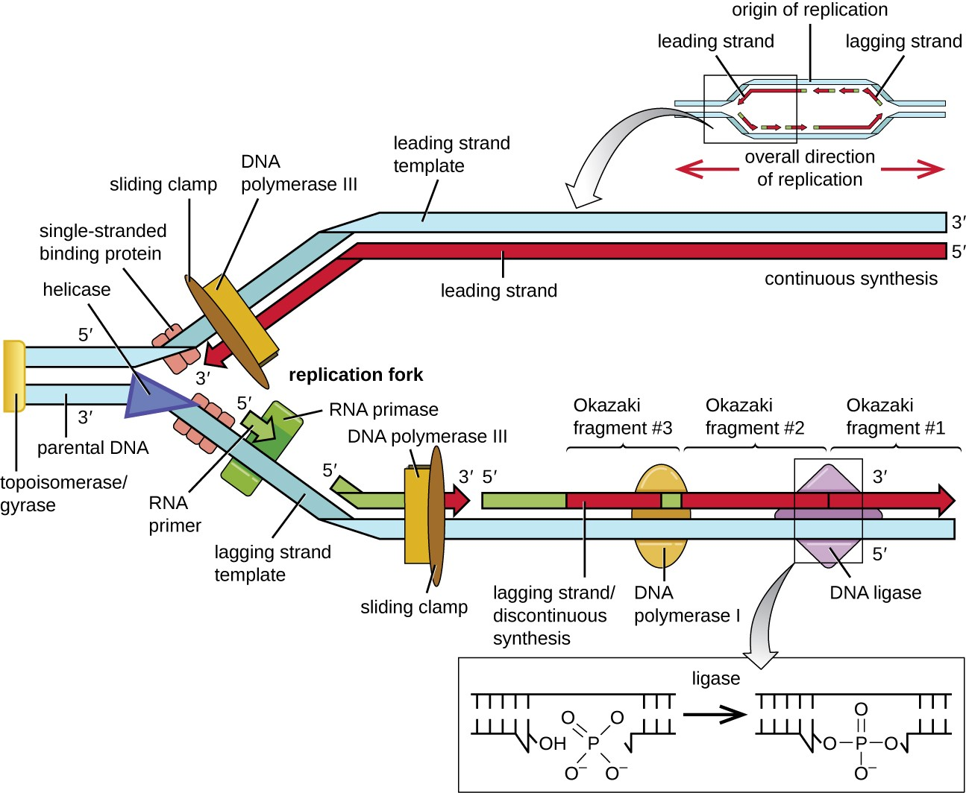
Elongation

Slide 53
Lagging strand synthesis
RNA Primers on Okazaki fragments are digested by the enzyme RNase.
The gaps are filled by DNA-pol I in the 5´→3´direction.
The nick between the 5´end of one fragment and the 3´end of the next fragment is sealed by ligase.

Slide 54
Okazaki fragments
Many DNA fragments are synthesized sequentially on the DNA template strand having the 5´- end. These DNA fragments are called Okazaki fragments. They are 1000 – 2000 nt long in prokaryotes and 100-150 nt long in eukaryotes.
The daughter strand consisting of Okazaki fragments is called the lagging strand.
63

Slide 55
Lagging strand (discontinuous)
Leading strand (continuous)

Slide 57
Termination
The replication of E. coli is bidirectional from one origin, and the two replication forks must meet at one point called ter at 32.
All the primers will be removed, and all the fragments will be connected by DNA-pol I and ligase.

Slide 58
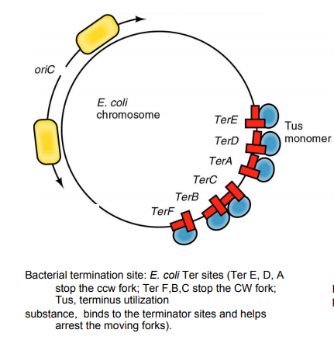
Ter-binding proteins - will recognizes the Termination sequences and helps to achieve the termination process.

Slide 59
Eukaryotic DNA Replication

Slide 60
Multiple origins on one chromosome, and replications are activated in a sequential order rather than simultaneously.

Slide 61
DNA Polymerse of Eukaryotes
Eukaryotic Enzyme Prokakaryotic Enzyme
DNA-pol α: initiate replication and synthesize primers
DNA-pol β: replication with low fidelity
DnaG, primase
Repair
DNA-pol γ: Mitochondrial DNA
synthesis
DNA-pol δ: leading strand DNA-pol III
DNA-pol ε: lagging strand synthesis, proofreading and
gap filling
DNA-pol I

Slide 62
Initiation
The eukaryotic replication origins are shorter than that of E. coli. The ori-sites in Eukaryotes called ARS (Autonomously Replicating Sequences) (or) Replicators.
Requires DNA-pol α (primase activity) and DNA- pol δ (polymerase activity and helicase activity).
DNA-pol δ requires a protein called for its
activity Proliferating Cell Nuclear Antigen (PCNA).
Needs Topoisomerase and Replication factors (RF) to assist.

Slide 63
Elongation
DNA replication and nucleosome assembling occur simultaneously.
Overall replication speed is compatible with that of prokaryotes.

Slide 64
Termination
3'
5'
3'
5'
5'
3'
5'
3'
connection of discontinuous segment
3'
5'
3'
5'
5'
3'
5'
3'
81

Slide 65
Telomere
The terminal structure of eukaryotic DNA of chromosomes is called telomere.
Telomere is composed of terminal DNA sequence and protein.
The sequence of typical telomeres is rich in T and G.
The telomere structure is crucial to keep the termini of chromosomes in the cell from becoming entangled and sticking to each other.

Slide 66
Telomerase
The eukaryotic cells use telomerase to maintain the integrity of DNA telomere.
The telomerase is composed of telomerase RNA
telomerase association protein telomerase reverse transcriptase
It is able to synthesize DNA using RNA as the template.

Slide 67
Step in Replication | Prokaryotic cells | Eukaryotic cells
Recognition of origin of replication | Dna A protein | RpA(Replication Protein-A)
Unwinding of DNA double helix | Helicase (requires ATP) | Helicase (requires ATP)
Stabilization of unwound templatestrnd | Single-stranded DNA-binding protein (SSB) | Single-stranded DNA-binding protein (SSB)
Synthesis of RNA primers | Primase | Primase
DNA Synthesis Leading strand Lagging strand | DNA polymerase III DNA polymerase III | DNA polymerase δ DNA polymerase Ԑ
Removal of RNA primers | DNA polymerase I (5 →3' exonuclease) | RNAse-H
Replacement of RNA with DNA | DNA polymerase I | Unknown
Joining of Okazaki fragments | DNA ligase (requires NAD) | DNA ligase (requires ATP)
Removal of positive supercoils ahead of advancing replication fork | DNA topoisomerase II | DNA topoisomerase II

