Slide 1
UNIT-6 (LIVESTOCK ECONOMICS AND MARKETING)
Lecture- 6th day
Speaker :- Dr. Puspendra Kumar Singh
Asstt. Professor
Department of Veterinary & Animal Husbandry Extension Education, BVC

Slide 2
Topics covered
Price determination under perfect competition in short and long run.

Slide 3
Concepts in price determination
“Both the elements of demand and supply are required for the determination of price of a commodity in the same manner as both the blades of scissors are required to cut a cloth.”
( Marshall)
Market demand is defined as a sum of the quantity demanded by each individual organizations in the industry.
Market supply refers to the sum of the quantity supplied by individual organizations in the industry.

Slide 4
In perfect competition, the price of a product is determined at a point at which the demand and supply curve intersect each other.
This point is known as equilibrium point
The price is known as equilibrium price.
At this point, the quantity demanded and supplied is called equilibrium quantity.

Slide 5
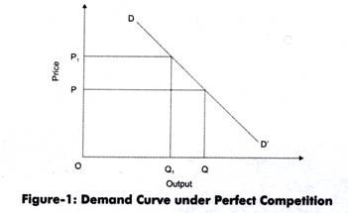
Demand under Perfect Competition:
A consumer demands more quantity at lower price and less quantity at higher price. Therefore, the demand varies at different prices.
As shown in Figure-1, when price is OP, the quantity demanded is OQ. On the other hand, when price increases to OP1, the quantity demanded reduces to OQ1. Therefore, under perfect competition, the demand curve (DD’) slopes downward.

Slide 6
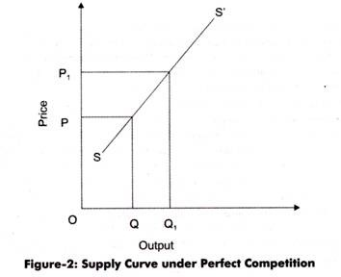
Supply under Perfect Competition:
Supply refers to quantity of a product that producers are willing to supply at a particular price. Generally, the supply of a product increases at high price and decreases at low price.
In Figure-2, the quantity supplied is OQ at price OP. When price increases to OP1, the quantity supplied increases to OQ1. This is because the producers are able to earn large profits by supplying products at higher price. Therefore, under perfect competition, the supply curves (SS’) slopes upward.

Slide 7
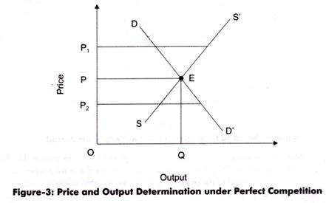
Equilibrium under Perfect Competition:
In Figure-3, it can be seen that at price OP1, supply is more than the demand. Therefore, prices will fall down to OP. Similarly, at price OP2, demand is more than the supply. Similarly, in such a case, the prices will rise to OP. Thus, E is the equilibrium at which equilibrium price is OP and equilibrium quantity is OQ.

Slide 8
Market Price of a Perishable Commodity:
In the case of perishable commodity like milk,
The supply is limited by the available quantity on that day.
It cannot be kept back for the next period.
Therefore, the whole of it must be sold away on the same day, whatever the price may be.
Fig. 4 shows the supply curve of milk. Which will be a vertical straight line MS, when OM is the quantity of milk available on that day?

Slide 9
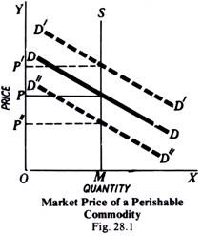
DD is the market demand curve. With perfect competition between buyers and sellers, an equilibrium price OP will be determined at which the quantity demanded is equal to the available supply. That is, equilibrium price will be established at the point where downward sloping demand curve DD intersects the vertical supply curve MS.

Slide 10
Now suppose that there is a sudden increase in demand from DD to D’D’. With the supply of milk remaining unchanged, the larger demand will raise the market price sharply from OP to OP’. On the contrary, if there is a decrease in demand from DD to D’-‘D”, the price will fall and the quantity sold will remain the same.

Slide 11
Market Price of Non-Perishable and Reproducible Goods:
In case of non-perishable but reproducible goods:
Supply curve cannot be a vertical straight line because some of the goods can be preserved to the next market period.
There will then be two critical price levels.
1. The first, if price is very high the seller will be prepared to sell the whole stock.
2. The second level is set by a low price at which the seller would not sell any amount and hold back the whole stock.
The price below which the seller will refuse to sell is called the Reserve Price.

Slide 12
Given the two price levels,
The amount will offer for sale will vary with price
To supply more at a higher price than at a lower one.
The supply curve of a seller will, therefore, slope upward to the right. Beyond a price at which he is prepared to sell the whole stock, the supply curve will be a vertical straight line whatever the price.

Slide 13
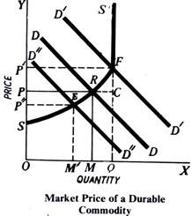

Slide 14
In Fig. 5. SRFS’ is the supply curve of the durable goods while OQ is the total amount of the stock of the goods.
Up to price OP’, the quantity supplier varies with price so that at a higher price more is supplied than at a lower one.
At the price OS, nothing is sold, the whole stock being held back. Therefore, SF portion of the supply curve slopes upwards from left to right.
At price OP’, the whole of the stock is offered for sale, and beyond the price OP’, the quantity supplied remains the same whatever the price. Therefore, beyond the price OP’, the market supply curve will be vertical straight line (FS’).

Slide 15
DD is the demand curve which slopes downwards from left to right. Market price comes to settle at OP, because at this price the quantity demanded is equal to the quantity supplied. At this equilibrium price OP, OM amount from the stock is sold, while the rest of the stock, i.e., MQ (= RC) is held back from the market.

Slide 16
Suppose: 1. Demand increases from DD to D’D’,
2. The price will rise to OP’,
3. Whole stock OQ will be sold.
If now the demand, further increases from D’D’ to some higher level, the quantity supplied or sold will remain the same, i.e., equal to OQ, and only the price will rise so that, at the new equilibrium level, the quantity demanded is equal to the available supply.
If the demand decreases from DD to D”D”, the price will fall to OP”, and the amount sold will decrease to OM’.
Since, in a perfectly competitive market, the product is homogeneous and no buyer has any preference for a particular seller,
Therefore, a single uniform market price will be established in the market.
Once the market price is determined, an individual seller in the market will take the price as given and constant.
The demand curve for a single seller a horizontal straight line, i.e., perfectly elastic at the level of the ruling market price.
costs of production do not enter into the calculation of the sellers, and, therefore, have little influence on the on the market price.

