Slide 1
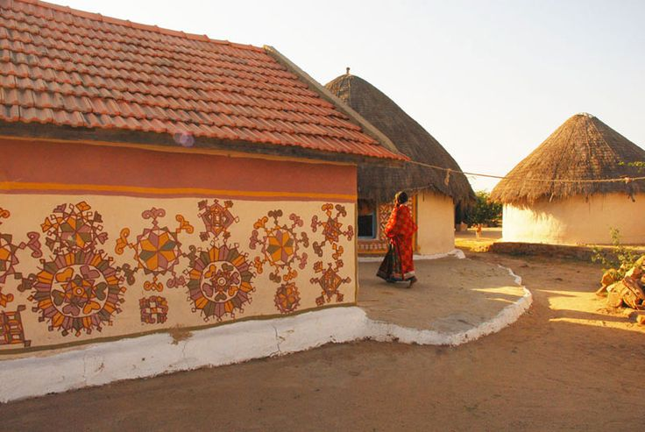
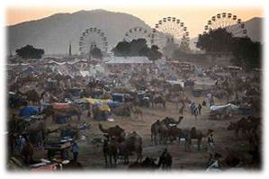
UNIT-6 (LIVESTOCK ECONOMICS AND MARKETING)
Lecture- 7th day
Speaker :- Dr. Puspendra Kumar Singh
Asstt. Professor
Department of Veterinary & Animal Husbandry Extension Education, BVC

Slide 2
Topics covered
Market, Classification of market.

Slide 3
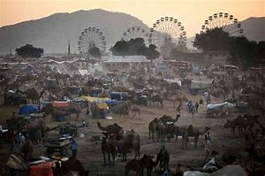
Market
Market derived from Latin word “Marcatus”
It is a place where actual buying and selling takes place.
A place where goods and services are exchanged.
Meeting together of people for their private purchases and sale of goods at a stated time and place.

Slide 4
Essentials of market
Commodity which has to purchase or sale
Presence of buyer and sellers for that commodity
A place or platform where buying and selling has to be done
Such type of interaction between buyer and seller so that the same price prevails for same products at the same time.

Slide 5
Livestock market
Livestock market can be classified in to following component:
Live animal marketing
Livestock product marketing
Other products
Byproduct
Waste product

Slide 6
Classification of Markets
Location
Area or Coverage
Time span
Volumes of transaction
Nature of transaction
Number of commodities
Degree of competition
Nature of commodities
Stage of marketing
Extent of public intervention
Type of population served
Visibility

Slide 7
A. Location
Village markets: These markets cover a village. Transaction take place between buyers and sellers who belong to the village.
Primary markets: These markets are located in big towns. The producers bring their produce in these markets and transactions are mainly take place between these and the traders.
Secondary wholesale markets: These markets are mostly located in district headquarters, larger towns or near important railway junctions. Producers from far away primary market or other markets come with their produce. Transactions take place in large quantities with wholesalers/traders.
Terminal markets: These markets are located mostly in metropolitan cities and sea ports. These markets at Organized, operate under government regulations and have advanced processing and storage infrastructure.
Seaboard markets: These are markets specifically meant for trade in international markets. These are located in seaport towns.

Slide 8
B. Area or Coverage
Local market : The area covered by this market is limited to some groups of villages. These markets are hence also known as village markets or primary markets. In these markets, mostly perishable commodities are bought and sold.
Regional market : The area of operation under a regional market may range from 1-3 districts to even an entire state. Food grain market is the most common example under regional market.
National market : Here, the entire country is the area of operation of the market. Common examples are mostly related to durable goods like jute, tea, textiles, etc.
International/world market : Here, the area of operation of the market is extended over the entire world. Naturally, this market exists for those commodities which have world-wide demand.

Slide 9
C. Time span
Short period market:
Held for a day or few hours
Highly perishable products
Prices of commodities governed mainly by extent of demand
Long period market :
Comparatively held for a longer period
Commodities traded are less perishable
Prices are governed both by the supply and demand forces
Secular market:
Market of permanent nature
Trades durable commodities

Slide 10
D. Volumes of transactions
Wholesale market:
Commodities are bought and sold in large lots
Generally located in towns/cities
Economic activities are so intense
Balancing supply and demand, discovery of the prices
Retail market:
Commodities bought and Sold to the consumers as per their requirements
Transactions take place between retailers and consumers
Near to consumers

Slide 11
E. Nature of transactions
Spot or Cash market
Goods are exchanged for money immediately after the sale
Forward market:
Purchase and sale of a commodity take place but exchange take place on some specified date in the future
Sometime there may not be any exchange, instead differences in the purchase & sale prices are paid or taken

Slide 12
F. Number of commodities
General market:
All types of commodities are bought and sold
Specialized market:
Notified commodities are bought an sold

Slide 13
G. Degree of competition
Perfect market :
Large number of buyers and sellers, All have perfect knowledge of demand, supply and prices
Prices are uniform over a geographical area, period of time, different forms of a product
Imperfect market:
Conditions of perfect competition are lacking
Different prices for the same basic product
Monopoly market
Monopsony market
Duopoly market
Duopsony market
Oligopoly market
Oligopsony market

Slide 14
H. Nature of commodities
Commodity market
Manufactured & semi manufactured goods market
Bullion market
Service and labour market
Capital market : It responsible for meeting the financial requirements of big industrial and commercial concerns
MONEY MARKET: Allow those who are in need of money to take loans in turn by way of interest
STOCK EXCHANGE MARKET: Shares are purchased and sold to make investments in public and private sector undertakings
FOREIGN EXCHANGE MARKET: Buying and selling of foreign currencies concerned with export and import trade

Slide 15
I. Stage of marketing
Producer market
Mainly assemble the commodity for further distribution
Consumer market
Collect the produce for final disposal to the consuming population

Slide 16
J. Extent of public intervention
Regulated market
Business is done in accordance with the rules and regulations framed by the statutory market organization representing different sections involved in markets
Marketing cost are standardized and practices are regulated
Unregulated market
Traders frame the rules for the

Slide 17
K. Type of population served
Urban market
Rural market

Slide 18
L. Visibility
Black market
Scarce commodities are sold at a very high price in a secret manner
Situation arises on account of excess of demand over limited supply
It is an anti social activity which gives way to black money.

