Slide 1
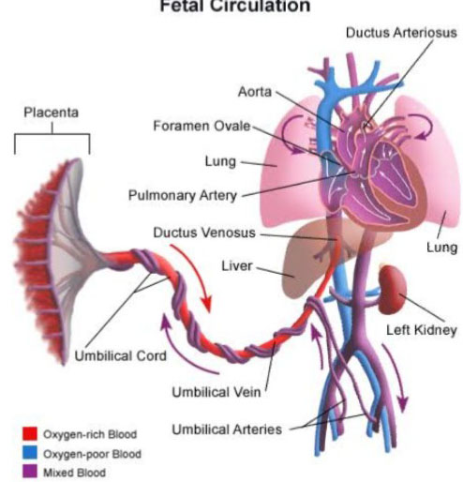
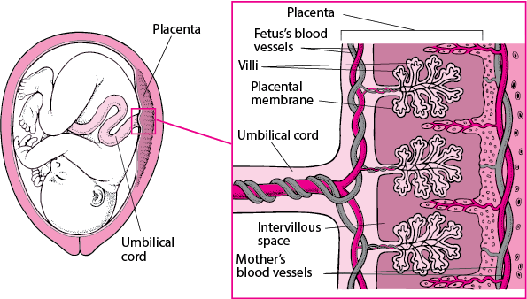
Unit-8 EMBRYOLOGY
FETAL CIRCULATION
Date of Lecture 30.05.2020
Dr. Manoj Kumar Sinha
Asst. professor-cum-Jr. scientist
Department of veterinary Anatomy

Slide 2
FETAL CIRCULATION
The circulation of oxygenated blood, deoxygenated blood and nutritive materials in the fetus is termed as Fetal Circulation
The circulatory system of the mother is not directly connected to that of the fetus thus the placenta functions as the respiratory center for the fetus as well as a site of filtration of nutrients and wastages
water glucose, amino acids, vitamins etc. freely diffuse through the placenta along with oxygen
The uterine arteries carry oxygenated blood to the placenta.

Slide 3
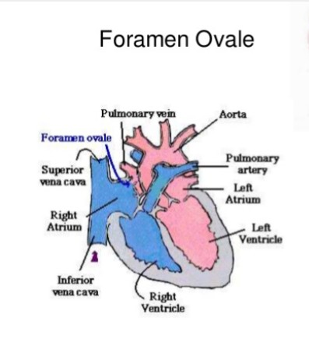
Three shunts are present in fetal life which play important role in fetal circulation
Ductus Venosus: connects the umbilical vein to the inferior venacava
Ductus Arteriosus: connects the main pulmonary artery to the Aorta
Foramen Ovale: Opening between the right and left atrium

Slide 4
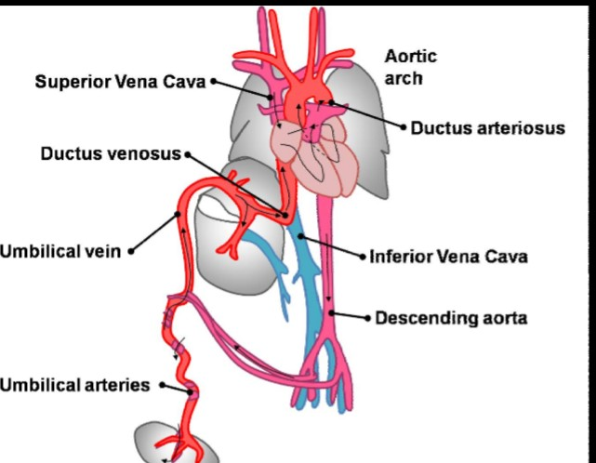

Slide 5
Continue..
The placenta accepts deoxygenated blood from the fetus through blood vessels that leave the fetus through the Umbilical Cord (Umbilical Arteries )
The oxygenated nutrient rich blood then returns to the fetus via the Umbilical cord (Umbilical Vein)

Slide 6
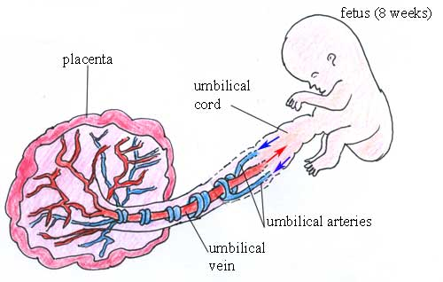
UMBILICAL CORD
Thick cord like structure which extends from center of the abdominal wall of the fetus to the center of the fetal surface of placenta (The structure connecting the fetus with the placenta)
The umbilical cord develops from and contains remnants of the yolk sac and allantois

Slide 7
Continue…
Umbilical cord is made up of :
Two umbilical arteries
one umbilical vein
duct of yolk sac and
distal part of allantoic diverticulum
Thus umbilical vein carries blood towards the fetus’s heart while the umbilical arteries carry blood away
All these structures are surrounded by Wharton’s jelly( a gelatinous substance made from mucopolysaccharides which protects the blood vessels inside) and finally enveloped by amniotic membrane
The Wharton's jelly is formed by the mucoid degeneration of the mesodermal cells of the connecting stalk

Slide 8
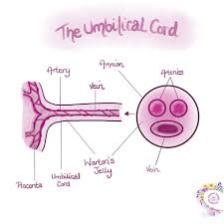
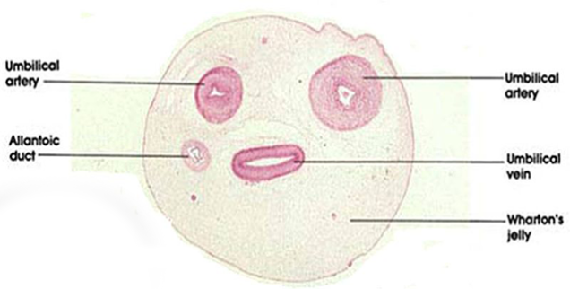
CROSS SECTION OF UMBILICAL CORD

Slide 10
Continue…
Early part of embryonic life two umbilical veins are present , but later only the left vein persists
The umbilical vein carrying placental (oxygenated) blood, enters the abdomen of the fetus at the umbilicus and then enters into the liver
Left vein then joins the portal vein, hepatic vein and finally opens into the abdominal venacava through Ductus Venosus
Then blood conveyed to the right atrium
Through Foramen Ovalae blood passes into the left atrium and then to the left ventricle
The foramen ovale closes at the time of birth
Through the aorta blood goes to the head, fore limbs and small amount of blood passes into the abdominal aorta

Slide 11
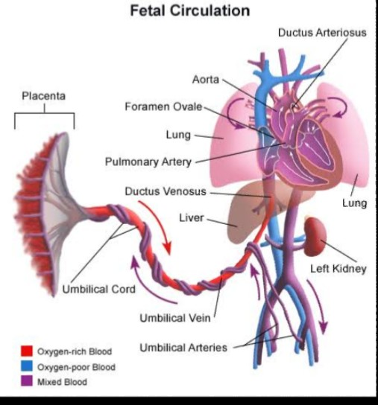

Slide 12
Continue…
From cranial end blood returns through anterior venacava to the right atrium
This blood along with blood from abdominal venacava passes into the right ventricle
The right ventricular blood goes via pulmonary trunk going to the descending aorta through Ductus Arteriosus because fetal lungs become inactive
Ductus Arteriosus is a arterial duct which connects the pulmonary artery with the aorta ( In the fetus there is special connection between the pulmonary artery and the aorta, called Ductus Arteriosus)
At birth it becomes occluded but in adult it persists as a ligament (Ligamentum Arteriosum)
Some of the blood moves from the aorta through the internal iliac arteries and re-enters the placenta, the maternal circulation

Slide 13
AT THE TIME OF BIRTH
Closure of Foramen Ovale
Closure of Ductus Arteriosus
Closure of Ductus Venosus
AFTER BIRTH
After birth of the baby the lung, renal, digestive and liver functions are working the fetal circulation undergoes some changes since they are no longer needed

Slide 14
