Slide 1
HYPOTHYROIDISM
UNIT-3
Dr. Vivek Kr. Singh
Assistant Professor
Department of Veterinary Clinical Complex

Slide 2
It is an endocrine disorder due to hypothalmic pituitary-thyroid axis dysfunction resulting in impaired (reduced) secretion of thyriod hormones and related classical cascade of clinical signs

Slide 3
The disorder is most common in dogs and rare in other domestic animals
Medium to large sized breeds of 4-10 years of age are most commonly affected
Golden Retriver, Doberman, Irish Setter etc.

Slide 4
Etiology
More than 95% of clinical cases in dogs are due to
Primary dysfunction of the thyroid gland
Secondary hypothyroidism is pituitary dependent hypothyroidism
Immune mediated lymphocytic thyroidits
Idiopathic atrophy of thyroid gland
Rarely congenital hypothyroidism occurs due to dysgenesis of thyroid gland during foetal life (Juvenile onset)

Slide 5
Clinical findings
The deficiency of thyroid hormone affects functions of all organs and systems, therefore results in variable clinical signs
Dullness
Lethargy
Exercise intolerance
Weight gain (without a corresponding increase in diet)

Slide 6
Cont…
Hypothermic (Seek warm places)
Dry skin
Puffiness of upper eye lid
Excessive shedding of hair
Non- pruritic bilaterally symmetrical alopecia
Alopecia involves ventral/ lateral trunk, thighs and dorsum of the tail
Rat tail appearance is common

Slide 7
Thickened skin folds above eyes
Reproductive disturbances
Infertility
Abortion
Poor litter survival
Lack of libido
Testicular atrophy

Slide 8
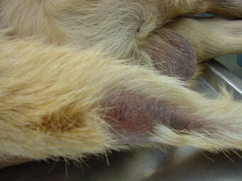
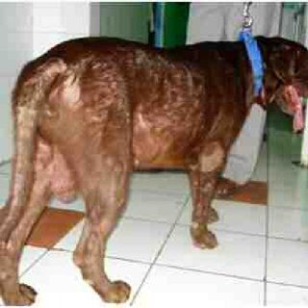
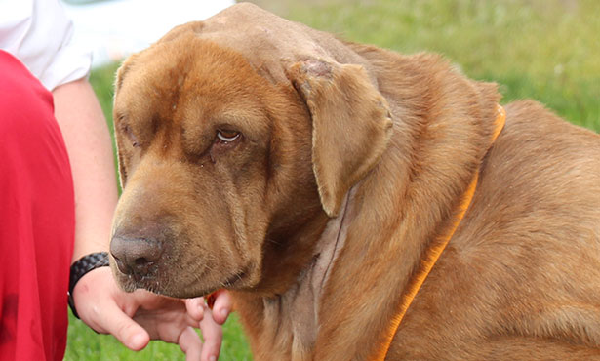
Rat Tail appearance
Dullness/ sitting in warm places
Alopecia
Puffy upper eyelids

Slide 9
Diagnosis
Clinical signs
Hematology reveals normocytic normochromic non-regenerative anaemia
High cholesterol level
Determination of free T₄ most accurate laboratory diagnostic method
Biopsy of thyroid to differentiate primary and secondary hypothyroidism

Slide 10
Treatment
Thyroid hormone replacement therapy is necessary for the rest of the dog’s life
Thyroxin (T₄) is the compound of choice in dogs
Administered @ 0.02-0.04 mg/ kg bwt orally once or in divide doses
Serum thyroid hormone should be monitored frequently to avoid thyrotoxicosis

