Slide 1
BIOCHEMISTY
Course No.-DTC-111, Credit Hours – 2 (1+1)
AMINO ACIDS
BINITA RANI
ASSOCIATE PROFESSOR (DAIRY CHEMISTRY)
FACULTY OF DAIRY TECHNOLOGY
S.G.I.D.T., BVC CAMPUS,
P.O.- BVC, DIST.-PATNA-800014

Slide 2
Amino acid - both amino and carboxyl functional groups.
H2NCHRCOOH - Alpha-amino acids
α–carbon - to which the amino and carboxylate groups are attached
Amino acids ➔ building blocks of proteins ➔ classified into
essential and
non-essential
Twenty amino acids ➔ eight are essential .
adequate consumption of amino acids :
during development and maturation
pregnancy, lactation, or
injury (a burn, for instance).
Complete protein source - all the essential amino acids
Incomplete protein source - lacks one or more.

Slide 3
Optical Property
Protein - Twenty types of amino acids
one- or three-letter abbreviations ➔ each amino acid representation in peptides.
All amino acids have asymmetric carbon ➔ optically active, except glycine
Amino acids can be
dextrorotatory or
levorotatory
depending upon the rotation of plane polarized light
L-amino acids represent majority of amino acids found in proteins.
D-amino acids - produced by exotic sea-dwelling organisms
L and D convention for amino acid configuration refers to optical activity of the glyceraldehyde isomer from which the amino acid is synthesized rather than the optical property of the acid itself (L-glyceraldehyde is levorotary; D-glyceraldehyde is dextrorotary)

Slide 4
General structure of amino acid
Non superimposable Mirror images of Amino Acids

Slide 5
Zwitterions
At isoelectric point, protonated ammonium groups and deprotonated carboxylate groups are equal, resulting ➔ net neutral charge and formation of Zwitterions
Zwitterion can behave as both a base as well as an acid.
For glycine, the isoelectric point is arithmetic mean of the two pKa values, because of absence of an ionizable group in its side chain.
Glycine has a net negative charge at pH > pI. ➔ move towards the anode
At pH < pI, glycine has a net positive charge ➔ move towards the cathode

Slide 6
Classification of Amino acids
As acidic, basic, aliphatic, aromatic, or sulfur-containing based on the R groups properties.

Slide 7
Amino acids with aliphatic side chains

Slide 8
Amino acids side chains with sulfur atoms

Slide 9
Amino acids side chains with hydroxylic (OH) groups

Slide 10
Amino acids with aromatic rings

Slide 11
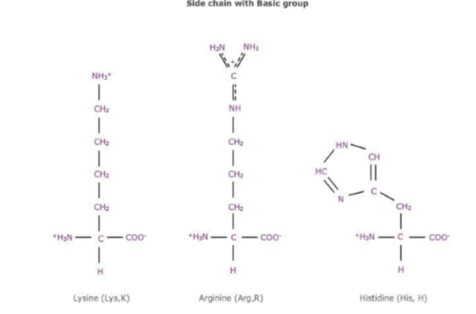
Amino acid side chain with basic group

Slide 12
Amino acids side chains with acidic groups or their amides

Slide 13
THANKS

