Slide 1
Structure And Composition of egg
By-
Dr. SUSHMA KUMARI
Asst.Prof., Dept. of LPT, BVC
Bihar Animal Sciences University

Slide 2
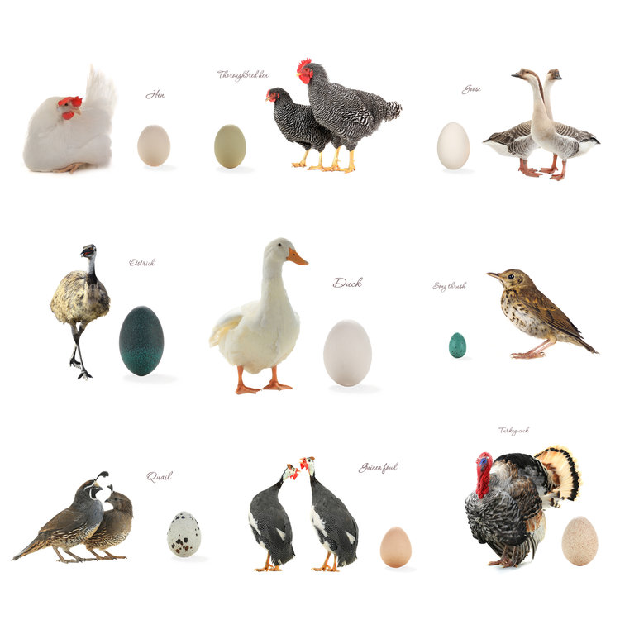
Composition of egg

Slide 4
STRUCTURE OF AN EGG

Slide 5
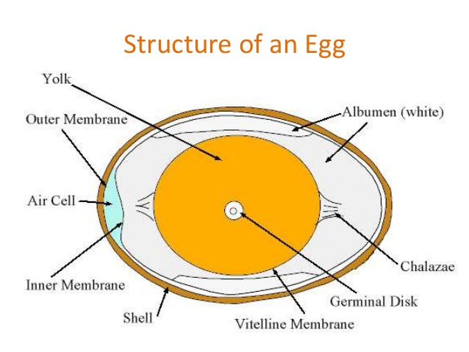

Slide 11
Composition of egg
Component | % | Water % | Protein % | Fat % | Ash %
Whole egg | 100 | 65.5 | 11.8 | 11 | 11.7
Egg white | 58-60% | 88 | 11 | 0.2 | 0.8
Egg yolk | 31-33% | 48 | 17.5 | 32.5 | 2
Shell | 9 � 12%

Slide 12
THANKYOU

