Slide 1
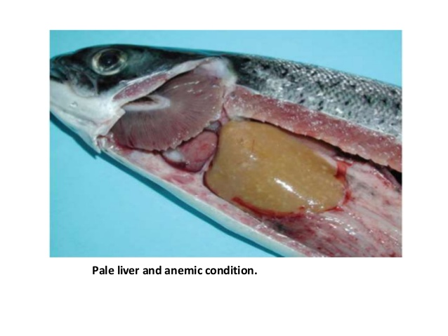
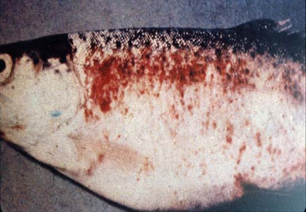
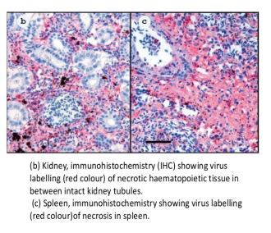
VIRAL DISEASES OF FISH (VHS, SVC & IHN )
Dr Deepak Kumar
Assistant Professor
Department of Veterinary Pathology
Bihar Veterinary College, Patna
Bihar Animal Sciences University, Patna- 14

Slide 2
VIRAL DISEASES OF FISH
The OIE lists viral diseases of fish as Notifiable:
Viral hemorrhagic septicemia
Spring viremia of carp
Infectious hematopoietic necrosis.
Koi Herpes Virus
5. Infectious Salmon Anaemia.
6. Red Sea Bream Irido Viral Disease
7. Infectious Pancreatic Necrosis
8. Noda Viral Infction

Slide 3
Viral Disease
Many produce high mortality in young fish and little or no losses in adults, which may become carriers.
Vaccines are not yet commercially available for viral diseases of fish.
Drugs are not effective, although antibiotics and other drugs may be used to control secondary bacterial infections that frequently follow viral diseases.
Management techniques that minimize stress and crowding, biosecurity measures, and temperature manipulation hold the greatest promise for control of many types of viral diseases.

Slide 4
Viral Haemorrhagic Septicemia
VHS is highly contagious disease caused by Rhabdo Virus, affecting both Salmonids in fresh and sea water when temperature become below 14o C.
First recorded by Schaperclaus ( 1938) in rainbow trout.

Slide 5
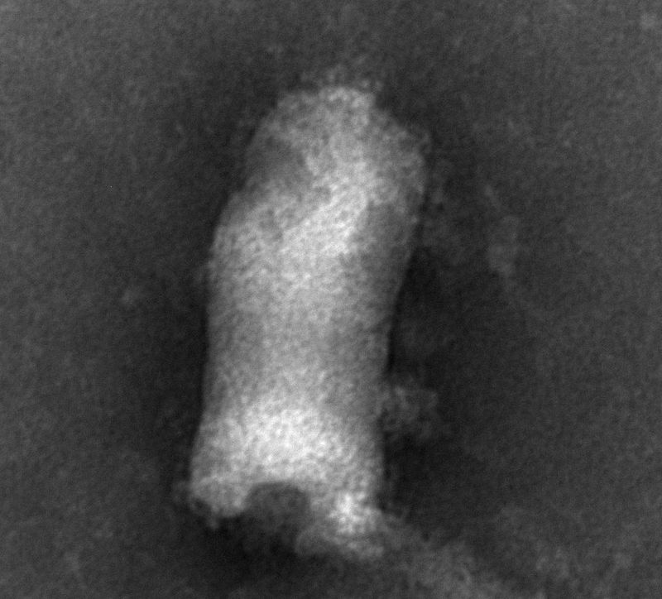
VHS
Etiology – Rhabdo virus, a RNA virus.

Slide 6
Transmission
VHSV can be spread from fish to fish through water transfer, as well as through contaminated eggs, urine, sperm, and ovarian fluids etc.

Slide 7
VHS
Pathogenesis -
The virus is Leucotropic in nature, affects mostly the circulating Leucocytes.
Affect the kidney melanomacrophages
Macrophages lyses & releases various active granules.
Released granules causes early dysfunction of different stem cell precursor.

Slide 8
Pathogenesis of VHS
Simultaneously, hepatocytes become infected, necrosed & liver Sinusoids filled with haemorrhages.
In kidney hyaline cast is found in tubular lumen.
Muscular haemorrages are prominent in cardiac ventricle.

Slide 9
Lesions
In acute form
High mortality is common in first few days.
Affected fish shows pale gills,
Exophthalmus
Darken body colour with erratic swimming movement.
Congestion & haemorrhages found in skin, kidney, liver & intestine during post mortem.

Slide 10
VHS
In chronic form
Affected fish become lethargic with anaemic gills & distended abdominal body cavity.
Splenomegaly
Hepatomegaly & Swollen kidney are prominent

Slide 11
Lesions
Nervous form
Spiral swimming is prominent due to motor nerve disorder.
Retracted abdomen with anemia is found in most cases with a history of sudden death.

Slide 12
VHS

Slide 13
VHS

Slide 14
VHS

Slide 19
SPRING VIRAEMIA OF CARP (SVC)
SVC is caused by Rhabdo virus, a RNA virus
Affecting both carp and other cyprinids with generalized viraemia and haemorrhage in viscera and muscles.
Extreme pin point haemorrhages found over the surface of swim bladder, resembling
“ Turkey egg appearance” & sometime termed as Swim bladder inflammation.

Slide 22
SVC
The SVC occurs during higher spring temperature, just after low winter temperature, so called SVC.
The disease was 1st reported by Fijan et al, (1971) in Yugoslavia.

Slide 23
Pathogenesis
The SVC virus enters through gills of fish, replicates in gill epithelium using highly vascularised area & ultimately spread to all vital organs.
In swim bladder, the monolayer epithelium converts to multilayer.
Necrosis of hepatocytes & cardic muscle are prominent.
In intestine, enterocytes become necrosed, inflammed, producing catarrhal enteritis. Ultimately villi become atrophied & FCR reduced.

Slide 24
Pathology
Exophthalmus with pale gill
Ascites
Peritonitis are common
Turkey egg apperance of swim bladder is pathogenomic in nature.
Petechial haemorrhages are found in most vital orgens like heart, liver, kidney, intestine & skeletal system.

Slide 30
Infectious Hematopoietic Necrosis ( IHN)
The disease is caused by Rhabdo virus, a RNA virus, affecting both rainbow trout and salmon with a mortality up to 100%.
The name itself speaks that necrosis of haematopoetic organ ( kidney) occurs in IHN.
The disease occurs at the temp 10 oC & subsides above the temp at 150c
IHN was first recorded by Wolf ( 1988).

Slide 31
Pathogenesis
The virus enters through gill, passes into esophagus & reaches to stomach.
Ultimately reach into blood circulation after viraemia.
Target organ of the viruses are connective tissues of entire digestive system & kidney.
In intestinal wall, severe necrosis of sub- mucosal eosinophilic granular cell, is the pathogenomic lesion.

Slide 32
Pathogenesis
The anterior kidney shows intense necrosis with congestion in renal sinus.
Sometimes, melanomacrophages present in kidney become necrosed.
Hemorrhagic thrombi is also found in cardiac muscle

Slide 33
Pathology
Affected fish shows pale gills
Exophthalmia
Darken body colour with increased pigmentation.
Hemorrhage found on skin & viscera particularly at the base of fins, behind the skull & above lateral line
Surviving fish may develop scoliosis

