Slide 1
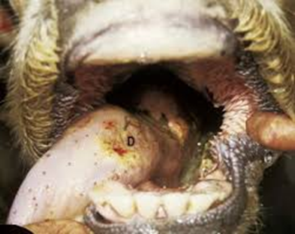
ACTINOBACILLOSIS Synonym : Wooden tongue

Slide 2
INTRODUCTION
Actinobacillosis is a specific infectious disease of cattle and sheep caused by Actinobacillus lignieresi and is characterized by fibrosis of tongue
Gram negative aerobic organism
Cattle usually affected. Sheep are rarely affected
Human infection of the disease has also been reported
Organisms are normally present in upper respiratory and alimentary tract
Affects mainly soft tissues.
Wounds and abrasions caused by foreign bodies are necessary for infection

Slide 3
PATHOGENESIS AND SYMPTOMS
Organisms are present in upper respiratory and alimentary tract mucosa and infection to soft tissues occurs through wounds and abrasions caused by foreign bodies like thorn and awns
Then organisms multiply and causes chronic supppurative and granulomatous inflammation of soft tissues i.e. tongue
The organisms may infect jaw of cattle, but usually it invades the tongue, lymph nodes of the head, neck and thorax
Tongue replaced by fibrous tissue and becomes hard, shrunken and immobile(Wooden tongue)
It usually affects soft tissue and lymph nodes of the mouth and pharynx

Slide 5
lesions
More frequent in soft tissues than bones
Spread to neighbouring tissue, lesions coalesce, forming a large nodules with central ‘Sulphur granules’ (Colonies of organisms)
Spread is usually through lymphatics causing lymphadenitis and abscess.
Tongue – Nodules which becomes indurated, rigid and it is referred to as ‘ Wooden longue’ - Diffuse sclerosing actinobacillosis

Slide 6
Lung and other tissues – Smaller abscesses seen.
Pigs - Lesions similar to cattle
Sheep - Lingual lesions are not common; subcutaneous tissue of the head, nose, lips, throat, cheeks and submaxillary region revealed granuloma

Slide 7
Microscopically
Granulomatous reaction
Surrounding a colony of organisms, club like structure (action of macrophage on the organism)
It is encircled by neutrophils, histiocytes, giant cells, lymphocytes and plasma cells and is enclosed by fibrous tissue
Spread to neighbouring tissue, lesions coalesce, forming a large nodules with central ‘Sulphur granules’ (Colonies of organisms)

