Slide 1
Canine Hypoadrenocorticism
(Addison Disease)
Unit: 3
4th Professional Dr. Anil Kumar
Asst. Professor
Dept. of VCC, BVC, Patna

Slide 2
ADDISON DISEASE
The adrenal glands are essential for life, being responsible for the minute-to-minute regulation of blood pressure, blood volume, and vascular tone.
ADRENAL GLAND
Outer Zone (Cortex)
Inner Zone (Medulla)
The zona glomerulosa,
Zona fasciculate
(70% of the cortex)
Zona reticularis
Mineralocorticoid (Aldosterone)
Sex steroids
Glucocorticoid(Cortisol)
carbohydrate, protein, and lipid metabolism result in sparing of glucose
Decrease lipogenesis and increase lipolysis in adipose tissue
suppress inflammatory and immunologic responses
Favors the spread of infection.
Negative effect on wound healing (fibroblast proliferation and collagen synthesis )
Ion transport by epithelial cells, resulting in a loss of potassium and retention of sodium.
A lack of secretion of mineralocorticoids (Addison disease) may result in a lethal retention of potassium and loss of sodium.
Progesterone, estrogens, and androgens are adrenal sex hormones

Slide 3
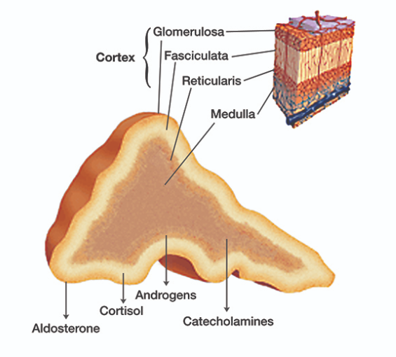
Adrenal hormones are necessary to control salt, sugar and water balance in the body.
It results from the lack of glucocorticoids, mineralocorticoids, or both
It is seen most commonly in young to middle-aged female dogs and occasionally in horses.
Etiology:
Primary—Unknown, but most cases probably result from an autoimmune process and characterized by a lack of glucocorticoids and mineralocorticoids.
Others :
Destruction of the adrenal gland by granulomatous disease
Metastatic tumor,
Hemorrhage
Infarction
Adrenolytic agents (mitotane), or
adrenal enzyme inhibitors (trilostane)

Slide 4
FORMS OF HYPOADRENOCORTICISM
Primary Hypoadrenocorticism
Characterized by a lack of glucocorticoids and mineralocorticoids
Mostly associated with immune-mediated destruction of adrenal cortical tissue
Mitotane or trilostane for Hyperadrenocorticism treatment
Neoplasia, infection, or infarction of the adrenal glands
Atypical
Hypoadrenocorticism
Seen in small population of “atypical” dogs
Adrenal destruction is purported to spare the glomerulosa layer, resulting in an isolated glucocorticoid deficiency and so, do not progress to clinically significant mineralocorticoid deficiency
Isolated glucocorticoid insufficiency is more commonly seen in older dogs with vague GI signs, weight loss, normal electrolyte concentrations, hypoalbuminemia and hypocholesterolemia.
Secondary
Hypoadrenocorticism
It is refers to a central (anterior pituitary) deficiency of ACTH and lead to
isolated glucocorticoid insufficiency
Mineralocorticoids are spared because ACTH does not directly influence their release.
It mainly results from results from abrupt discontinuation of long-term exogenous administration of corticosteroids or progesterone analog
Rarely, congenital defects of the pituitary gland ( a cystic Rathke’s pouch, neoplasia, or trauma)

Slide 5
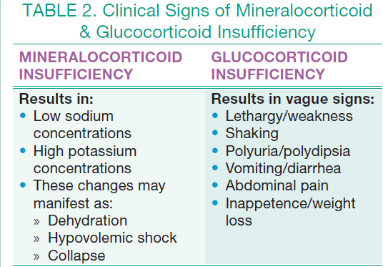
Age, Sex and Breed:
Dogs of any sex, age, or breed (including mixed breeds) can develop the disease.
The disease is heritable in certain breeds:
Clinical Signs:
The Addisonian crisis is the life-threatening culmination of combined hormone deficiencies that can be fatal if not appropriately treated

Slide 6
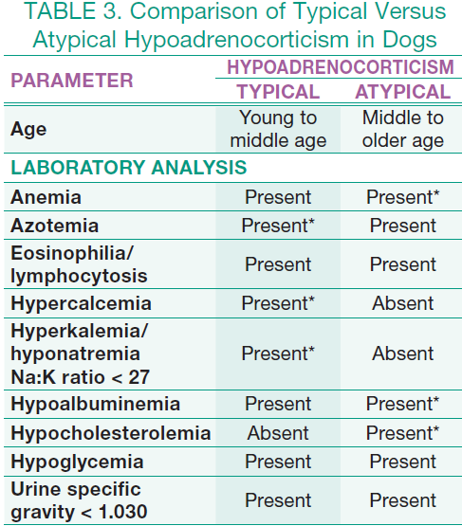
DIAGNOSIS: The disease is diagnosed on the basis of a:
Compatible history
Clinical signs
Laboratory abnormalities
Imaging studies and
ACTH stimulation test results
Note:
The combination of
Na/K ratio with lymphocyte
count is a better screening test
for hypoadrenocorticism
than either variable alone.

Slide 7
Patients with atypical hypoadrenocorticism are more likely to exhibit hypoalbuminemia, hypocholesterolemia, and anemia on routine blood work.
Diagnostic Imaging:
Thoracic radiographs may reveal a small heart and caudal vena cava, which indicates hypovolemia
On abdominal ultrasonography, atrophy of the adrenal glands with thin and short as compared with normal, but in some cases there may benormal size adrenal glands.
ECG: Depending upon the degree of hyperkalemia, the ECG may
Reveal a bradyarrhythmia with absent P waves
Tented T waves
Prolonged QRS complexes, and
decreased R wave amplitude

Slide 8
ACTH Stimulation Test:
The gold standard for diagnosis of all forms of hypoadrenocorticism; it should be performed in any patient suspected of having the disease.
A baseline serum cortisol level > 2 mcg/dL can be used to rule out hypoadrenocorticism, while a cortisol level ≤ 2 mcg/dL necessitates an ACTH stimulation test.
TREATMENT: The main goal of therapy is to:
Restoration of blood volume
Correction of electrolyte/acid-base disorders
Fluid therapy: is always be instituted prior to the use of adrenal steroid replacement therapy and can be performed while the patient is undergoing the ACTH stimulation test.
Starting with aggressive IV fluid therapy with isotonic crystalloids (0.9% sodium chloride, Ringer’s lactate solution)

Slide 9
To solve an adrenal crisis is an acute medical emergency:
An infusion with 0.9% saline should be started.
If the dog is hypoglycemic, the saline should include 2.5%–5% dextrose.
The hypovolemia is corrected rapidly by administering 0.9% saline (60–70 mL/kg throughout the first 1–2 hours).
Urine output should be assessed to determine whether the dog is becoming anuric.
Fluids should be continued, at a rate appropriate to match ongoing losses, until the clinical signs and laboratory abnormalities have resolved.
If hyperkalemia persists despite fluid resuscitation and mineralocorticoid replacement therapy, suspect renal failure and monitor patient for oliguria or anuria.

Slide 10
Additionally, to correct life-threatening hyperkalemia:
Consider treatment with dextrose (10% glucose in 0.9% saline can be given for 30–60 min to increase potassium movement into the cells) and regular insulin (0.25–1 U/Kg, IM, will enhance glucose and potassium uptake), addressing metabolic acidosis, or
Treatment with a beta-adrenergic drug, such as terbutaline or albuterol.
Prednisolone sodium succinate (22–30 mg/kg) or dexamethasone sodium phosphate (0.2–1 mg/kg) may be used in the initial management of shock.
Prednisolone or prednisone should be given at 1 mg/kg, twice a day, for the first few days of therapy and then at 0.25–0.5 mg/kg/day.
Mineralocorticoid replacement therapy is also begun to help with electrolyte imbalances and hypovolemia.
Electrolytes, renal function, and glucose should be monitored regularly to assess response to therapy.

Slide 11
For long term maintenance therapy :
The mineralocorticoid desoxycorticosterone pivalate (DOCP) is administered at 2.2 mg/kg, IM or SC, every 25–28 days.
Electrolytes should be measured at 3 and 4 weeks after the first few injections to determine the duration of action.
Alternatively, fludrocortisone acetate is administered PO at 10–30 mcg/kg/day. Serum electrolytes should be monitored weekly until the proper dose is determined.
Some dogs (especially dogs on DOCP) also require daily oral glucocorticoid therapy to adequately control clinical signs.
in ~50% of dogs, replacement doses of prednisone (0.2–0.4 mg/kg/day) are required
Dogs with atypical Addison disease require only replacement doses of prednisone, although it is recommended that electrolytes be monitored every 3 months for the first year after diagnosis.
Dogs with chronic hypoadrenocorticism should be re-examined every 3–6 months

Slide 12
