Slide 1
ANIMAL GENETICS & BREEDING
Principles of Genetics & Population Genetics
Course No. AGB Lecture no. – 5
UNIT - I
Regression
Dr K G Mandal Department of Animal Genetics & Breeding Bihar Veterinary College, Patna Bihar Animal Sciences University, Patna

Slide 2
Regression
Regression measures the average relationship between two variables.
Concept of regression was given by Francis Galton.
It is denoted as ‘b’.
b_{yx} means regression of y on x, where, y is dependent variable and x independent variable.
b_{xy} means regression of x on y, where, x is dependent variable and y is independent variable.

Slide 3
In case of correlation, r_{xy} = r_{yx}
In case of regression, b_{yx} ≠ b_{xy}
Regression coefficient: It measures the amount of change in dependent variable for unit change in the independent variable.

Slide 4
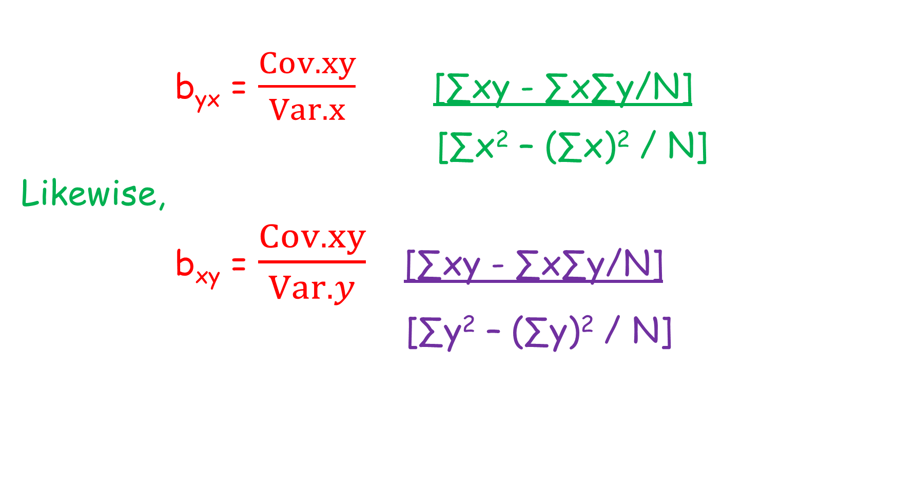
b_{yx} = $\frac{Cov.xy}{Var.x}$ = [∑xy - ∑x∑y/N]
[∑x² – (∑x)² / N]
Likewise,
b_{xy} = $\frac{Cov.xy}{Var.y}$ = [∑xy - ∑x∑y/N]
[∑y² – (∑y)² / N]

Slide 5
Relationship between correlation & regression:
r_{xy} = √b_{xy}.b_{yx}
b_{xy} = $\frac{Cov.xy}{Var.y}$x$\frac{6x}{6x}$ = $\frac{Cov.xy}{6y.6y}$x$\frac{6x}{6x}$
= $\frac{Cov.xy}{6y.6x}$x$\frac{6x}{6y}$ = r. $\frac{6x}{6y}$

Slide 6

Similarly,
b_{yx} = $\frac{Cov.xy}{Var.x}$x$\frac{6y}{6y}$ = $\frac{Cov.xy}{6x.6x}$x$\frac{6y}{6y}$
= $\frac{Cov.xy}{6x.6y}$x$\frac{6y}{6x}$ = r. $\frac{6y}{6x}$

Slide 7
b_{xy}.b_{yx} = r. $\frac{6x}{6y}$ x r $\frac{6y}{6x}$ = r²
= r²
r = √ b_{xy}.b_{yx}
Thus, Coefficient of correlation = Geometric mean of two regression coefficients.

Slide 8
Properties of regression coefficient:
Both the regression coefficients i.e., byx and bxy have the same sign.
r_{xy} will also have the same sign as that of byx & bxy.
If one of the regression coefficients is more than one, then other will be less than one.
continued …………..

Slide 9
4. Regression coefficients have the same unit as that of the unit of original observation.
5. The arithmetic mean of two regression coefficients is more than one [½(bxy + byx) ≥ 1].
6. The maximum value of bxy . byx = 1 Because b_{xy}.b_{yx} = r² & maximum value of r = 1, so r² = 1.

Slide 10
Test of regression coefficient:
Regression coefficient is tested through t – test at n -2 df where n is the pair no. of observations.
Testing formula:
t_{(n-2)df} = $\frac{byx}{S.E.(b)}$
S.E. b_{yx} = √$\frac{\left[∑y2 −(∑y\right)2/n] −b[∑xy −∑x∑y/n] }{\left(n −2\right)[∑x2 −\left(∑x\right)2/n ]}$

Slide 11
Interpretation:
If the calculated value of t at 5% or 1% level of significance is more than the tabulated value of t at (n-2)df and corresponding level of significance (5% or 1%) then the difference is said to be significant at the given level of significance.

Slide 12
Use of Regression Coefficient:
To determine the degree of resemblance between relatives.
To estimate heritability through regression of offspring on parent.
To predict the value of dependent variable for any known value of the independent variable.

Slide 13

Prediction equation:
1. y’ = y + b_{yx} (x – x)
On the basis of correlation coefficient:
y ‘ = y + r $\frac{sy}{sx}$ (x – x)
x ‘ = x + r $\frac{sx}{sy}$ (y – y)
Where, y ‘ = Predicted value of y.
x ‘ = Predicted value of x.
Y = average value of y variable
x = average value of x variable

Slide 14
Computation of coefficient of regression
On the basis of following data of x and y variables, find out regression of y on x and regression of x on y. b_{yx} & b_{xy} ?
X | Y | XY | X² | Y²
10 | 11 | 110 | 100 | 121
12 | 12 | 144 | 144 | 144
14 | 13 | 182 | 196 | 169
16 | 14 | 224 | 256 | 196
18 | 15 | 270 | 324 | 225
20 | 16 | 320 | 400 | 256
22 | 17 | 374 | 484 | 289
24 | 18 | 432 | 576 | 324
26 | 19 | 449 | 676 | 361
28 | 20 | 560 | 784 | 400
30 | 21 | 630 | 900 | 441
∑X = 220 | ∑Y = 176 | ∑XY = 3740 | ∑X² = 4840 | ∑Y² = 2926

Slide 15

∑X = 220 ∑Y = 176 ∑XY = 3740 ∑X² = 4840 ∑Y² = 2926
(∑X)2 = 220*220 = 48400 (∑Y)2 = 176*176 = 30976
bxy = $\frac{Cov.xy}{Var.y}$= [∑xy - ∑x∑y/N] = $\frac{\begin{aligned}3740 −220 x 176/11 \\ \end{aligned}}{2926 −30976/11}$
[∑y² – (∑y)² / N]
= (3740 – 3520) / (2926 -2816)
= 220 / 110
= 2

Slide 16
∑X = 220 ∑Y = 176 ∑XY = 3740 ∑X² = 4840 ∑Y² = 2926
(∑X)2 = 220*220 = 48400 (∑Y)2 = 176*176 = 30976
b_{yx} = [∑xy - ∑x∑y/N]
[∑x² – (∑x)² / N]
= [3740 – 220 x 176/11] / [4840 – 48400/11]
= [3740 – 3520] / [4840 – 4400]
= 220 / 440
= 1/2
bxy x byx = 2 x 1/2 = 1

Slide 17
THANK YOU

