Slide 1
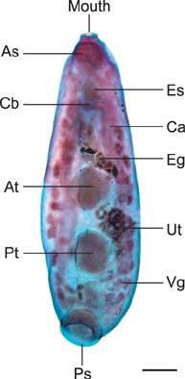
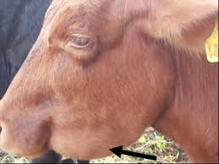
Amphistomiasis
Dr. Bipin Kumar
Assistant Professor
Department of Veterinary Medicine
Bihar Veterinary College, Patna
(Bihar Animal Sciences University, Patna)

Slide 2
Also known as Stomach flukes or Conical flukes.
It is a parasitic disease of cattle and sheep and humans caused by immature helminthic flatworms.
Infection occurs through ingestion of contaminated vegetables and raw meat, in which the viable infective metacercaria are deposited from snails, which are the intermediate hosts.

Slide 3
Etiology/Epidemiology
Name of trematode | Host | Location
Paramphistomum gotoi | Cattle | Forestomach
Paramphistomum cervi | Cattle | Forestomach
Cotylophoran cotylophorum | Sheep, Goat & Cattle | Rumen and reticulum
Gigantocotyle explanatum | Cattle &Buffalo | Bile duct, Gall bladder & Duodenum
Gastrothylax crumenifer | Sheep,Cattle &Buffalo | Rumen and reticulum
Gastrodiscus aegypticus | Horse and pig | Large and small intestine

Slide 4
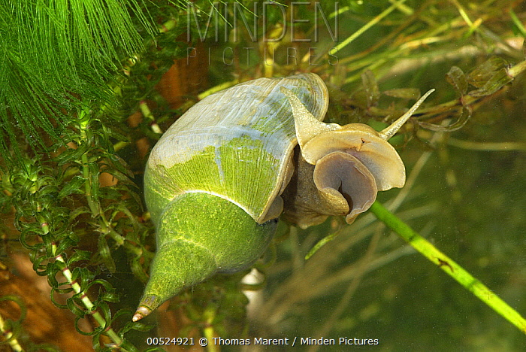
Transmitted by various species of snails;
Planorbis, Bulinus
Pseudosuccinea, Fossaris
Indoplanorbis, Lymnaea
Pygmanisas, Glyptanisus & Cleopatra

Slide 5
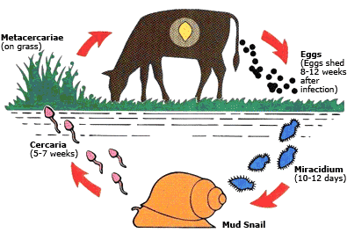

Slide 6
Factors influencing ourbreak of amphistomiasis;
Management
Environmental factors
Intermediate host
Definitive host
The egg contain the miracidium when passed in the faeces.
Management
Animals are reared in extensive systems of management
Grazing near pond area/ other natural resources, especially - drier months
Snail population - concentrated more
Fresh palatable grasses are more
Favour for encystation of metacercariae
Attracts animals

Slide 7
Temperature – embryonation (miracidium) & maturation of cercariae (27°C)
Light - Strong light influences release of cercariae from snail
Intermediate host
Availability of suitable snail
Young snails are highly susceptible than adult
Multiplication of snails take places in warm, watery environment
Definitive host
Young animals are highly susceptible than adult
Preinfection – give resistant
The egg contain the miracidium when passed in the faeces
The egg do not hatch

Slide 8
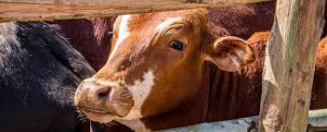
PATHOGENESIS AND CLINICAL SIGNS
Adult flukes
Forestomach–large number of worms–Not much pathogenic changes
Bile duct & gall bladder–Superficial Haemorrhage
Liver–Fibrosis
Immature flukes (Pitto)
Duodenum, upper ileum-plug feeder: Plug intestinal mucosa–Haemorrhages and necrosis (Haemorrhagic duodenitis)
Embedded in mucosa/ muscularis
Clinical signs
Fetid diarrhoea
Marked weakness
Thirsty and drink more water

Slide 9
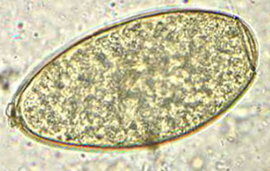
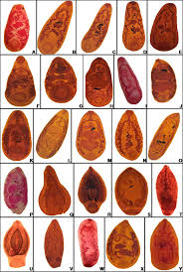
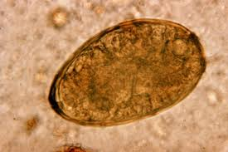
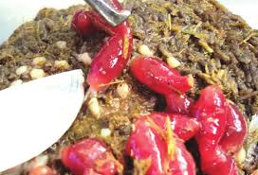
DIAGNOSIS, TREATMENT AND CONTROL
Diagnosis
Based on history and Clinical signs
Faecal examination
Gross – presence of immature worms in fluid faeces
Microscopic - Presence of typical egg (Upperculated)

Slide 10
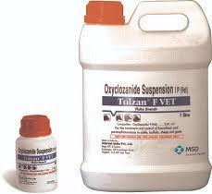
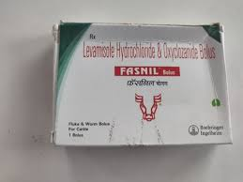
Treatment
Bithionol sulphoxide – 40 mg/ kg (activity against Immature – 100%)
Resorantol – 65 mg / kg ( Immature – 65% &Mature – 100%)
Niclosamide - 90 mg / kg (Immature – 99.9% &Mature – 8%)
Niclofolan - 6 mg / Kg (Immature – 96% & Mature – 43%)
Oxyclozanide – 18.7 mg / kg for two days (Immature & Mature - 100 %)
Hexachlorophene – 20 mg/ kg - single dose
Resorantol and Oxyclozanide are the drug of choice for both immature and mature Amphistomes

Slide 11
Control
Regular deworming.
Drainage of low lying area and destruction of snails.
Pasture management.

Slide 12
Thank you

