Slide 1
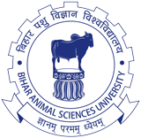
UNIT-IV
Environmental Hygiene
(Credit Hours-3+1)

Slide 2
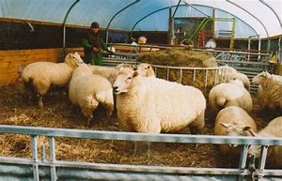
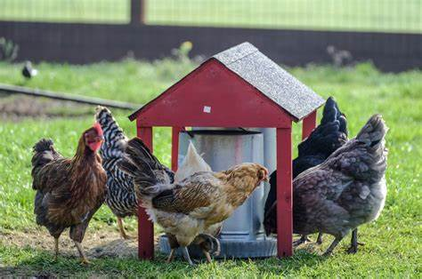
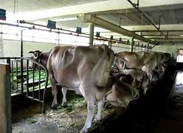
Animal houses and sanitation

Slide 3
Introduction
The word “sanitation” means the science of safeguarding health
Environmental sanitation:
“It embraces the control of all those factors in man’s (in our context animals) physical environment which exercise a deleterious effect on the physical development (to productivity), health & survival” (World Health Organization)
The physical environment
The non-living objects & physical factors affecting the animals,
viz., air, ventilation, lighting, noise, climate & water
In fact, the term sanitation covers the whole field of controlling the environment of animals with a view to prevent disease & promote health

Slide 4
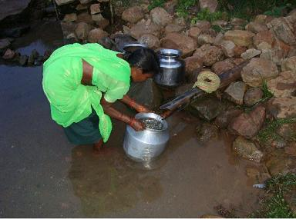
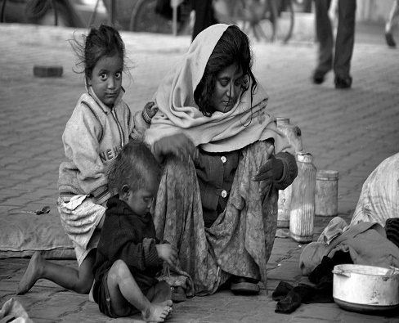
Problems in the maintenance of sanitation in animal houses
The lack of awareness
Poverty
Problems of safe water supply
Disposal of excreta

Slide 5
Water requirements for animals /animal houses
Animal | Water requirement
Dairy cows & buffaloes For maintenance purpose: For Milk production: For washing & cleansing of cow-sheds, animal themselves, utensils an average of another | 110 lit. water/ cow 28 lit. /d Additional 3 lit. /each lit of milk 45-70 lit./cow
A horse Under average stable-feeding purposes Washing and other general purpose | 36 lit. of water 36 lit. of water
Sheep and goats an average daily allowance | 18 lit./d/ head
Pigs For all purposes | 40 lit. /d/head
Hens an avg. 100 hens | 20-30 lit. /d

Slide 6
Objectives of sanitation
To establish hygienic atmosphere & structures
To create conditions for comfortable living of livestock (including poultry & ducks) so that they may remain healthy & productive

Slide 7
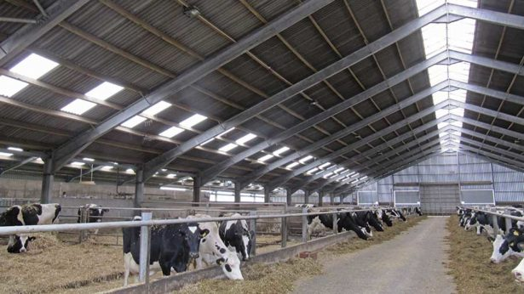
Requirements of livestock buildings
Prime important in maintaining good sanitation
Farm livestock are homeotherms: maintain a thermal balance between the heat they produce or gain or loose it from the environment
The heat produced & released by the body: working efficiency & production
Small amount of heat is lost: excretions & secretions
Main heat losses:
Radiation,
Convection: temperature of air/surrounding, humidity, movement of air
Conduction
Evaporation

Slide 8
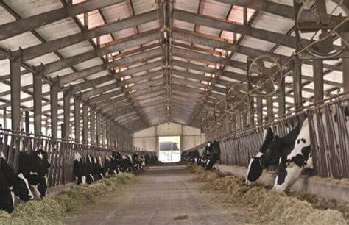
Factors effecting growth and productivity of animals
Temperature
Regulation at extremes of temperatures
Thermo-comfortable zone: optimum production
Allow animals to make their own zone: huddling or separation
Development of such zones depends: age, sex, species, weight, feeding rate, acclimatization, husbandry system
Relative humidity (30 to 90 %):
Allows the livestock to thrive well
Proper ventilation to maintain ventilation
Air movement
Air temperature above & below body temperature tend to reduce dissemination of body temperature & compels animals through more exercise, more feed intake & sufferings

Slide 9
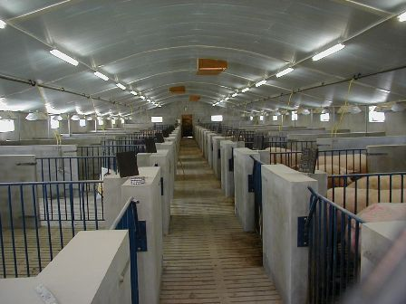
Thermo-control in piggeries
Pigs regulate the production of heat at some cost in terms of food energy
Intensive pig houses:
Designed to ensure the best feed conversion efficiency by regulation of temperature & ventilation
Optimal efficiency of production increases
The optimum temperature range for adult pigs ranges: 4- 30⁰C

Slide 10
Thermo-control in ruminant houses
The comfort zone
European cattle: 0- 200C
Jersey – Fresians: 20- 250C,
Brown Swiss: 30- 320C
Tropical cattle-38⁰C
European – tropical crossbreds : 30⁰C
Management of thermal control:
Provision of appropriate sheds,
Wallows
Artificial shows ameliorate the effect of high temperature
In loose housing system: open fronted barns,
protection from solar radiation
maximum provision of air movement

Slide 11
Large ruminant housing
Construction of environmentally controlled house: high standard of thermal insulation of all surfaces round the animals – the floor, walls, roof, doors & windows
Traditional farm buildings without thermal insulation are common in most organized farms & rural areas
Construction of farm buildings primarily to floor, walls & roof
Materials for wall construction:
Strength,
Thermal insulation &
Method of construction (in relation to hygiene)
The surface should be smooth, impervious with minimum of places allowing dirt accumulation

Slide 12
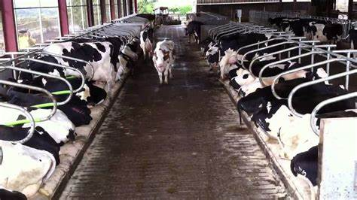
Large ruminant housing
The floor:
The animals stand, exercise, move, lie down & excrete
It is critical to thermal physical comfort, health & security
Should be non-slippery,
well drained,
Comfortably soft,
Warm & dry,
Easy to clean mechanically
Floors with drainage channel covered with a removable metal grid
Design of stalls & mangers: asy consumption of food & less food wastage
Edges & crevices: should be avoided
wall to floor junctions should facilitate brushing & washing

Slide 13
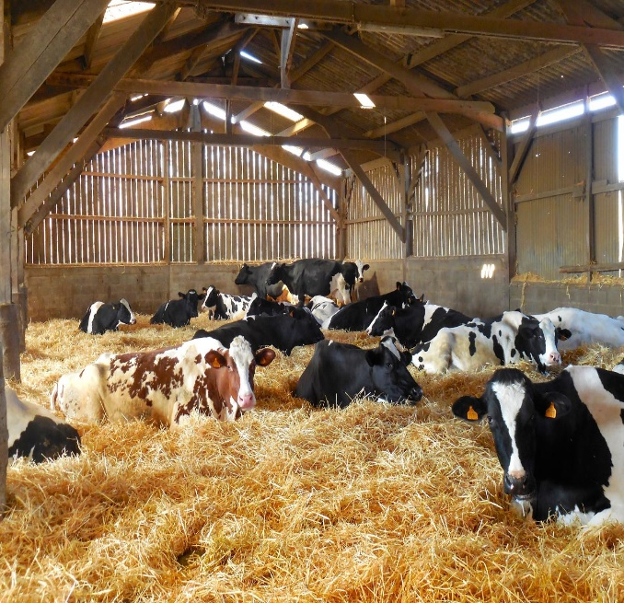
Large ruminant housing
The roof
Can be clad with corrugated asbestos or metal sheeting for uniform internal temperature
Damp-resistant hard board or flat asbestos sheets can be used as loft seal
Bedding: concrete floor with straw or other bedding
Reducing heat loss, make it comfortable,
Provide desired warmth to milking cow & prevent injuries
Clean and dry
Soiled portions should be renewed regularly

Slide 14
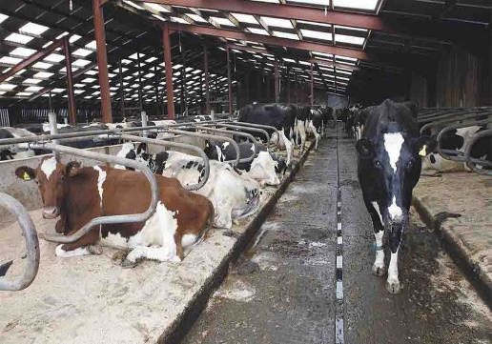
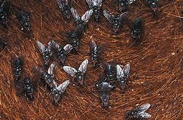
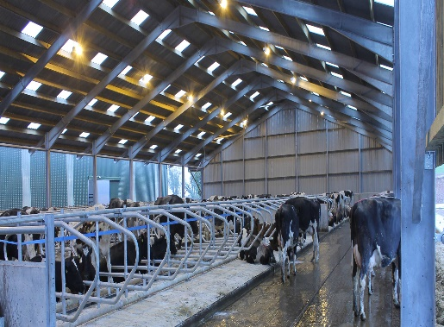
Large ruminant housing
Cleaning of the yard is utmost importance:
Slurry & other organic matter should be scrapped properly
To prevent foot trouble in animals
Dirty ramps tend: become slippery create risk of fall & injury
Fly control:
Periodic spray of an appropriate repellent in dry shed
Wire-netting in the building at a desired height (wall to roof):
prevent birds & insects entering & disturbing the animals
Lighting arrangement:
Particularly during night & early morning hours,
Availability of adequate natural light

Slide 15
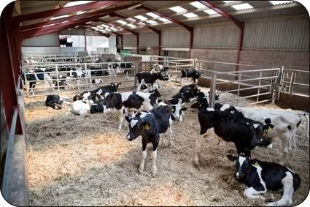
Calf housing
Should be in two units
One for very young & another for the older ones
It will facilitate disinfection & adequate rest
Individual pens with solid partitions are preferred for calves bought from outside so as to prevent the risk of disease
Roof lighting: light emitting through a double thickness glass or artificial lighting can be provided

Slide 16
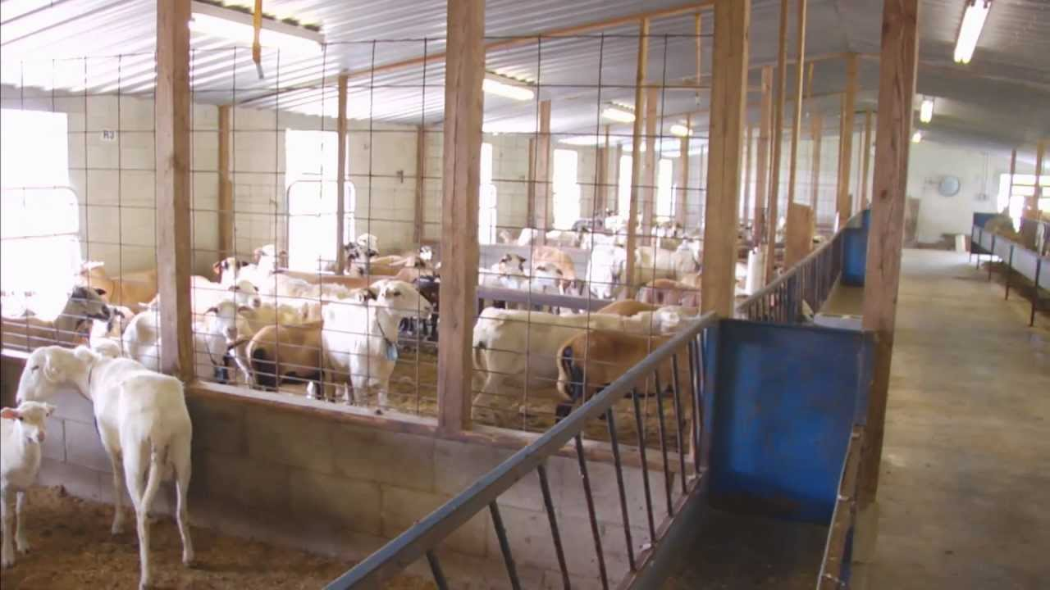
Sheep housing
Building with generous air space, i.e., climatic housing
Sheep require a cover to protect from elements
Sheep fleece provides excellent thermos-insulation
Shearing the ewes necessitates good quality housing so as to minimize the risk of suffering from cold & draught
Huddling of sheep together in the absence of fleece increases the danger of respiratory and skin diseases in adults and enteric diseased in lambs
Adults sheep can withstand in temperature range of – 7 to 30⁰C

Slide 17
Poultry housing
The problem of sanitation in poultry houses is tackled from different angles,
viz., temperature & humidity requirement, Provisions of lighting & watering
Temperature:
Brooder temperature: 35⁰C (optimum for one day old chicks)
reduction of 0.5⁰C daily until a level of 18-21⁰C is reached
The change should be steady with reduction uneven air temperatures
Broilers house temperature: 18-21⁰C or slightly lower (13 to 16⁰C) would be ideal
This can be achieved by increasing ventilation & by use of fans for affecting enhanced air velocity
For intensively kept layers, the optimum temperature for productivity and health is about 21⁰C
Relative Humidity:
Maximum of 75% is acceptable
Below 50% (critically if less than 30%): aggravate infections and disseminate contagions

Slide 18
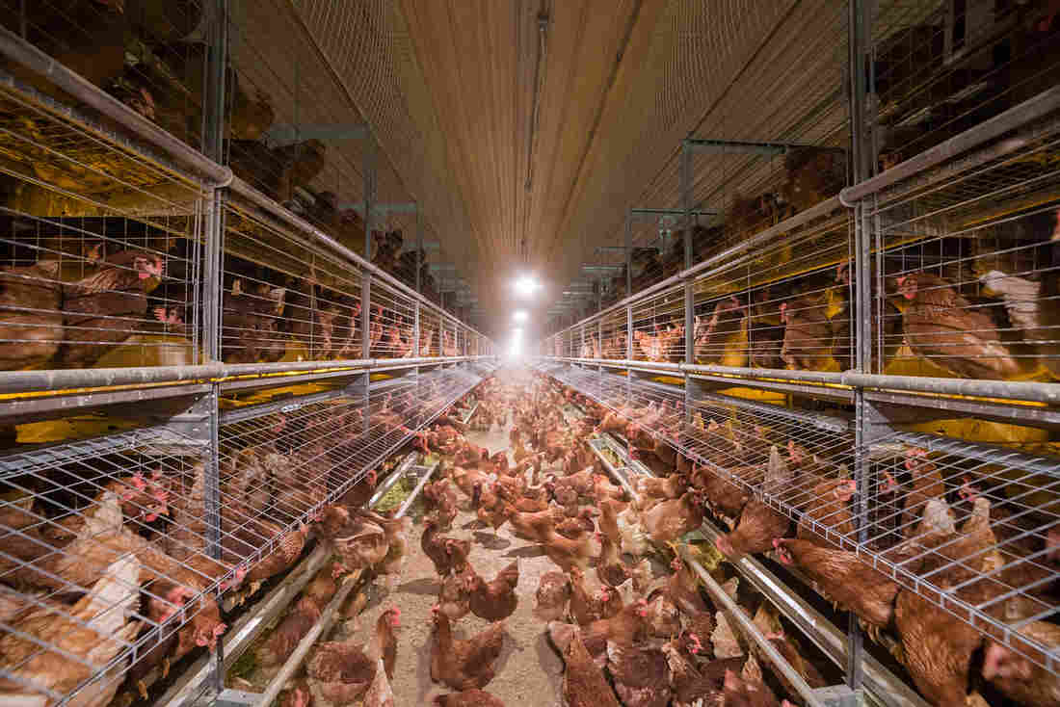
Proper lighting:
Development of reproductive organs & egg production
A maximum of 18 hours/day of lighting is 49 weeks onwards in case of layers
The lighting system with dimming device: provide sufficient & even intensity of light to each bird
It can be produced by suspending an ordinary bulb with a reflector at a height of 3 meter at the center of the house
The reflector would keep the bulb dust free

